Slide 1
Gauge Theory duals of Null and Space-like Singularities
Sumit R. Das
S.R.D, J. Michelson, K. Narayan and S. Trivedi, PRD 74 (2006) 026002
S.R.D, J. Michelson, K. Narayan and S. Trivedi, PRD 74 (2007) 026002
A. Awad, S.R.D, K. Narayan and S. Trivedi, hep-th/0711.2994

Slide 2
Space-like and Null Singularities
Space-like or Null singularities are difficult to understand – these are singularities which you cannot “see” and therefore cannot avoid.
They usually signify a beginning or end of time
This is hard to think about in the usual context of quantum mechanical time evolution
In this talk – will summarize one approach to gain insight using dual descriptions of the AdS/CFT type

Slide 3
Usual AdS/CFT
IIB string theory in asymptotically space-times is dual to large-N expansion of =4 SYM theory on the boundary with appropriate sources or excitations.
The usual relationship between the dimensionless parameters on the two sides are
Where is the string coupling, is the square of the Yang-Mills coupling, is the string length and is the AdS length scale

Slide 4
Usual AdS/CFT
IIB string theory in asymptotically space-times is dual to large-N expansion of =4 SYM theory on the boundary with appropriate sources or excitations.
The usual relationship between the dimensionless parameters on the two sides are
Usual notions of space-time are valid only in the regime where supergravity approximation is valid, i.e.

Slide 5
Usual AdS/CFT
IIB string theory in asymptotically space-times is dual to large-N expansion of =4 SYM theory on the boundary with appropriate sources or excitations.
The usual relationship between the dimensionless parameters on the two sides are
Usual notions of space-time are valid only in the regime where supergravity approximation is valid, i.e.
For generic values of the parameters , the gauge theory hopefully continues to make sense, though there is no interpretation in terms of General Relativity.

Slide 6
Usual AdS/CFT
IIB string theory in asymptotically space-times is dual to large-N expansion of =4 SYM theory on the boundary with appropriate sources or excitations.
The usual relationship between the dimensionless parameters on the two sides are
Usual notions of space-time are valid only in the regime where supergravity approximation is valid, i.e.
For generic values of the parameters , the gauge theory hopefully continues to make sense, though there is no interpretation in terms of General Relativity.
Could this happen near singularities ?

Slide 7
A Scenario
At early times, start with the ground state of the gauge theory with large ‘t Hooft coupling.
The physics is now well described by supergravity in usual
boundary
t
x
z
Intial Time Slice

Slide 8
A Scenario
Now turn on a time dependent source in the Yang-Mills theory which deforms the lagrangian.
boundary
x
t
z
Intial Time Slice
J(t)

Slide 9
A Scenario
Now turn on a time-dependent source in the Yang-Mills theory which deforms the lagrangian.
This corresponds to turning on a non-normalizable mode of the supergravity in the bulk, thus deforming the original
boundary
t
x
z
Intial Time Slice
Sugra mode

Slide 10
A Scenario
The gauge theory evolves according to the deformed hamiltonian
boundary
x
t

Slide 11
A Scenario
The gauge theory evolves according to the deformed hamiltonian
At sufficiently early times the supergravity background evolves according to the classical equations of motion
boundary
t
x
z

Slide 12
A Scenario
At later times, the curvatures or other invariants of supergravity start becoming large
If we nevertheless insist on the supergravity solution we encounter a singularity at some finite time
Beyond this time, it is meaningless to evolve any further.
Spacelike singularity
boundary
t
x
z

Slide 13
A Scenario
However, the gauge theory could be still well defined at this time.
And if we are lucky enough the gauge theory may be evolved beyond this point
At much later times, the source could weaken again and one may regain a description in terms of supergravity
boundary
Spacelike singularity
t
x
z

Slide 14
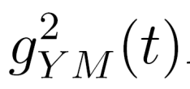
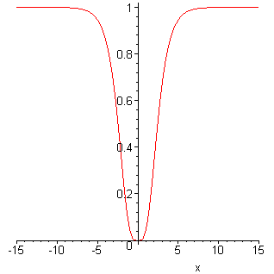
Models implementing this Scenario
We will try to implement this scenario by turning on sources in the gauge theory which correspond to time dependent couplings
The gauge theory would still live on flat space-time and there would be no other source.
We will choose the gauge theory coupling to be bounded everywhere and becoming vanishingly small at some time.
t

Slide 15
In supergravity this would correspond to a metric which is constrained to be FLAT on the boundary and a dilaton whose boundary value matches the gauge theory coupling.
At early times this should be

Slide 16
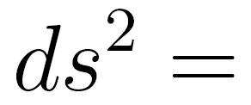
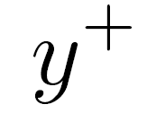
Null Solutions
The best controlled solutions of this type are those with null rather than spacelike singularities
Where is the dilaton which is a function of alone.
These solutions have been independently obtained and studied by
Chu and Ho, JHEP 0604 (2006) 013
Chu and Ho, hep-th/0710.2640

Slide 17
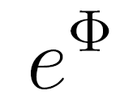
Null Solutions
The best controlled solutions of this type are those with null rather than spacelike singularities
Where is the dilaton which is a function of alone.
This function may be chosen freely..in particular we can choose this function of the desired form.
For example,

Slide 18
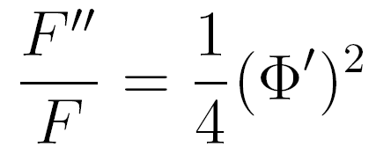
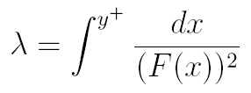
There is a singularity at
. Null geodesics
where
reach this at finite affine parameter if
is finite.
boundary
Null singularity
t
y
z

Slide 19
There is a singularity at
. Null geodesics
where
reach this at finite affine parameter if
is finite.
Tidal forces diverge here.
boundary
Null singularity
t
y
z

Slide 20
There is a singularity at
. Null geodesics
where
reach this at finite affine parameter if
is finite.
However, the singularity weakens as we approach the boundary
boundary
Null singularity
t
y
z

Slide 21
These solutions are in fact related to
where
by coordinate transformations
This is an example of the general fact that a Weyl transformation on the boundary is equivalent to a special class of coordinate transformations in the bulk - the Penrose-Brown-Hanneaux (PBH) transformations.

Slide 22
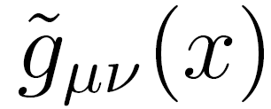
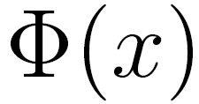
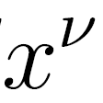
A more general class
In fact there is a more general class of solutions of the following form
The 4d metric and the dilaton are functions of the four coordinates and the 5-form field strength is standard.
This is a solution if and

Slide 23
A more general class
In fact there is a more general class of solutions of the following form
The 4d metric and the dilaton are functions of the four coordinates and the 5-form field strength is standard.
This is a solution if and
Thus a solution of 3+1 dimensional dilaton gravity may be lifted to be a solution of 10d IIB supergravity with fluxes.

Slide 24
We will consider solutions of this type where the 4d metric is conformal to flat space
The connection between Weyl transformations on the boundary and and PBH transformations then ensures that there is a different foliation of the AdS space-time in which the boundary is flat – and all we have is a nontrivial dilaton.
We will always define the dual gauge theory to live on this flat boundary.

Slide 25
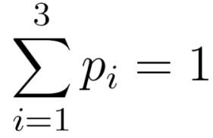
Kasner-like Solutions
The easiest form of time dependent solution is the lift of a usual 4d Kasner universe
This has a spacelike curvature singularity at t=0.
The effective string coupling vanishes here – as required.
However the coupling diverges at infinite past and future.

Slide 26
Nevertheless it is instructive to see what the dual gauge theory looks like. This can be explicitly worked out for
In this case the 4d metric is conformal to flat space

Slide 27
Nevertheless it is instructive to see what the dual gauge theory looks like. This can be explicitly worked out for
In this case the 4d metric is conformal to flat space
The exact PBH transformation may be written down and the metric which has a flat boundary is

Slide 28
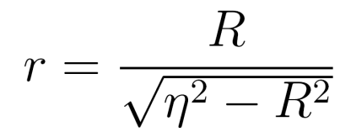
FRW-type solutions
Time dependent solutions with bounded coupling have 3+1 dimensional slices which are conformal to FRW universes with k=-1.
The 3+1 dimensional slice is in fact conformal to part of Minkowski space. Defining new coordinates

Slide 29
This solution becomes
The original space-time is thus conformal to the past light cone part of Minkowski space
singularity

Slide 30
This solution becomes
The original space-time is thus conformal to the past light cone part of Minkowski space
Singularity is now at
This metric can be
extended to the whole
plane
singularity

Slide 31
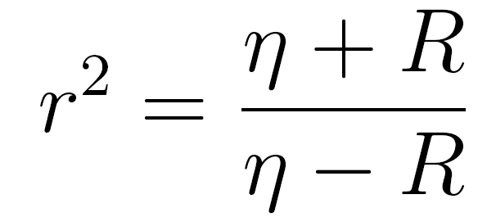
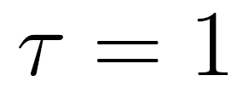
It is useful to write this solution in slightly different coordinates
In these coordinates the conformal factor depends on a single time variable
The dilaton is now
The spacelike singularity is now at

Slide 32
We should be able to find PBH transformations to a foliation of this spacetime which leads to a flat metric.

Slide 33
We should be able to find PBH transformations to a foliation of this spacetime which leads to a flat metric.
In this case, we have not been able to determine the exact form of the transformations. However all one needs is the transformation near the boundary. We will, therefore, determine this in an expansion around the boundary.

Slide 34
We should be able to find PBH transformations to a foliation of this spacetime which leads to a flat metric.
In this case, we have not been able to determine the exact form of the transformations. However all one needs is the transformation near the boundary. We will, therefore, determine this in an expansion around the boundary.
These transformations are

Slide 35
We should be able to find PBH transformations to a foliation of this spacetime which leads to a flat metric.
In this case, we have not been able to determine the exact form of the transformations. However all one needs is the transformation near the boundary. We will, therefore, determine this in an expansion around the boundary.
The metric near the boundary becomes
The boundary metric is now explicitly flat.

Slide 36
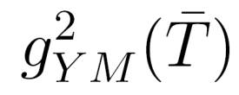
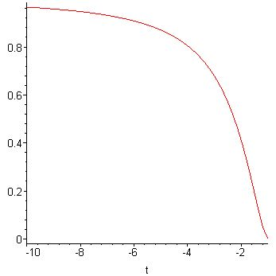
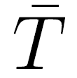
In terms of these new coordinates the spacelike singularity appears at and the asymptotic past is
The effective string coupling is bounded, decreasing from a finite value in the past to a zero value at the singularity.
Therefore, the dual gauge theory lives on flat space and has a time dependent coupling constant which vanishes at some finite time .

Slide 37
In terms of these new coordinates the spacelike singularity appears at and the asymptotic past is
The effective string coupling is bounded, decreasing from a finite value in the past to a zero value at the singularity.
At early times the ‘t Hooft coupling is large and supergravity can be trusted.

Slide 38
In terms of these new coordinates the spacelike singularity appears at and the asymptotic past is
The effective string coupling is bounded, decreasing from a finite value in the past to a zero value at the singularity.
At late times the ‘t Hooft coupling becomes small and supergravity is meaningless. This is when the singularity appears in the bulk.

Slide 39
The Energy-Momentum Tensors
The holographic stress tensor of these backgrounds provide insight into the nature of the quantum state
In the regime where supergravity is reliable, this evaluates the energy momentum tensor of the dual gauge theory
For backgrounds which are asymptotic to at early times we can use this calculation to see whether the initial state is reasonable.
We will compute this using the method of covariant counterterms
(Henningson and Skenderis ;
Balasubramanian and Kraus ;
Fukuma, Matsura and Sakai;…………….. )

Slide 40
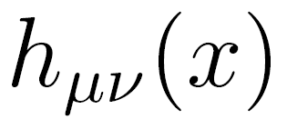
Consider a 5d metric of the form
The cutoff boundary is taken to be at
With appropriate counterterms the holographic stress tensor is given by
where is the extrinsic curvature of the boundary,
is the induced metric
and is the Einstein tensor computed from the induced metric.

Slide 41
Different choices of the boundary will lead to different results. In the dual gauge theory this reflects the fact that different regularizations correspond to different definitions of the renormalized Energy Momentum tensors.

Slide 42
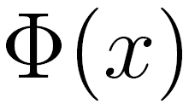
Different choices of the boundary will lead to different results. In the dual gauge theory this reflects the fact that different regularizations correspond to different definitions of the renormalized Energy Momentum tensors.
For the backgrounds we considered, there is a choice of coordinates where the boundary metric and the
dilaton depend only on the boundary coordinates.

Slide 43
Different choices of the boundary will lead to different results. In the dual gauge theory this reflects the fact that different regularizations correspond to different definitions of the renormalized Energy Momentum tensors.
For the backgrounds we considered, there is a choice of coordinates where the boundary metric and the
dilaton depend only on the boundary coordinates.
In these coordinates the holographic stress tensor vanishes for all backgrounds at all times.

Slide 44
Different choices of the boundary will lead to different results. In the dual gauge theory this reflects the fact that different regularizations correspond to different definitions of the renormalized Energy Momentum tensors.
For the backgrounds we considered, there is a choice of coordinates where the boundary metric and the
dilaton depend only on the boundary coordinates.
In these coordinates the holographic stress tensor vanishes for all backgrounds at all times.
However the gauge theory is best defined in a choice of boundary where the boundary metric is flat.

Slide 45
Different choices of the boundary will lead to different results. In the dual gauge theory this reflects the fact that different regularizations correspond to different definitions of the renormalized Energy Momentum tensors.
For the backgrounds we considered, there is a choice of coordinates where the boundary metric and the
dilaton depend only on the boundary coordinates.
In these coordinates the holographic stress tensor vanishes for all backgrounds at all times.
However the gauge theory is best defined in a choice of boundary where the boundary metric is flat.
In this choice of boundary the result depends on the specific background.

Slide 46
EM Tensor : Null Solutions
For the null solutions, the energy momentum tensor vanishes even for a choice of flat boundary.

Slide 47
EM Tensor : Null Solutions
For the null solutions, the energy momentum tensor vanishes even for a choice of flat boundary.
This ensures that in the gauge theory we are starting off with the vacuum state at early light cone times

Slide 48
EM Tensor : Null Solutions
For the null solutions, the energy momentum tensor vanishes even for a choice of flat boundary.
This ensures that in the gauge theory we are starting off with the vacuum state at early light cone times
The fact that the em tensor continues to vanish at all later times is probably a reflection of the fact that for backgrounds with a null isometry there is no particle production due to the source.

Slide 49
EM Tensor : Null Solutions
For the null solutions, the energy momentum tensor vanishes even for a choice of flat boundary.
This ensures that in the gauge theory we are starting off with the vacuum state at early light cone times
The fact that the em tensor continues to vanish at all later times is probably a reflection of the fact that for backgrounds with a null isometry there is no particle production due to the source.
In particular, the conformal anomaly vanishes. The general expression for the anomaly agrees with the field theory calculation of Fradkin and Tseytlin and Liu and Tseytlin – and the holographic calculation of Nojiri and Odinstov

Slide 50
EM Tensor : FRW-type solutions
For the FRW type solutions which have bounded couplings, the metric in flat boundary coordinates is

Slide 51
EM Tensor : FRW-type solutions
For the FRW type solutions which have bounded couplings, the metric in flat boundary coordinates is
The energy momentum tensor is given by

Slide 52
The energy momentum of the dual field theory, is related to the holographic energy momentum tensor by the relation

Slide 53
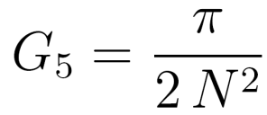
The energy momentum of the dual field theory, is related to the holographic energy momentum tensor by the relation
And we have to use the relationship between the 5d Newton constant and the parameters of the gauge theory

Slide 54
The energy momentum of the dual field theory, is related to the holographic energy momentum tensor by the relation
And we have to use the relationship between the 5d Newton constant and the parameters of the gauge theory
This yields

Slide 55
The energy momentum of the dual field theory, is related to the holographic energy momentum tensor by the relation
And we have use the relationship between the 5d Newton constant and the parameters of the gauge theory
This yields
and the conformal anomaly is

Slide 56
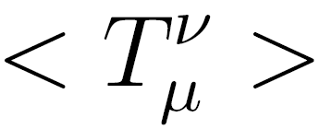
At early times, the bulk background is and the vanishes

Slide 57
At early times, the bulk background is and the vanishes
This signifies that the initial state is indeed the vacuum.

Slide 58
At early times, the bulk background is and the vanishes
This signifies that the initial state is indeed the vacuum.
As the source builds up, the energy momentum tensor picks up.

Slide 59
At early times, the bulk background is and the vanishes
This signifies that the initial state is indeed the vacuum.
As the source builds up, the energy momentum tensor picks up.
If we extrapolate the bulk calculation to the time of the singularity, , this quantity diverges

Slide 60
At early times, the bulk background is and the vanishes
This signifies that the initial state is indeed the vacuum.
As the source builds up, the energy momentum tensor picks up.
If we extrapolate the bulk calculation to the time of the singularity, , this quantity diverges
However, this is precisely the time when the bulk calculation has no significance in the gauge theory, which is now weakly coupled.

Slide 61
Properties of the gauge theory
For the null backgrounds, the dual gauge theory is easier to analyze.
Even though the theory lives on flat space, the dilaton factor is in front of the kinetic term and diverges at the time of bulk singularity.

Slide 62
Properties of the gauge theory
For the null backgrounds, the dual gauge theory is easier to analyze.
Even though the theory lives on flat space, the dilaton factor is in front of the kinetic term and diverges at the time of bulk singularity.
Normally one would absorb the coupling factor by a field redefinition so that only nonlinear terms involve the coupling.

Slide 63
Properties of the gauge theory
For the null backgrounds, the dual gauge theory is easier to analyze.
Even though the theory lives on flat space, the dilaton factor is in front of the kinetic term and diverges at the time of bulk singularity.
Normally one would absorb the coupling factor by a field redefinition so that only nonlinear terms involve the coupling.
However in this case the factor is a function of . Such a redefinition would introduce extra terms in the quadratic terms rendering the propagator non-standard

Slide 64
Luckily , we can work in a light cone gauge .
In this gauge we can perform the following field redefinitions
The constraint which determines is identical to the standard constraint

Slide 65
Luckily we can work in a light cone gauge .
In this gauge we can perform the following field redefinitions
The constraint which determines is identical to the standard constraint
The quadratic part of the action of the dynamical fields becomes standard – extra term is a total derivative

Slide 66
Luckily we can work in a light cone gauge .
In this gauge we can perform the following field redefinitions
The constraint which determines is identical to the standard constraint
The quadratic part of the action of the dynamical fields becomes standard – extra term is a total derivative

Slide 67
Luckily we can work in a light cone gauge .
In this gauge we can perform the following field redefinitions
The constraint which determines is identical to the standard constraint
The quadratic part of the action of the dynamical fields becomes standard – extra term is a total derivative
The nonlinear terms contain positive powers of

Slide 68
Luckily we can work in a light cone gauge .
In this gauge we can perform the following field redefinitions
The constraint which determines is identical to the standard constraint
The quadratic part of the action of the dynamical fields becomes standard – extra term is a total derivative
The nonlinear terms contain positive powers of
This factor is bounded and goes to zero in the potentially problematic region.

Slide 69
There are other gauge choices which are useful. Chu and Ho use a gauge of the form
They have used this gauge to calculate the effective action .
This gauge could be more useful since it may avoid some of vexing issues associated with light cone gauge and light front evolution.

Slide 70
For time dependent couplings this redefinition of fields does not lead to a standard kinetic term in usual gauges. This typically leads to singular terms, since
However, just like the null solutions, this could be a gauge artifact. We have not yet found a suitable gauge to display this.

Slide 71
With space-time dependent couplings loop diagrams can have divergences in addition to usual loop UV divergences. While the latter can be dealt with usual renormalization – the meaning of the former is not clear.
However, when the coupling
depends on only one null coordinate
bounded everywhere
differs from a constant only in a small region
these additional divergences are absent.

Slide 72
Since the coupling vanishes near the singularity, we could get some intuition from perturbation expansion.

Slide 73
Since the coupling vanishes near the singularity, we could get some intuition from perturbation expansion.
For null backgrounds, this is simpler since all the effects of space-time dependence reside in the non-linear terms, which may be treated perturbatively.

Slide 74
Since the coupling vanishes near the singularity, we could get some intuition from perturbation expansion.
For null backgrounds, this is simpler since all the effects of space-time dependence reside in the non-linear terms, which may be treated perturbatively.
Formally, usual UV divergences coming from integrals over loop momenta can be renormalized. In this case
Where is a local functional of

Slide 75
Since the coupling vanishes near the singularity, we could get some intuition from perturbation expansion.
For null backgrounds, this is simpler since all the effects of space-time dependence reside in the non-linear terms, which may be treated perturbatively.
Formally, usual UV divergences coming from integrals over loop momenta can be renormalized. In this case
Where is a local functional of
However, the resulting quantum effective action can have additional divergences even after this renormalization.

Slide 76
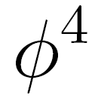
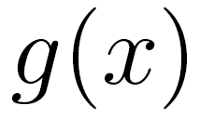
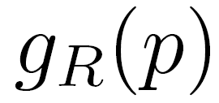
Consider for example a scalar field theory with a space-time dependent coupling which we take to be general for the moment.
In terms of the fourier transform of the renormalized coupling
the one loop contribution is
where is the fourier transform of the background field.

Slide 77
If was a constant (in position space), this would lead to the usual momentum conserving delta function

Slide 78
If was a constant (in position space), this would lead to the usual momentum conserving delta function
However in our case the integral over is non-trivial and may lead to a divergent answer.
This divergence would usually come from large values of - so that we can ignore the external momenta

Slide 79
When the coupling depends on a single null coordinate this expression simplifies and the potential for divergence reduces as well. Writing
the relevant term becomes
For the kind of couplings we have been considering – it is easy to find situations when this last integral is convergent.
This is because the coupling differs from a constant only in a small region near

Slide 80
For a coupling which is of the following simple form

Slide 81
For a coupling which is of the following simple form
The fourier transform dies away rapidly at large values of the momenta
This guarantees that the integral is convergent.

Slide 82
For a coupling which is of the following simple form
The fourier transform dies away rapidly at large values of the momenta
This guarantees that the integral is convergent.
For smooth solutions of this general form, the result continues to hold

Slide 83
Features of the Worldsheet
In these examples, the Yang-Mills coupling becomes vanishingly small at the time when the bulk becomes singular.
According to the usual wisdom of AdS/CFT one would expect that stringy effects become large.
Since the string coupling in the bulk also vanishes at this time one might also expect that classical stringy effects could bring about the “resolution” of this singularity.
The meaning of this is not entirely clear. In fact our point is that a closed string description is useless at this time – we should replace this by a perturbative gauge theory
Nevertheless it may be useful to look at the worldsheet theory.

Slide 84
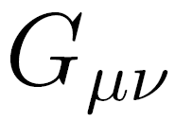
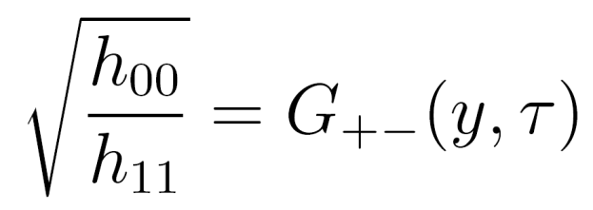
Rewrite the metric in terms of coordinates
The invariant form of the action is, with
The string metric is related to the Einstein frame metric by
Now fix a light cone gauge
And a further choice of the worldsheet coordinate

Slide 85
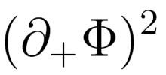
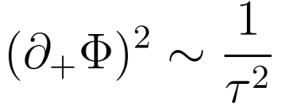
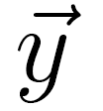
The final form of the worldsheet action is
At early times this reproduces the known form in
Since as , the oscillator states become light.
However, diverges at
Thus the oscillator states decouple at this time.
In a sense we are left with a very floppy tensionless string which can, however, oscillate only in two transverse dimensions.

Slide 86
String and Brane Excitations
Clearly, higher massive modes of the fundamental string are excited copiously as we approach the singularity.
It turns out that other branes are excited as well.
We have studied this by considering the Penrose limit of the null backgrounds and constructing Matrix Theory in the resutling pp-wave
The Matrix theory shows spherical D-branes (which appear as fuzzy solutions of the model) grow in size as we approach the singularity.

Slide 87
Epilouge
We have constructed toy models of cosmology which have natural gauge theory duals.

Slide 88
Epilouge
We have constructed toy models of cosmology which have natural gauge theory duals.
In the regions where the bulk solution becomes singular – and therefore cannot be trusted, the gauge theory dual becomes weakly coupled and therefore is not expected to have a gravity dual in any case

Slide 89
Epilouge
We have constructed toy models of cosmology which have natural gauge theory duals.
In the regions where the bulk solution becomes singular – and therefore cannot be trusted, the gauge theory dual becomes weakly coupled and therefore is not expected to have a gravity dual in any case
For null singularities, preliminary studies of the gauge theory seem to suggest that the gauge theory evolution may indeed well defined.

Slide 90
Epilouge
We have constructed toy models of cosmology which have natural gauge theory duals.
In the regions where the bulk solution becomes singular – and therefore cannot be trusted, the gauge theory dual becomes weakly coupled and therefore is not expected to have a gravity dual in any case
For null singularities, preliminary studies of the gauge theory seem to suggest that the gauge theory evolution may indeed well defined.
For space-like singularities, things are less clear – but now at least we have examples where the issue can be analyzed.

Slide 91
The real question is whether the time evolution of the gauge theory allows us to evolve across what appears to be singular from the dual gravity picture.

Slide 92
The real question is whether the time evolution of the gauge theory allows us to evolve across what appears to be singular from the dual gravity picture.
If this is indeed true we will have a truly attractive scenario where the large number of additional degrees of freedom which are typically present in holographic descriptions help “resolve” singularities.

Slide 93
The real question is whether the time evolution of the gauge theory allows us to evolve across what appears to be singular from the dual gravity picture.
If this is indeed true we will have a truly attractive scenario where the large number of additional degrees of freedom which are typically present in holographic descriptions help “resolve” singularities.
Even if this is not true, we would like to know the precise signatures of cosmological singularities in the gauge theory.

Slide 94
The real question is whether the time evolution of the gauge theory allows us to evolve across what appears to be singular from the dual gravity picture.
If this is indeed true we will have a truly attractive scenario where the large number of additional degrees of freedom which are typically present in holographic descriptions help “resolve” singularities.
Even if this is not true, we would like to know the precise signatures of cosmological singularities in the gauge theory.
In any case, the emergent nature of space-time in string theory has interesting things to say about singularities.

Slide 95
Thank you

