Slide 1
General Relativity in X-ray Astronomy
Astrosat and Future Experiments
Biswajit Paul
Raman Research Institute

Slide 2
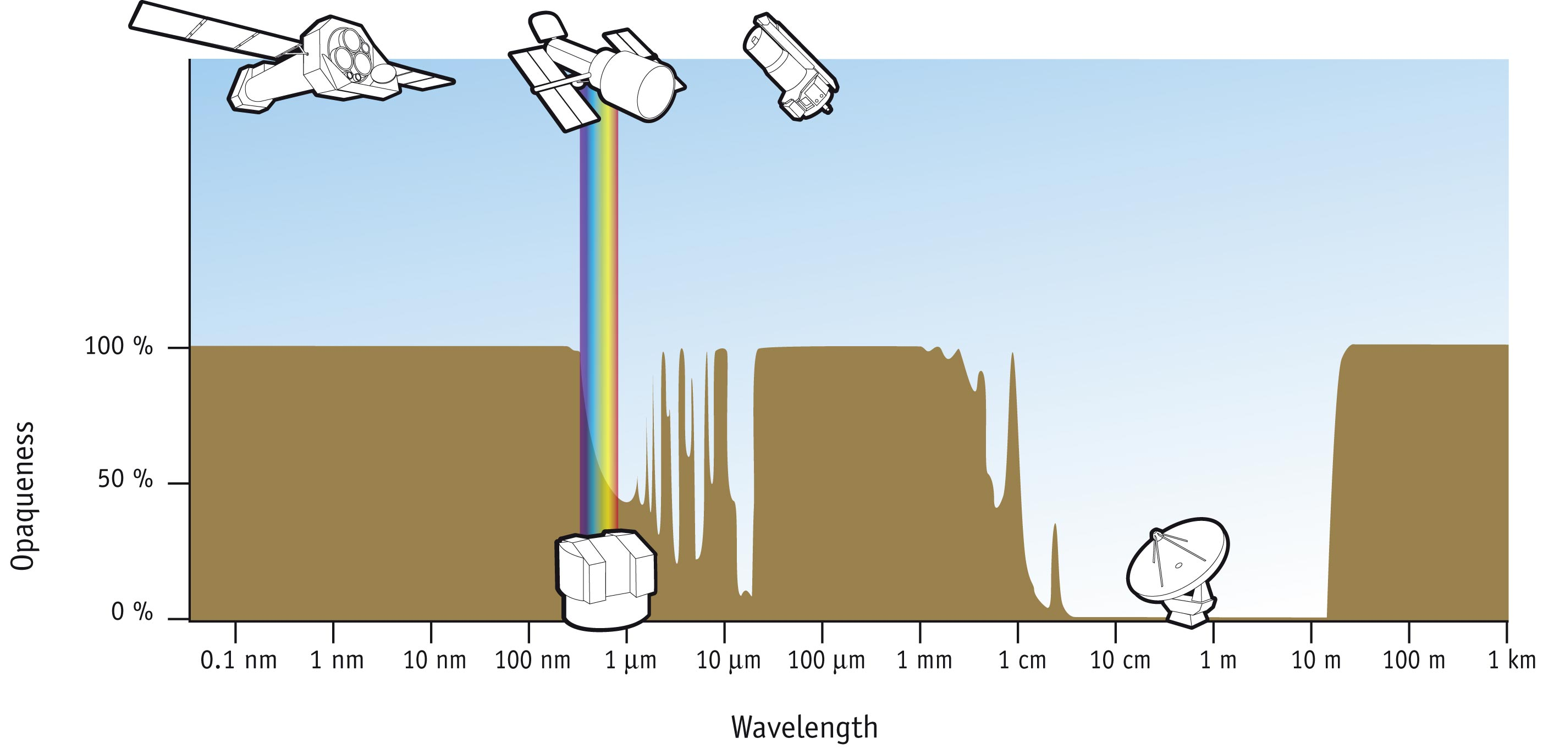
Astronomy in different wavelengths

Slide 3
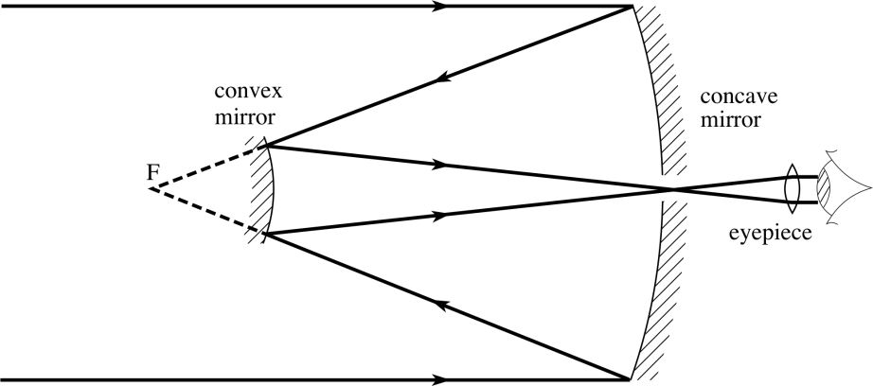
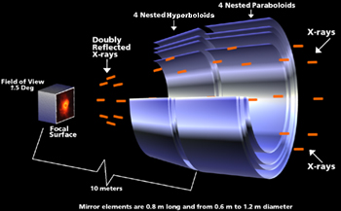
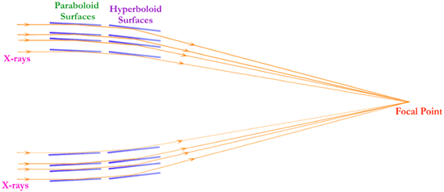
X –ray Telescopes are Different

Slide 4
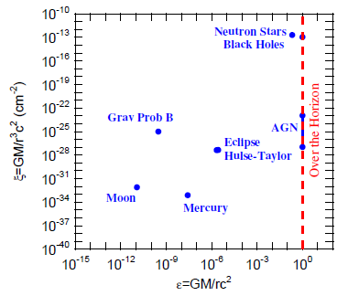
Strong Field and Curvature
Psaltis 2009

Slide 5
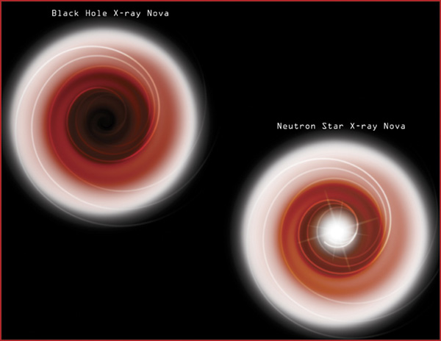
Accretion onto black holes & neutron stars

Slide 6
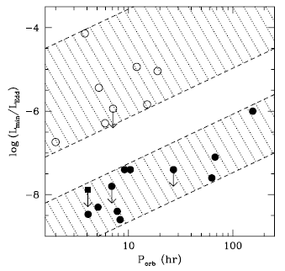
Absence of a hard surface
Narayan et al. 1997

Slide 7
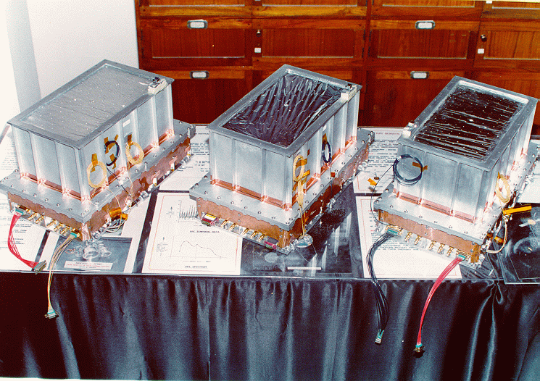
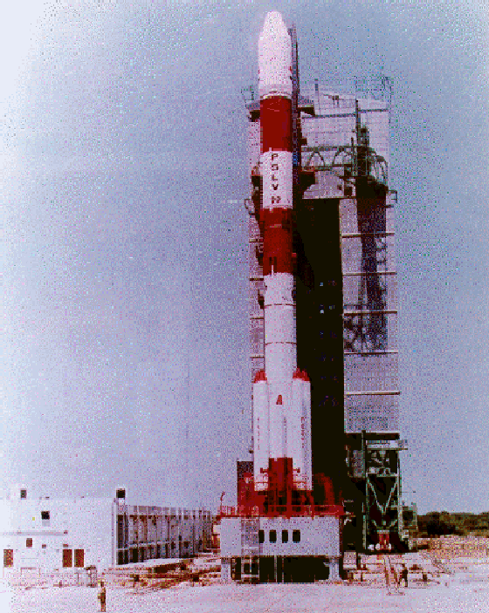
Indian X-ray Astronomy Experiment
1996-2000

Slide 8
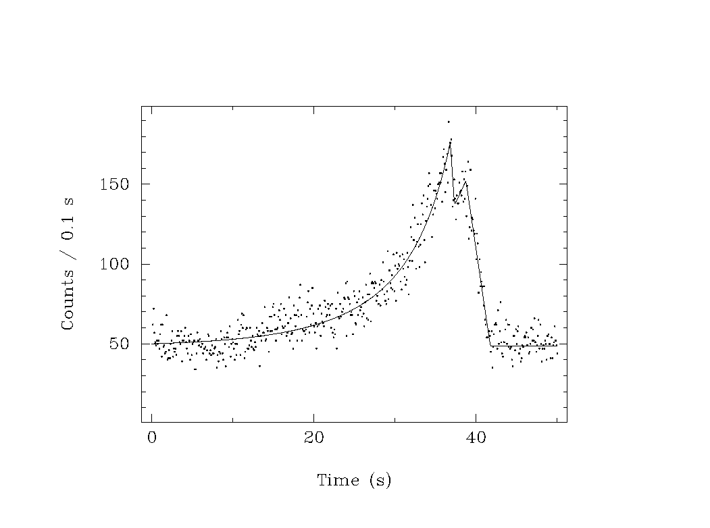
Through the Event Horizon
GRS 1915+105
Paul et al. 1998

Slide 9
Black Hole Spin Measurement
Continuum Spectrum
Gravitational Redshift of Iron Line
X-ray Polarisation
Astrophysical Relevance

Slide 10
Black Hole Spin Measurement
Provide rare means of testing predictions of Relativity in strong-field gravity regime.
Natal spins in stellar-mass BHs can probe formation event (novae/supernovae).
Indicator of recent gas accretion vs. merger history of supermassive BHs.
Thought to drive jet production and outflows in all BHs, seeding the interstellar or intergalactic medium with matter and energy.

Slide 11
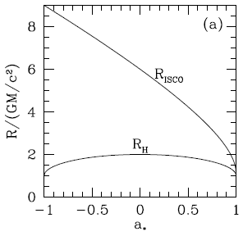
Innermost Stable Circular Orbit (ISCO)
a* = J/(GM²/c)

Slide 12
Continuum Spectrum
Measure F & T (from spectrum)
R Scales with D
R

Slide 13
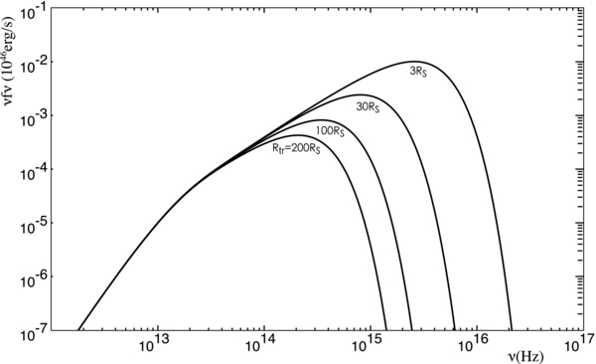
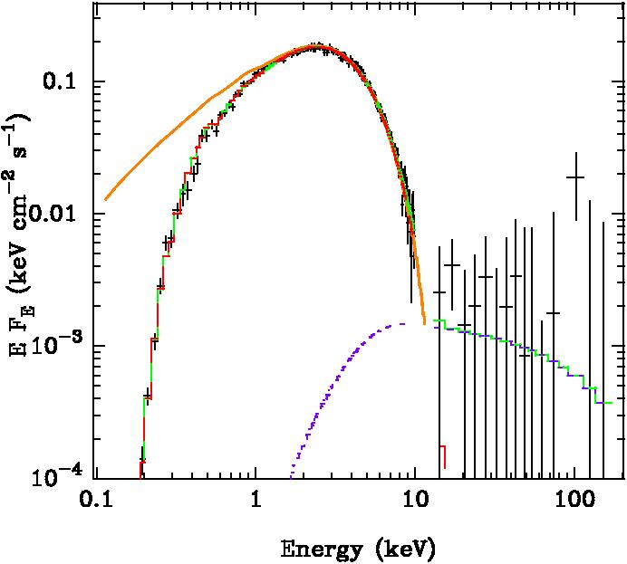
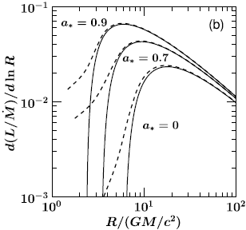
Continuum Spectrum
Narayan et al. ……

Slide 14
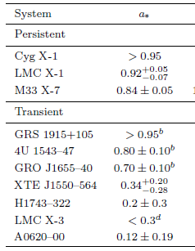
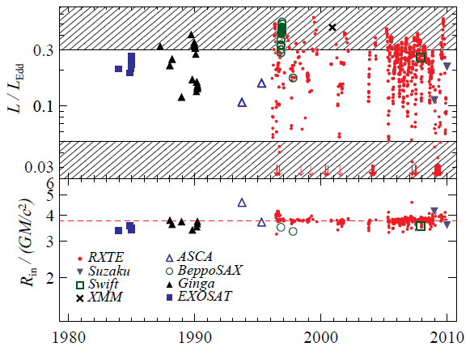
Continuum Spectrum
Narayan et al.

Slide 15
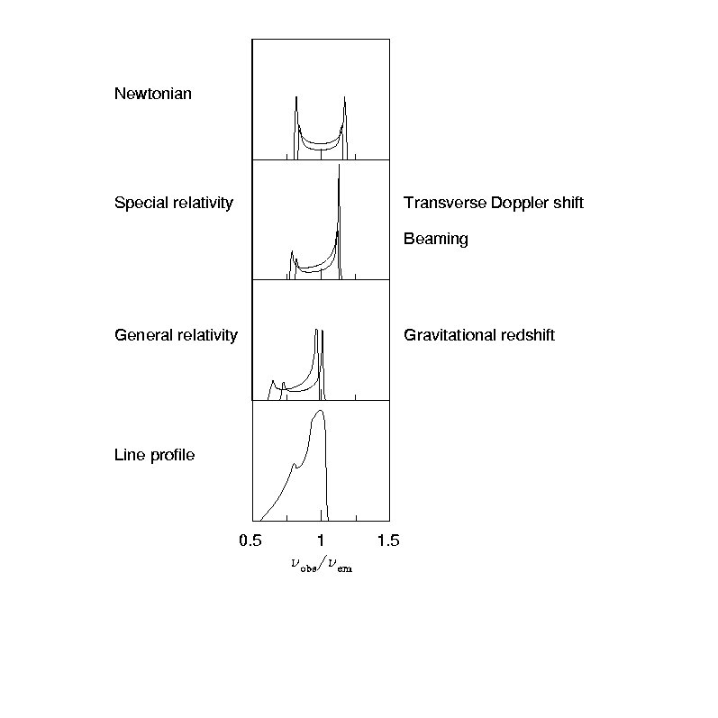
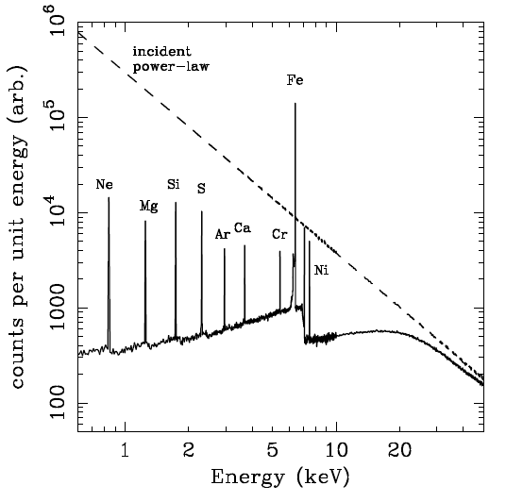
Relativistic Iron Lines

Slide 16
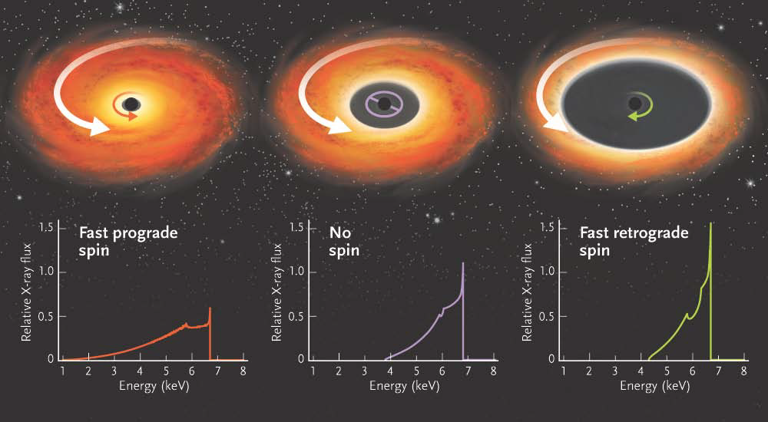
Relativistic Iron Lines

Slide 17
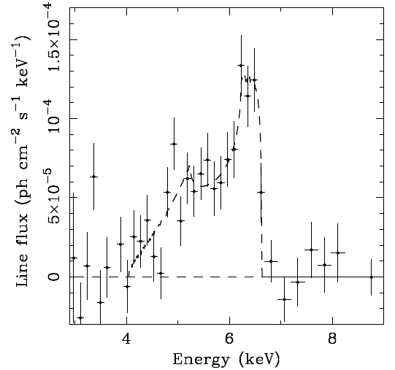
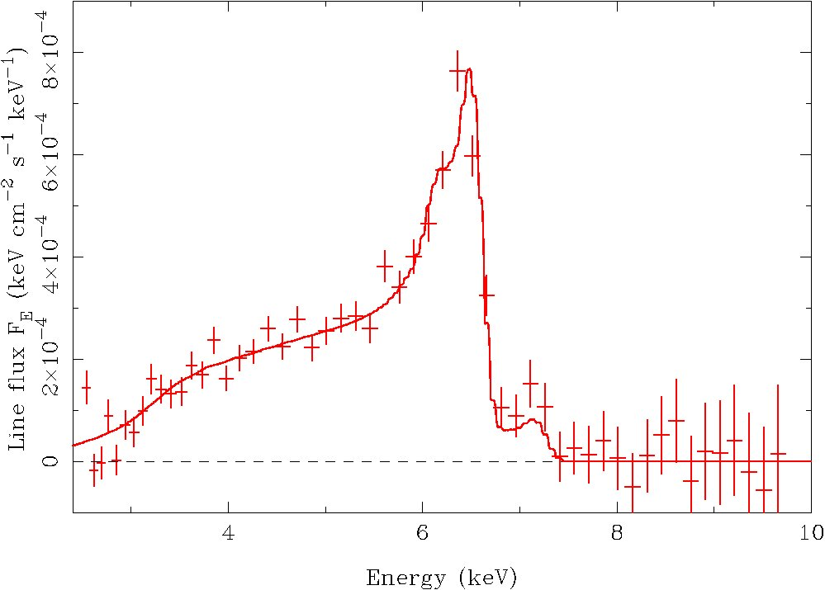
Relativistic Iron Lines (MCG -6-30-15)
Tanaka et al. 1995;
Reynolds et al. 2003

Slide 18
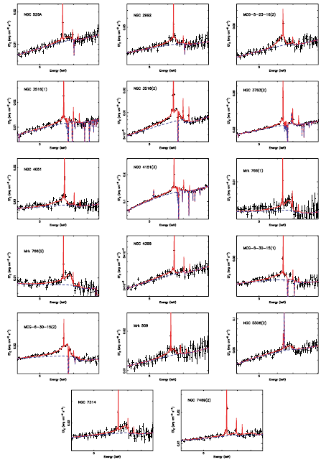
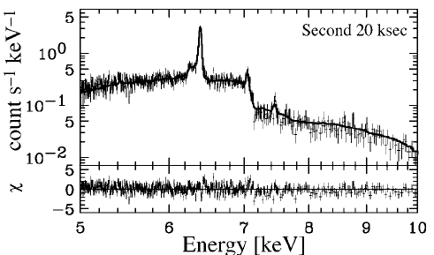
Relativistic Iron Lines with XMM-Newton
Nandra et al. 2007
Watanabe et al. 2004

Slide 19
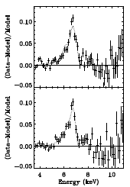
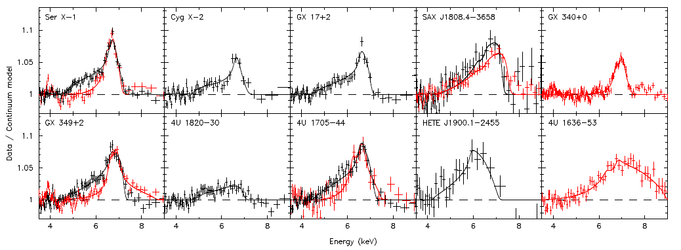
Relativistic Iron Lines in Accreting NS
Bhattacharyya et al. 2007;
Cackett et al. 2010

Slide 20
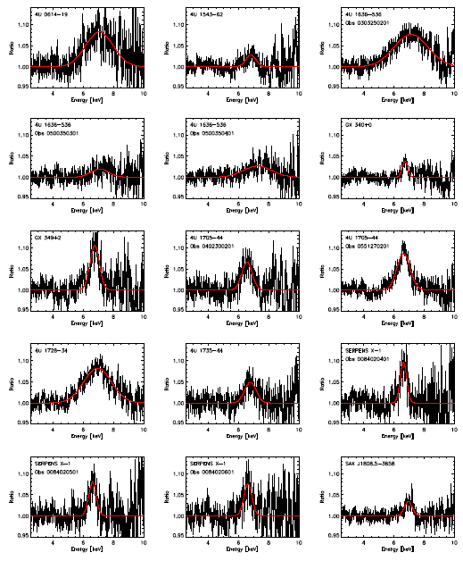
Relativistic Iron Lines in Accreting NS
Ng et al. 2010

Slide 21
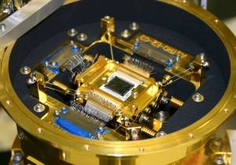
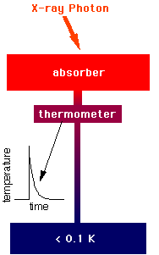
X-ray Spectroscopy Frontier
Astro-H (JAXA)

Slide 22
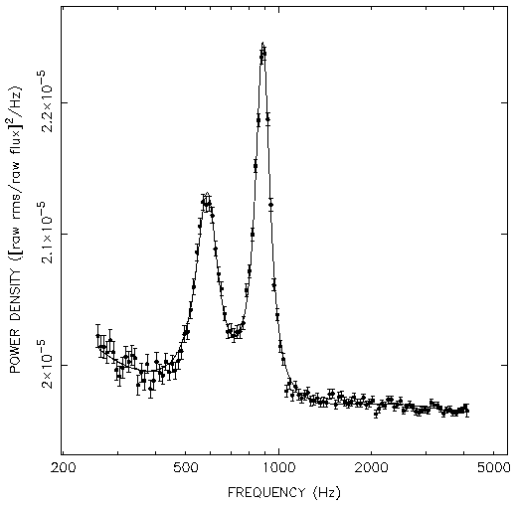
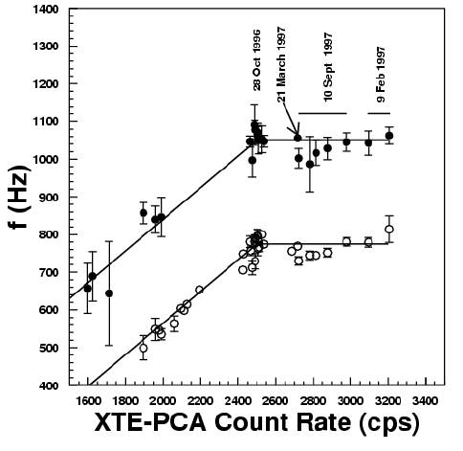
X-ray Timing: NS
Van der Klis et al. 1997

Slide 23
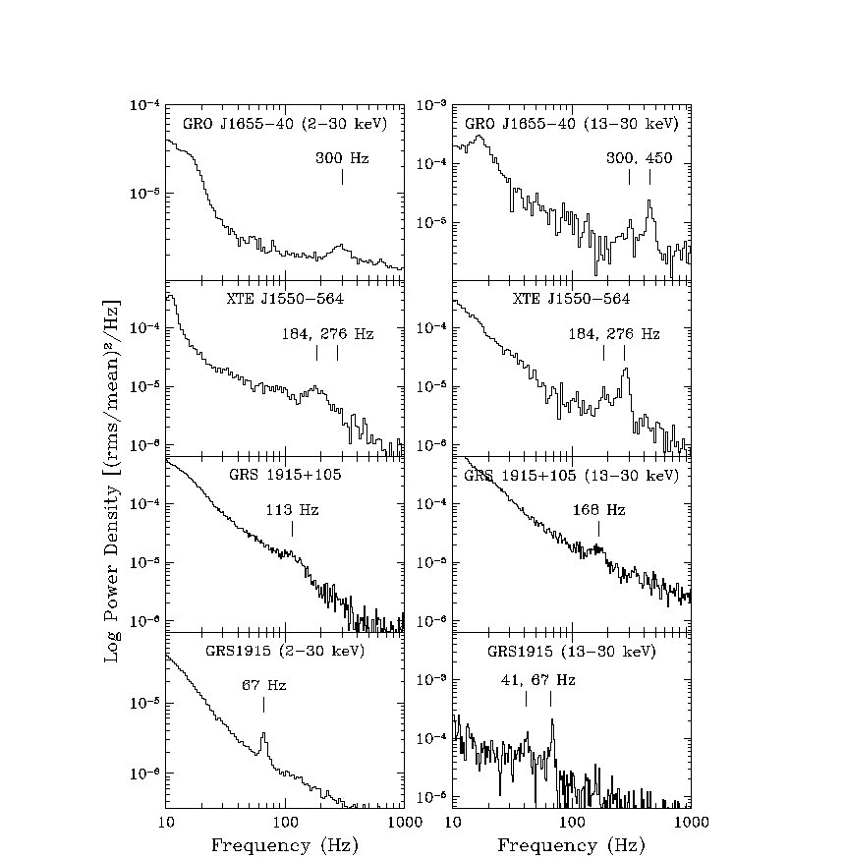
X-ray Timing: BH
Parametric resonance
Remilard et al. 2005

Slide 24
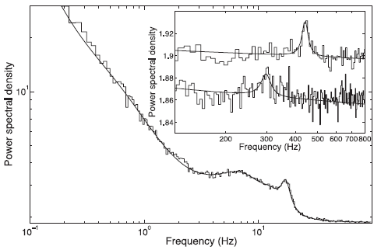
X-ray Timing: BH
Relativistic Precession Model
Orbital Frequency
(- epicyclic frequency)
Periastron Precession Frequency
(- vertical epicyclic frequency)
Nodal Periastron Frequency
Lense –Thirring effect
→
Mass and spin of the black hole
Motta et al. 2014

Slide 25

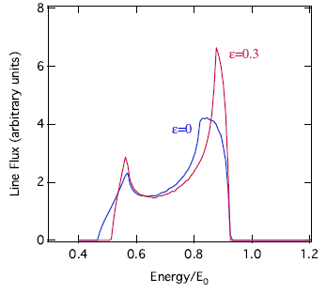
Test of No-Hair Theorem
Johannsen and Psaltis 2010

Slide 26
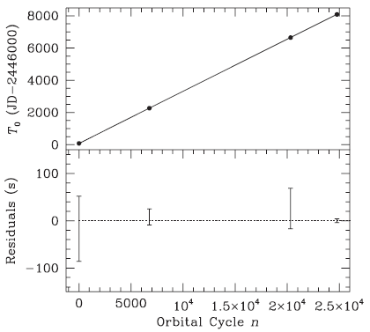
Fundamental Physics
In braneworld gravity models with infinitely large extra dimensions, black holes evaporate fast through the emission of the additional gravitational degrees of freedom
…..
leads to a change in the orbital period of X-ray binaries harboring black holes
…..
obtain an upper limit on the rate of change of the orbital period of the binary A0620−00 and use it to constrain the asymptotic curvature radius of the extra dimension to a value comparable to the one obtained by table-top experiments
Johannsen et al. 2010

Slide 27
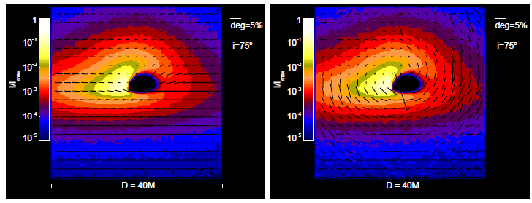
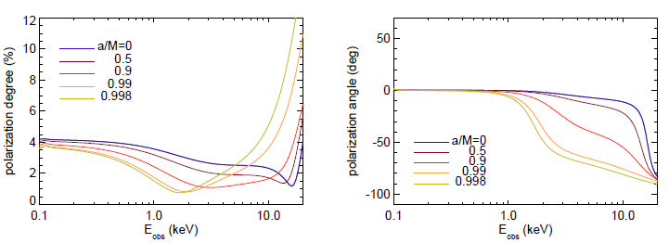
X-ray polarisation in black hole accretion disk
Test of strong field gravity
Schnittman and Krolik 2009

Slide 28
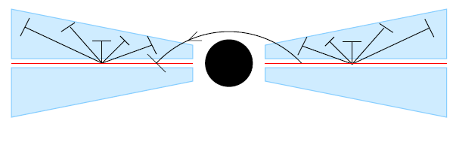
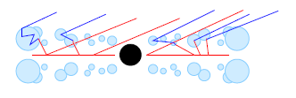
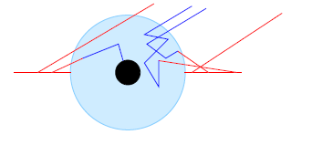
X-ray Polarisation and Corona
RRI, 26 September 2014
Dovciak et al. 2010

Slide 29
Gravitational Waves and
X-ray Astronomy
High Mass Binary evolution
Input for continuous wave emission
  SCO X-1, rotation powered pulsars
EM counterpart

Slide 30
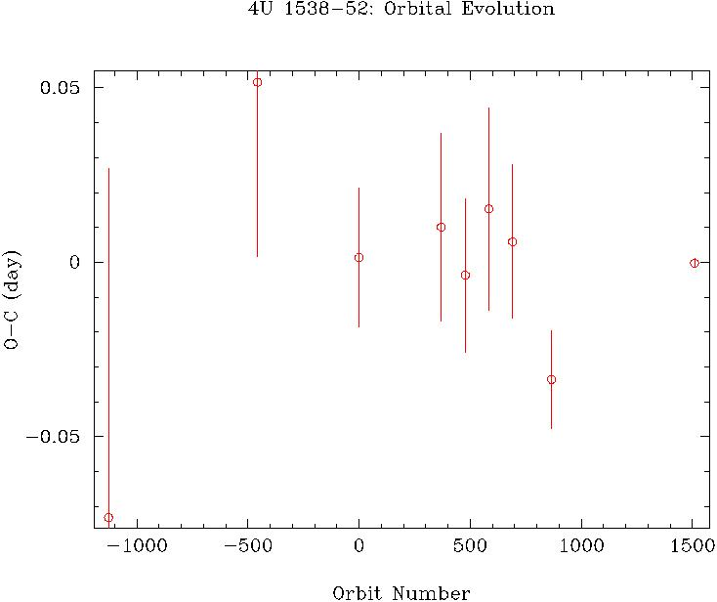
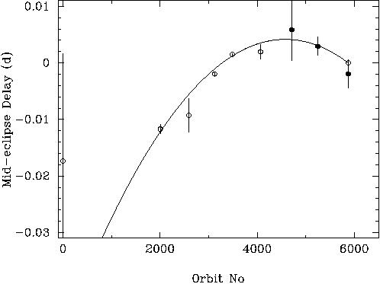
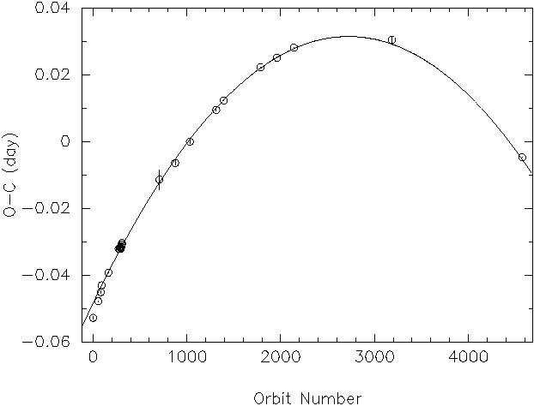
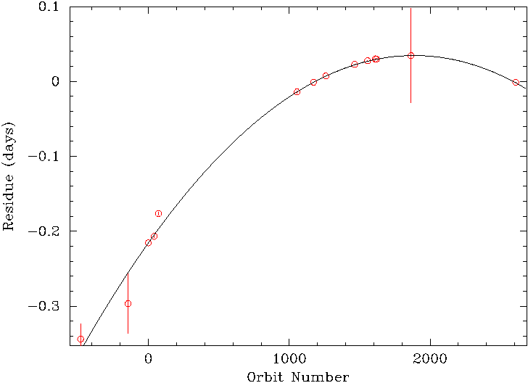
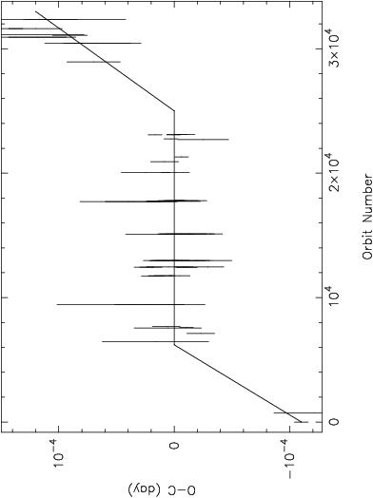
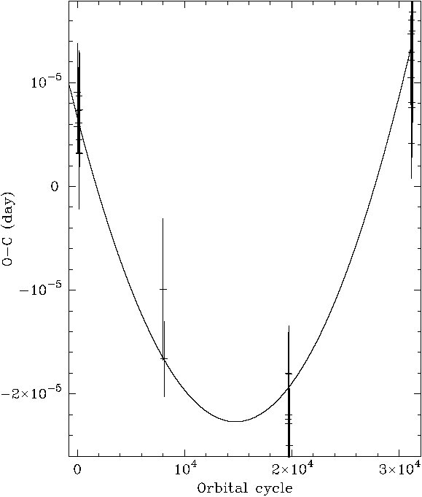
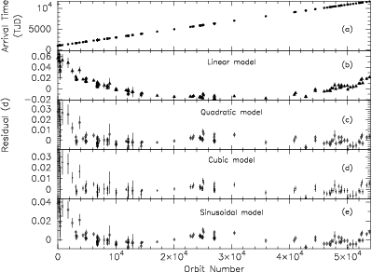
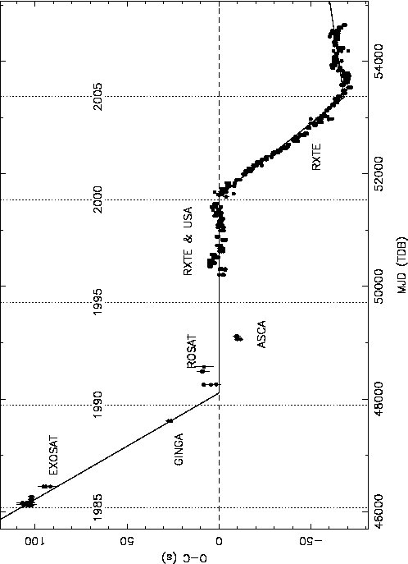
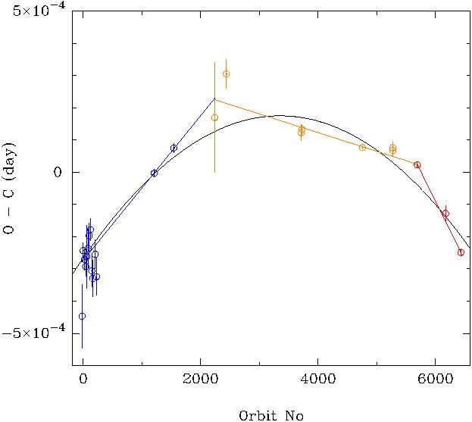
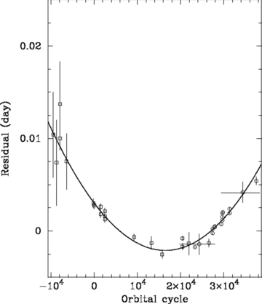
Orbital evolution of X-ray binaries
LMC X-4
CenX-3
SMC X-1
4U 1538-52
Double Compact Binaries Gravitational Wave Emitters
Short Gamma-ray Bursts
XTE J1808-5635
Cyg X-3
XTE J 1810-271
XTE J1710-281
EXO 0748-676
4U 1822-37
Her X-1
Her X-1

Slide 31
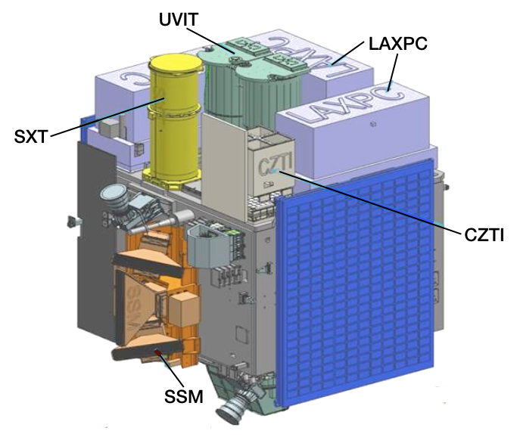


ASTORSAT

Slide 32




Slide 33


Slide 34



X-ray Timing
Chakrabarty et al. 1998
Wijnands et al. 1998
Image: NASA
Van der Klis et al. 1997

Slide 35


Hard X-ray QPOs

Slide 36

LAXPC: Effective Area

Slide 37



X-ray Polarimetry

Slide 38


Thomson X-ray Polarimeter
Photoelectron/Bragg: < 10 keV
Thomson: 5-30 keV
Compton :> 30 KeV
Notes:
How are the compact stars formed
Irreversible: point of no return
Fraction of mass locked in compact stars
Extreme conditions: gravity, magnetic field, temperature, density, relativisitic particles, GR tests, NS EOS
Efficient for conversion of matter to energy
Nobel prizes
38

Slide 40

Thomson X-ray Polarimeter: Instrument

Slide 41


X-ray Polarimetry

Slide 42
X-ray Astronomy and GR
Timing
Continuu Spectroscopy
Relativistic iron line
Polarimetry

