Slide 1
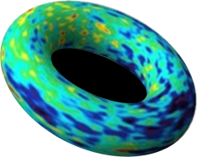
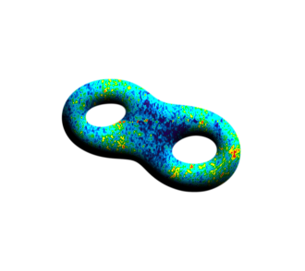
Inflation in String Theory
Liam McAllister
Cornell
ICGC 2015, IISER Mohali December 15, 2015

Slide 2
Summary
The patterns in the cosmic microwave background radiation are affected by, and provide experimental probes of, the physics of the Planck scale.
Interpreting the observations therefore requires a theory of quantum gravity, such as string theory.
Our understanding of string theory is now sufficient to derive models of inflation in string theory, and test these against observations.

Slide 3
Plan
Quantum gravity
What and why?
String theory as a quantum gravity theory
Inflation depends on quantum gravity
Inflation in string theory
Conclusions

Slide 4
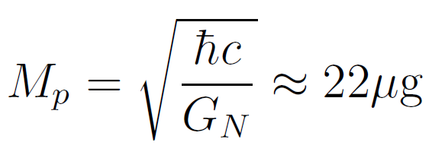
Quantum gravity and the Planck scale
For Planck scale particles, quantum mechanics and general relativity are both important.
Individual quanta have Schwarzschild radii comparable to their Compton wavelengths.

Slide 5
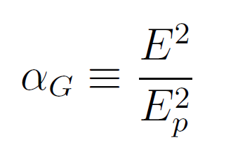
Quantum gravity and the Planck scale
+
+
+ ...
Corrections more important at higher energies!
Perturbative quantum gravity is ultraviolet-divergent: calculations give infinities at high energy.
To subtract these infinities, infinitely many parameters must be adjusted: the theory is non-renormalizable.

Slide 6
An Effective Description
Non-renormalizability is not a fatal flaw.
The infinities arise at some characteristic energy Λ, the ‘cutoff’.
For gravity, Λ = Planck energy, where
=1.
Experiments at E<< Λ register small corrections: the high-energy
physics decouples.

Slide 7
An Effective Description
Non-renormalizability is not a fatal flaw.
The infinities arise at some characteristic energy Λ, the ‘cutoff’.
For gravity, Λ = Planck energy, where
=1.
Experiments at E<< Λ register small corrections: the high-energy
physics decouples. We can use an
effective field theory that
encodes these quantum effects.
For astrophysical gravity, corrections are negligible: classical GR suffices.

Slide 8
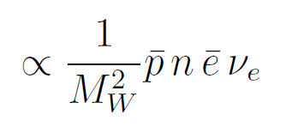
Effective field theory example
integrate out W
Effective theory has a
4-fermion interaction,
but no W.
Low-energy phenomena, e.g. beta decay, depend on high-energy physics, e.g. existence of W bosons.

Slide 9
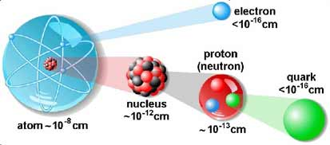
Decoupling works

Slide 10
When can we NOT decouple quantum gravity?
In extreme conditions:
Black hole singularities
Possibly black hole horizons (firewall)
Planckian-energy collisions
Cosmological singularities
Cosmological inflation

Slide 11
Why is quantum gravity interesting?
By understanding more extreme conditions, we can learn more fundamental laws.
General relativity and quantum field theory are pillars of 20th century physics. At the Planck scale, one or both must be modified. Which, and how?
Quantum gravity is required to interpret certain observations in cosmology.
Required to understand the initial singularity.
Key to understanding the origin of the universe, and the nature and origin of gravity.

Slide 12
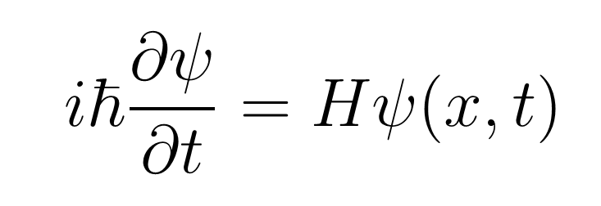
Why is quantum gravity difficult?
General relativity is non-renormalizable: quantum calculations yield infinities, and to remove these requires adjusting infinitely many parameters.
Other quantum fields evolve in a background spacetime, but in quantum gravity, the arena, not just the actors, is quantum-mechanical.
Gravity produced by a single quantum is extremely weak at terrestrial energies, so experimental guidance is limited.

Slide 13
Why is quantum gravity difficult?
General relativity is non-renormalizable: quantum calculations yield infinities, and to remove these requires adjusting infinitely many parameters.
Other quantum fields evolve in a background spacetime, but in quantum gravity, the arena, not just the actors, is quantum-mechanical.
Gravity produced by a single quantum is extremely weak at terrestrial energies, so experimental guidance is limited.
So, seek constraints from cosmological observations.

Slide 14
String theory: a finite theory of quantum gravity
Quantization of a relativistic closed string yields a massless graviton in a finite theory of quantum gravity.
In some regimes (e.g. AdS/CFT) we have a nonperturbative definition of the theory.
Incredibly rich, with overwhelming evidence for consistency as a mathematical framework.
To understand whether string theory underlies our universe, we study four-dimensional solutions (vacua) arising in compactifications.
cf. talk by Sen

Slide 15
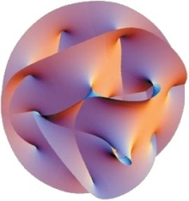
Compactification
String theory naturally exists in 10 dimensions.
To connect to 4d, we compactify:
0123 456789
x
regular spacetime compact space (6d)
> 10²⁸ cm < 10⁻³⁰ cm

Slide 16
Compactification
From geometry, compute 4d low-energy effective quantum field theory, coupled to general relativity.
This is an EFT descending from quantum gravity.

Slide 17
Quantum gravity effects in EFT
We can compute the low-energy EFT of a vacuum of string theory, including quantum gravity (“Planck-suppressed”) effects.
For some observables, these QG effects decouple.
For others, they do not.
In inflation, controlling QG effects is essential for making any predictions.

Slide 18
Plan
Quantum gravity: what and why?
Inflation depends on quantum gravity
Inflation in string theory
The task
Overview of status
Examples
Conclusions

Slide 19
Inflation

Slide 20
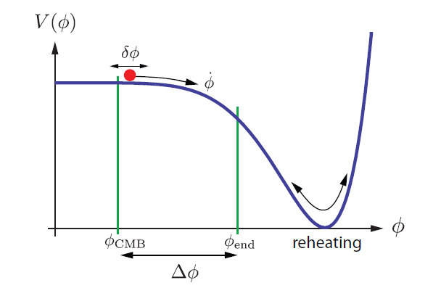
Physics of inflation
cf. talk by Martin
Simplest case: single scalar field with a potential,
Potential drives acceleration.

Slide 21
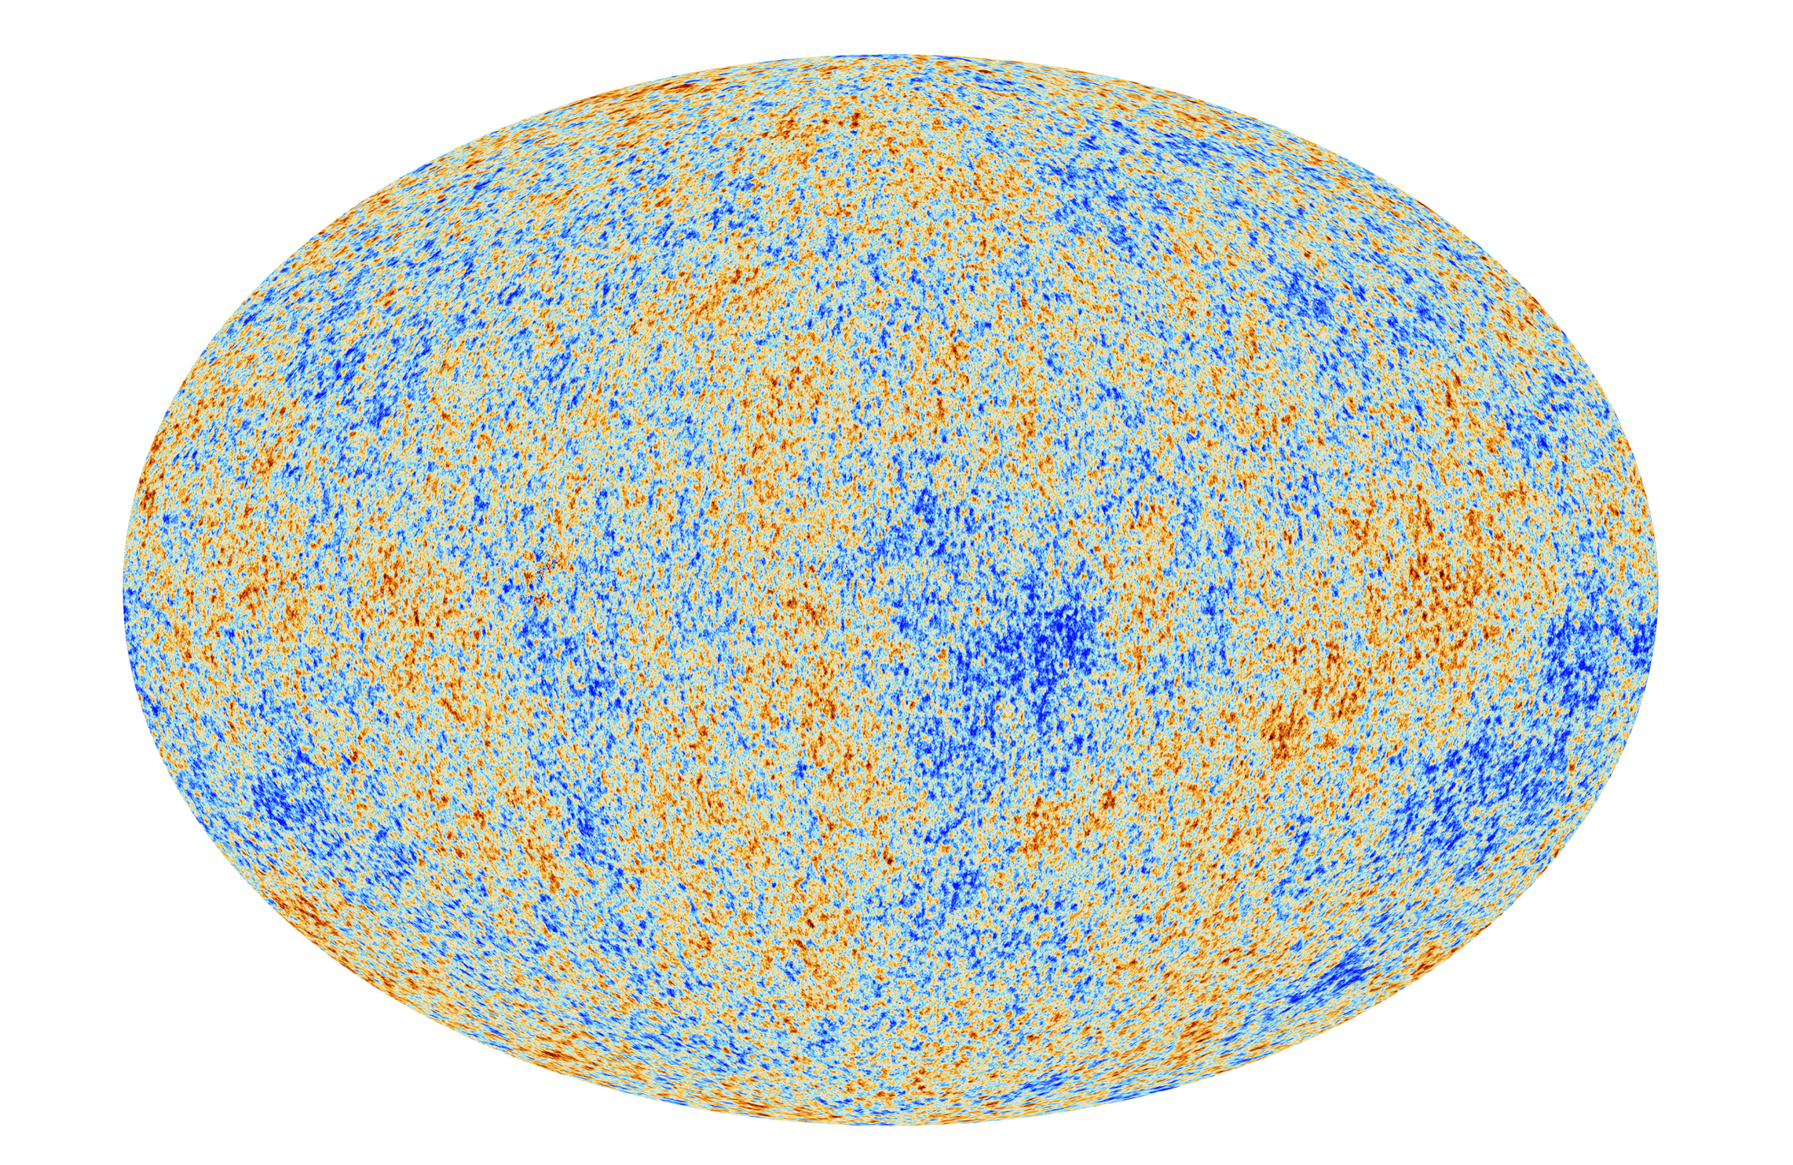
Inflation predicts:
Universe on large scales is homogeneous, isotropic, and flat.
Small density perturbations are approximately Gaussian, adiabatic, and scale-invariant; and correlated on super-horizon scales, with a series of acoustic peaks.

Slide 22
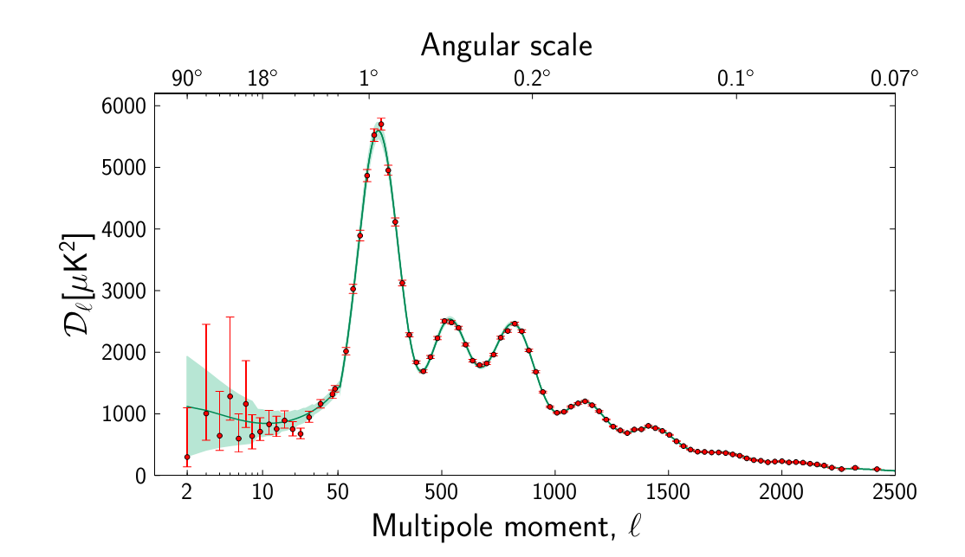
Planck CMB power spectrum

Slide 23
Planck CMB power spectrum
homogeneous
flat
adiabatic, coherent phases
scale-invariant
Gaussian
super-horizon
isotropic

Slide 24
Limitations of inflation
Inflation does not solve all the problems of the early universe:
What preceded inflation? Why and how did it begin?
Is inflation eternal?
In what vacuum state did the modes giving the CMB begin?
Inflation is not a complete ‘microphysical’ theory:
It is a phenomenological framework in effective field theory.
Perturbations computed in semiclassical gravity.
How is the inflaton field related to the rest of physics?
Predictions depend on assumptions about Planck-scale physics!

Slide 25
Dependence of inflation on quantum gravity
An order-one change in the spectrum at the Planck scale ends inflation: couplings to QG degrees of freedom make the potential too steep to inflate.
So the predictions depend on the quantum gravity spectrum.

Slide 26
The Planck-scale spectrum
mass
mass
mass

Slide 27
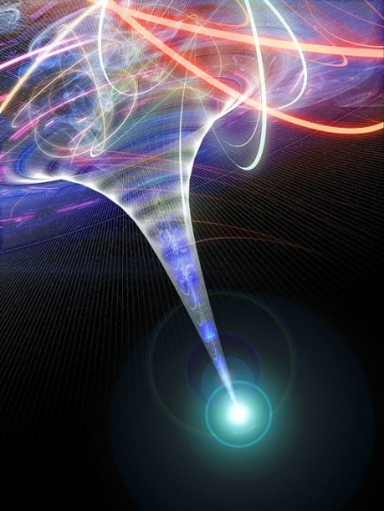
The Planck-scale spectrum
mass
mass
mass

Slide 28
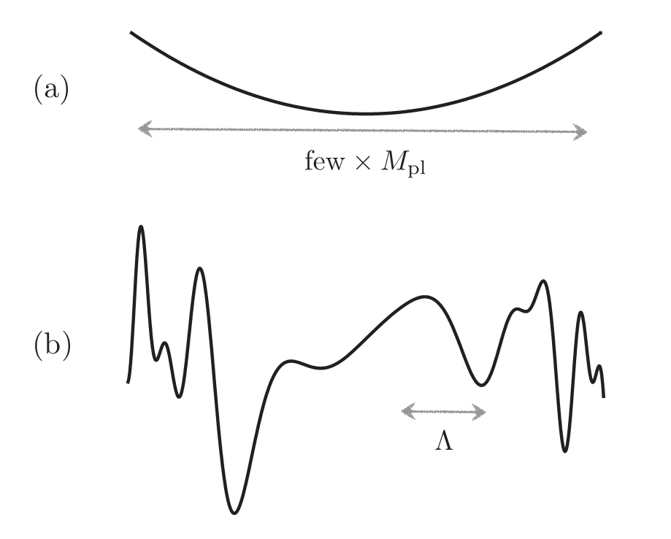
Structure on Planckian distances
Inflaton potential generally has ‘structure’ on scales ~ .
V(φ)
φ

Slide 29
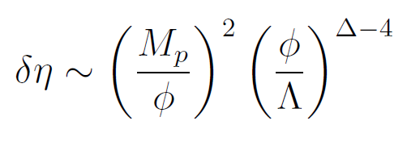
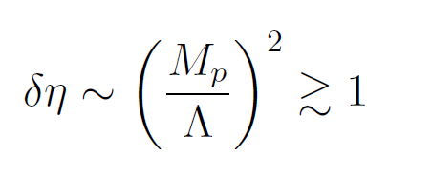
Planck-sensitivity of inflation
For small inflaton displacements, , one must control corrections with .
For large inflaton displacements, , one must control an infinite series of corrections, with arbitrarily large Δ.
(These large-field models we can identify unambiguously by detecting primordial tensors.)

Slide 30
IR and UV corrections
Linde 83
Approximate shift symmetry:
Radiatively stable: safe from loops of light fields, i.e.
inflaton and graviton.
Consistent as a low-energy theory.
Question: does it admit a UV completion? What are the effects of heavy fields (d.o.f. of the UV completion)?
Heavy fields negligible only if the UV theory respects the shift symmetry.
Smolin 80

Slide 31
Analogy: suppose a 20% increase in the mass of the charm quark halves the viscosity of water.
Non-decoupling is rare and strange!
When it happens, it is a powerful lever.

Slide 32
Experimental probes of particle spectrum slightly above collider energy are common (flavor, electroweak precision).
Rare event searches can test higher scales (GUT proton decay).
Inflation, even at very low energy, probes the Planck scale..

Slide 33
Plan
Quantum gravity: what and why?
Inflation depends on quantum gravity
Inflation in string theory
The task
Overview of status
Examples
Conclusions

Slide 34
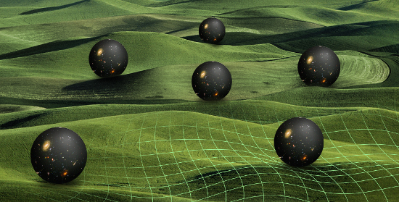
Task:
Derive 4d EFTs in solutions of string theory.
Directly compute quantum gravity effects!
Characterize inflationary dynamics and signatures.

Slide 35
Task: Compactification
Ideally: specify discrete data (compactification topology, quantized fluxes, wrapped branes), and derive, order by order in the genus expansion, a 4d EFT that supports inflation. Compute Planck-suppressed contributions directly.

Slide 36
In general, the Planck-suppressed contributions to the potential arise from integrating out massive fields that are part of the ultraviolet completion of gravity.
In string theory, the contributing massive fields notably include stabilized moduli.

Slide 37
Moduli and inflation in string theory
String compactifications typically lead to 4d effective theories with many scalar fields corresponding to deformations of the internal space.
Because their action originates in the 10d gravity sector, their couplings in 4d are of gravitational strength.
These moduli fields are highly problematic in cosmology.
photodissociation during BBN; overclosure; decompactification; etc.

Slide 38
Moduli and inflation in string theory
String compactifications typically lead to 4d effective theories with many scalar fields corresponding to deformations of the internal space.
Because their action originates in the 10d gravity sector, their couplings in 4d are of gravitational strength.
These moduli fields are highly problematic in cosmology.
photodissociation during BBN; overclosure; decompactification; etc.
Simplest hope: perhaps in some circumstances the moduli will become extremely massive, and decouple completely.
A key achievement of the past 15 years: emerging understanding of effects that give masses to the moduli, i.e. of methods of moduli stabilization.

Slide 39
Moduli and inflation in string theory
String compactifications typically lead to 4d effective theories with many scalar fields corresponding to deformations of the internal space.
Because their action originates in the 10d gravity sector, their couplings in 4d are of gravitational strength.
These moduli fields are highly problematic in cosmology.
photodissociation during BBN; overclosure; decompactification; etc.
Simplest hope: perhaps in some circumstances the moduli will become extremely massive, and decouple completely.
A key achievement of the past 15 years: emerging understanding of effects that give masses to the moduli, i.e. of methods of moduli stabilization.
These masses are finite! Integrating out the stabilized moduli yields critical contributions to the dynamics of the light fields.

Slide 40
Moduli mass spectra
(assuming SUSY spontaneously broken)
M_{Planck}
UV d.o.f.: integrate out
M_{KK}
‘stabilized’ moduli: dynamical, fluctuating
inflaton
massless moduli
H
0
I II III IV

Slide 41
Task: Compactification
In practice:
The problem is difficult! Compactness and broken supersymmetry spoil many methods applicable in cleaner systems.
Many analytic data unavailable (e.g., metric on a compact CY3)
Perturbative corrections past one loop are rarely known, but frequently important.
Perturbative and nonperturbative quantum effects often control the vacuum structure and potential.
A huge arsenal of approximation schemes is used. But these are not always convergent parametric expansions.
Extensive use of approximations, estimates, and assumptions creates ambiguity.
Reasonable people may well disagree over whether a given model ‘exists’ or ‘works’.
cf. talk by Sen

Slide 42
Approximations
Classical
Large radius
Leading instanton
Noncompact
SUSY
Minkowski
Decoupled
Probe
Dilute flux
Large charge
Smeared
Adiabatic

Slide 43
Status summary
Many mechanisms for inflation in string theory have been identified.
Totally explicit end-to-end computations of the inflaton potential from topological data (including computing next-order corrections to show they are small) have not been achieved, but:
solid progress is being made.
indirect determination of the action has grown quite sophisticated
There are string theory constructions both of large-field inflation and of small field inflation. The technical challenges are rather different. Far too early to try to judge which is more natural in string theory.

Slide 44
The state of the art
(for type IIB string theory on an orientifold of a CY3: all other cases are strictly harder/less developed for this purpose)
Specify compactification, at the level of Hodge numbers, orientifold actions, D-brane configurations.
Assume that generic 3-form flux stabilizes the complex structure moduli and axiodilaton.
Compute potential for Kähler moduli and D-brane positions, with contributions from (some of)
Euclidean D-branes, or gaugino condensation on seven-branes. Arithmetic genus condition occasionally checked; Pfaffian prefactor rarely computed, assumed ~O(1).
The (α′)³ Riemann⁴ correction.
Other less-characterized α′ corrections
String loop corrections at one loop. Often one takes a form conjectured based on toroidal orientifolds.

Slide 45
The state of the art
(for type IIB string theory on an orientifold of a CY3: all other cases are strictly harder/less developed for this purpose)
With this approximation to the effective action:
Establish existence of a local minimum of the moduli potential. Typically AdS₄, either SUSY or non-SUSY.
In few-moduli cases, this is clean.
In many-moduli cases, potential instabilities are often underestimated.
Argue for the possibility of ‘uplifting’ to de Sitter.
Simplest module for uplifting: anti-D3-brane in Klebanov-Strassler (or similar).
This module is reasonable in compactifications admitting highly warped regions
Instabilities arising on uplifting are often underestimated.

Slide 46
The state of the art
(for type IIB string theory on an orientifold of a CY3: all other cases are strictly harder/less developed for this purpose)
In this setting, identify an inflaton candidate and compute its potential.
Many challenges:
Physical effects that give mass to the moduli fields also give an undesirably large mass to the inflaton.
‘Stabilized’ moduli shift or fluctuate during inflation.
Inflationary energy breaks supersymmetry.
Inflationary energy backreacts on the compactification.

Slide 47
An example of inflation in string theory

Slide 48
D-brane inflation
Kachru, Kallosh, Linde, Maldacena, L.M., Trivedi 03
cone (6d)
D3-brane
Calabi-Yau
space (6d)
Baumann, Dymarsky, Klebanov, Maldacena, L.M., Murugan 06
Krause, Pajer 07; Baumann, Dymarsky, Klebanov, L.M. 07; Panda, Sami, Tsujikawa 07
Baumann, Dymarsky, Kachru, Klebanov, L.M. 08, 09, 10; Ali et al. 08, 10
Agarwal, Bean, L.M., Xu 11; Renaux-Petel, L.M., Xu 12

Slide 49
D-brane inflation
cone (6d)
D3-brane
coefficients dictated by details of bulk
Calabi-Yau
space (6d)
Dimensions fixed by geometry of cone
Ceresole, Dall'Agata, D'Auria, Ferrara 99
Baumann, Dymarsky, Kachru, Klebanov, L.M. 08, 09, 10
Gandhi, L.M., Sjörs 11

Slide 50
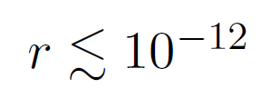
Phenomenology of D3-brane inflation
Inflation occurs occurs by chance at an inflection point.
No overshoot problem; attractor behavior.
Primordial tensors are negligible:
The probability of N_{e} e-folds is a power law, N_{e}⁻³ .
Approx. one trial in 10⁵ consistent with observations.
Coulomb + moduli potential not steep enough, in this setting, to drive a DBI phase.
Significant multifield effects present in 10% of trials solving the horizon problem. However, constraints from spectrum require N_{e}>120, and multifield effects are absent in most such cases.
Silverstein, Tong 03;
Alishahiha, Silverstein, Tong 04

Slide 51
Overview of results from inflation in string theory
Ultraviolet completions of inflation models in EFT, with modified signatures
Predictions more restricted than in EFT
Parameter bounds (e.g., field ranges and tensors)
Correlated signatures (e.g., tensors+NG)
Source of new ideas for EFTs
DBI, monodromy, alignment, flux cascades, tachyon condensation, RMT
Geometric perspective (moduli spaces, D-brane motion) on EFTs
Broad prior: many light moduli fields.

Slide 52
hep-th/1404.2601

Slide 53
Conclusions
Whether inflation occurs, and what its precise predictions are, depend on the nature of quantum gravity. So CMB observations give us a direct window on the physics of the Planck scale.
To write down a well-specified inflationary model, one must assume or compute the form of quantum gravity contributions.
We have built explicit models of inflation in string theory, by computing and controlling the quantum gravity effects.
These models can have distinctive signatures.
The next decade should see decisive advances in our understanding of the very early universe, and possibly even of the quantum gravity theory underlying it.

Slide 55
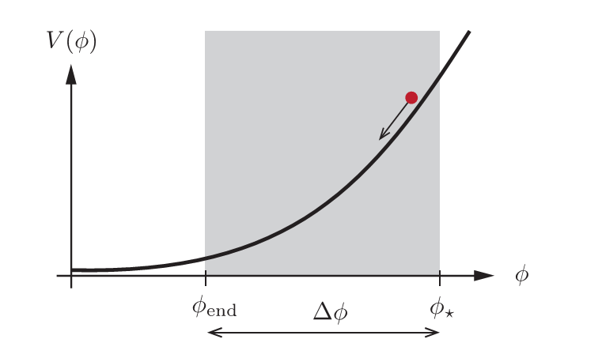
The Lyth bound
Relates r to the displacement of the inflaton in field space.
Detectable primordial tensors imply super-Planckian physics; a theory of quantum gravity becomes compulsory!

