Slide 1
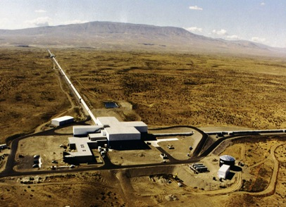
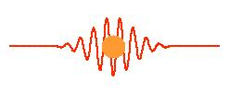
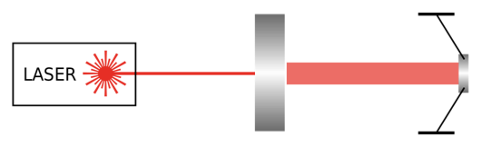
Quantum opportunities in
gravitational wave detectors
Gravitational wave
detectors
Quantization of light
Cavity Optomechanics
Nergis Mavalvala, MIT
@ ICGC, Dec. 2015

Slide 2
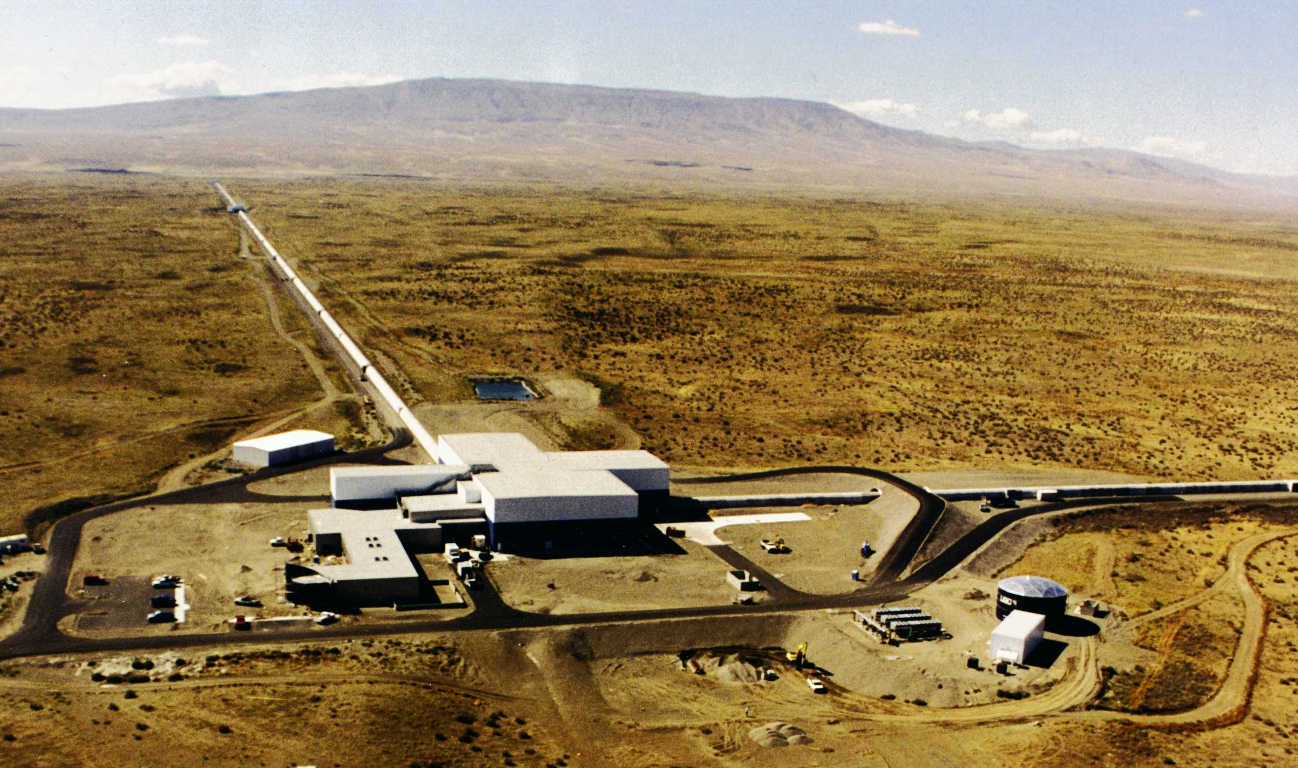
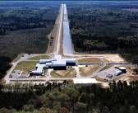

Quantum opportunities
Gravitational wave detectors are the most sensitive position meters ever constructed
They must measure relative mirror displacements of 10⁻¹⁹ m
They are kilometers long, with nearly a Megawatt of laser power incident on 40 kg quasi-freely moving mirrors
The quantum optical noise limits the sensitivity of gravitational wave detectors
Quantum opportunities in gravitational
wave detectors
Applications of quantum optics
  techniques
  New tools for quantum optomechanics
  on truly macroscopic (human) scales
Notes:
<number>
Braginsky, Thorne, Caves, Unruh introduced these two ideas in the late 1970s, but then the optomechanics got forgotten.

Slide 3
Interferometric gravitational
wave detectors
Notes:
<number>

Slide 4
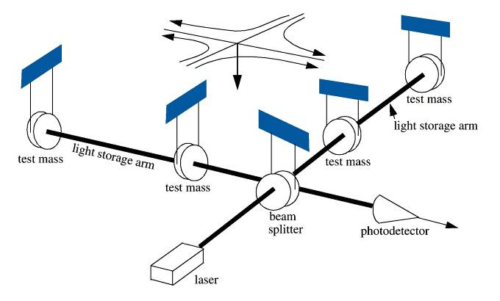
Interferometric detector
Mirrors hang as pendulums
  Quasi-free particles
  Respond to passing GW
  Filter external force noise
4 km
20 kW
Optical cavities
  Mirrors facing each other
  Builds up light power
Lots of laser power P
Signal α P
Noise α
10 W

Slide 5
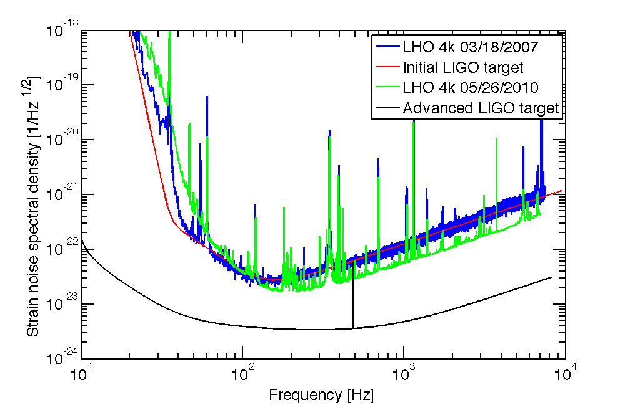
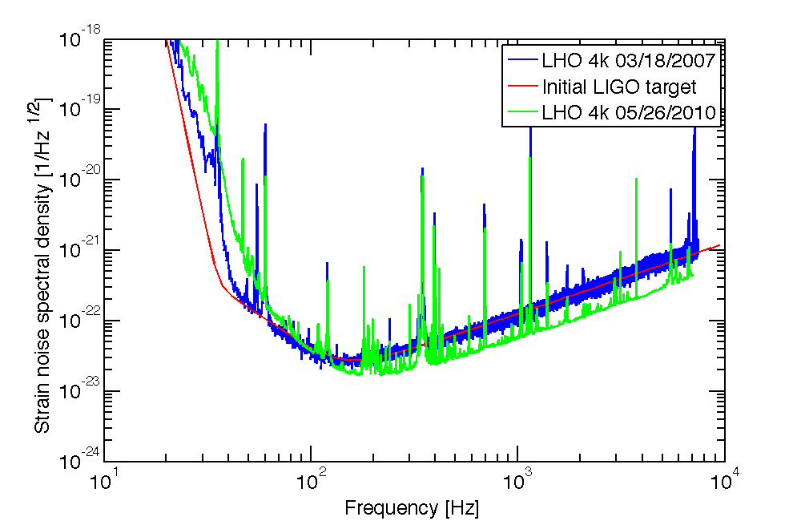
Phases of LIGO
Seismic
noise
Thermal noise
Shot noise

Slide 6
Phases of LIGO
Strain noise spectral density [1/Hz ^{1/2}]
Frequency [Hz]

Slide 7
Advanced LIGO
Shot noise
More laser power
→ stronger measurement
Radiation pressure noise
Stronger measurement
→ larger backaction

Slide 8
Origin of the Quantum Noise
Vacuum fluctuations

Slide 9
Quantum Noise in an Interferometer
Radiation pressure noise
Coherent intracavity field +
quantum fluctuations
➔ fluctuating force
➔ mirror displacement
Laser
X₂
X₂
X₁
X₁
X₂
X₂
Shot noise
Coherent signal field +
quantum fluctuations
➔ fluctuating phase
X₁
X₁

Slide 10
Squeezed vacuum injection
in a LIGO interferometer

Slide 11
Squeezing injection in LIGO
Correlate randomly fluctuating sidebands ➔ noise cancellations

Slide 12
LIGO H1 Squeezed
2 dB (25%) improvement
Squeezing down to 150 Hz
LIGO Scientific Collaboration, Nature Photonics (2013)

Slide 13
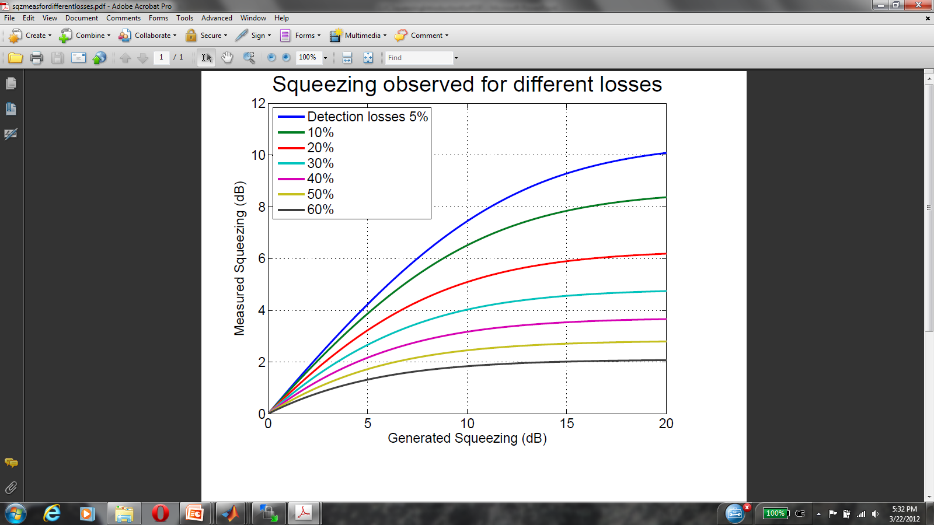
Why are losses so bad?
aLIGO
H1

Slide 14
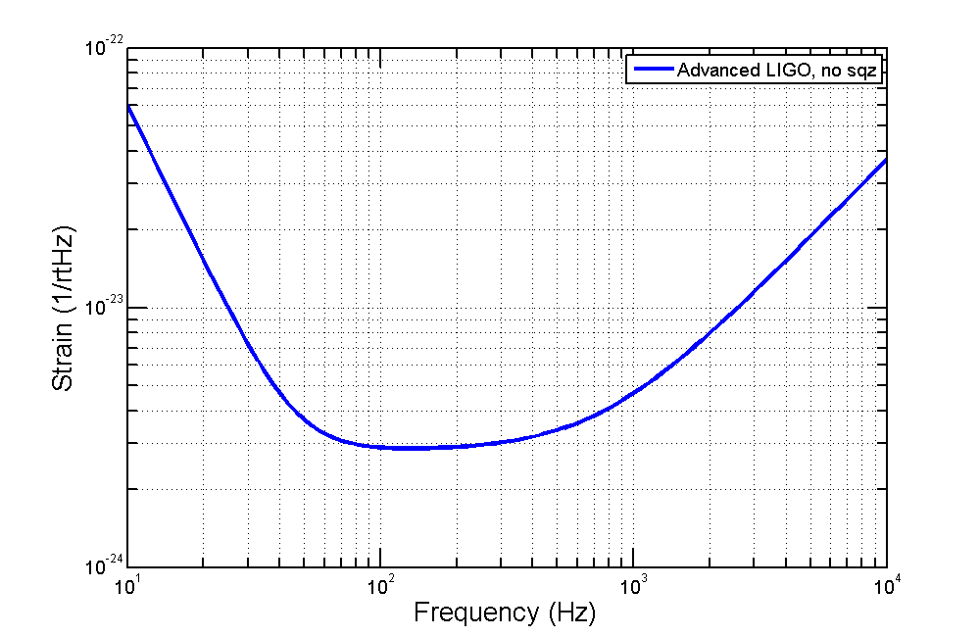
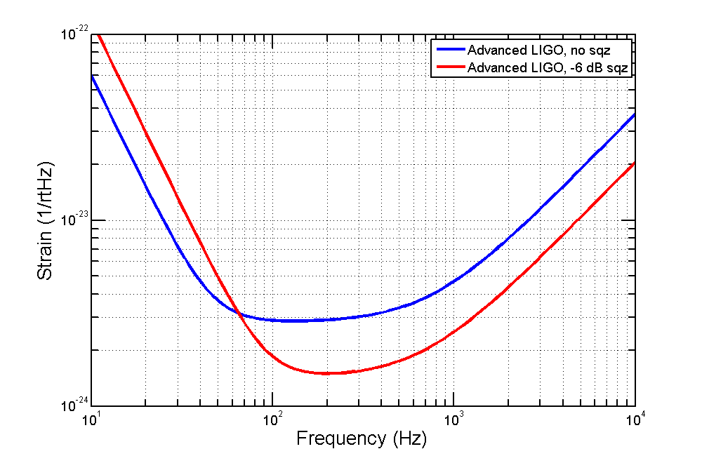
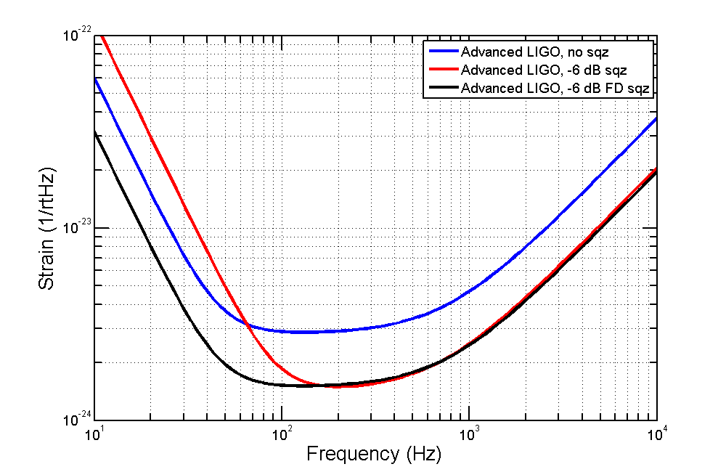
Adv. LIGO with squeeze injection
Radiation pressure
Shot noise
Schnabel, Mavalvala, McClelland, and Lam, Nature Communication (2010)
McClelland, Mavalvala, Schnabel, and Chen, Lasers and Photonics Reviews (2011)

Slide 15
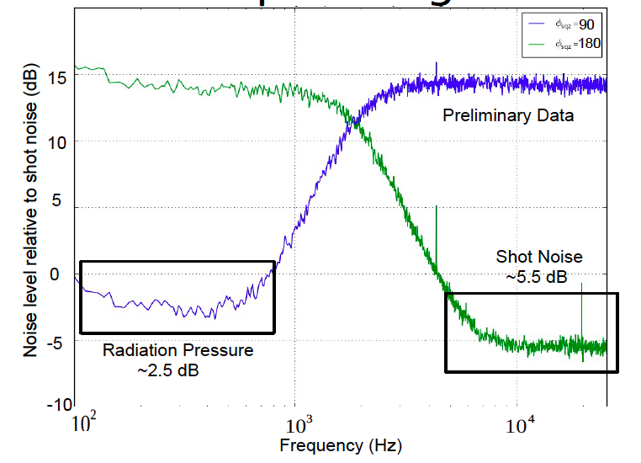
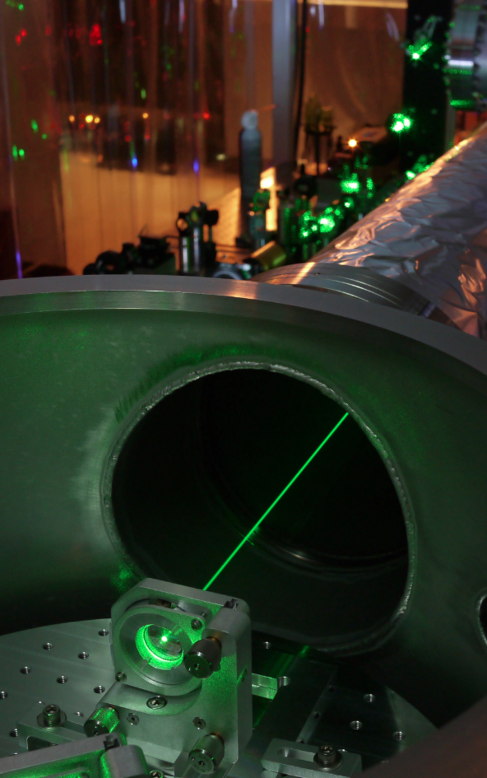
Frequency-dependent squeezed light
Mavalvala + Evans
A squeezed light source for Advanced LIGO
Goal: 2x SNR improvement ➔ 8x more volume in space !
Filter cavity
Oelker, Isogai et al. (2015)

Slide 16
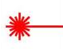
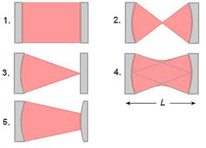
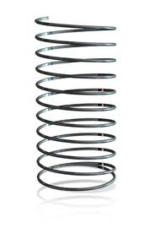
Cavity optomechanics &
Radiation Pressure

Slide 17
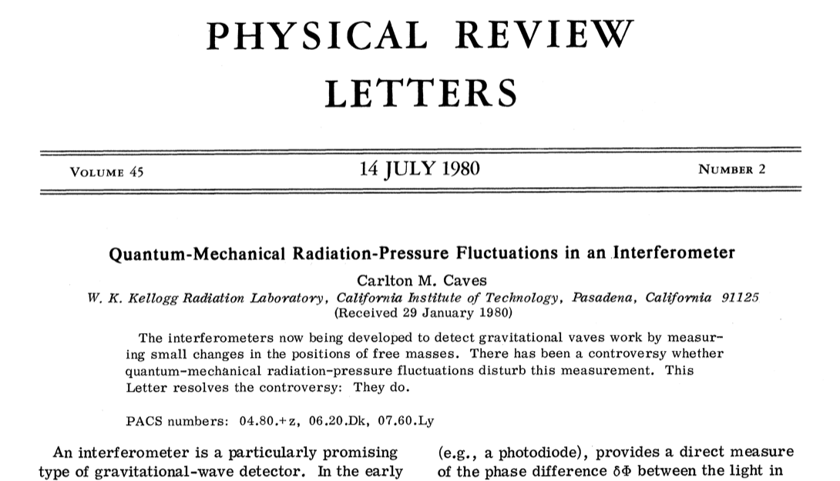
Radiation Pressure

Slide 18
When radiation
pressure dominates …
Techniques for improving gravitational wave detector sensitivity
Opportunities to study quantum effects in macroscopic systems
  Observation of quantum radiation pressure
  Generation of squeezed states of light
  Quantum states preparation
Tools for quantum information science
Hybrid quantum systems

Slide 19
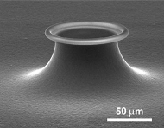
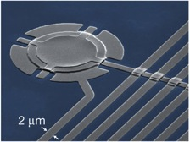

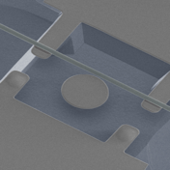
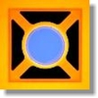
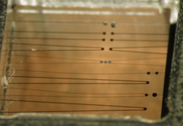
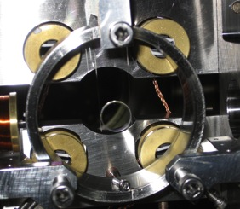
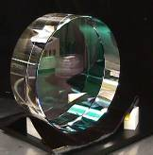
Optomechanics experiments
NEMS → 10⁻¹¹ g
Toroidal microcavity
→ 10⁻¹¹ g
PC zipper → 10⁻¹² g
WG-WGM
→ 10⁻¹¹ g
AFM cantilevers
→ 10⁻⁸ g
Trampolines
→ 10⁻⁷ g
Micromirrors
→ 10⁻⁶ g
SiN₃ membrane
→ 10⁻⁸ g
LIGO
→ 10³ g
Minimirror → 1 g
Notes:
Photonic crystal microcavity, Painter group (Caltech)
Lehnert group. Membrane capacitively cpld to SC microwavecircuit. Mass = 48 pg.
Kippenberg group (Munich)
Whispering gallery mode resonator couples through optical force to optical waveguide. Painter group (Caltech)
Harris group (Yale)
Bouwmeester group (UCSB)
Buowmeester group (Leiden, 2011). Mass = 100 ng.
Mavalvala group (MIT). Mass = 0.25 ug
LIGO-MIT group
LIGO

Slide 20



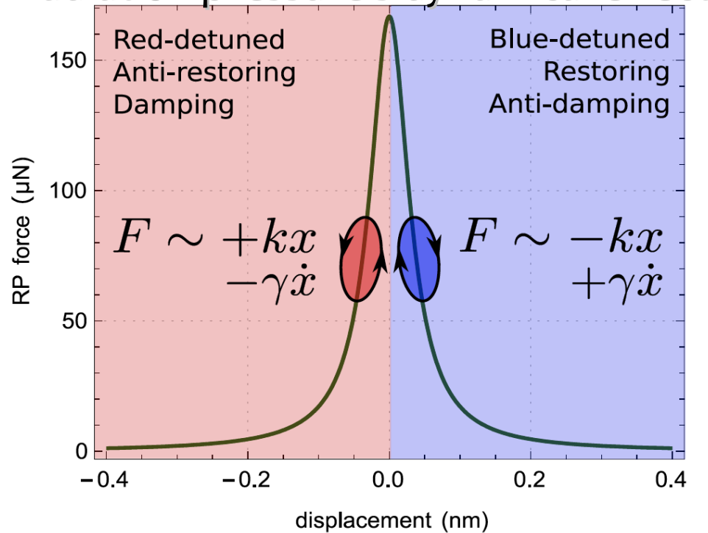
Cavity Optomechanics
Movable mirror oscillator interacts strong laser field in optical cavity
Detune optical field from cavity resonance
Change in mirror
position changes
intracavity power
→ radiation pressure
  exerts force on mirror
  Time delay in cavity
  results in cavity
  response doing work
  on mechanics

Slide 21
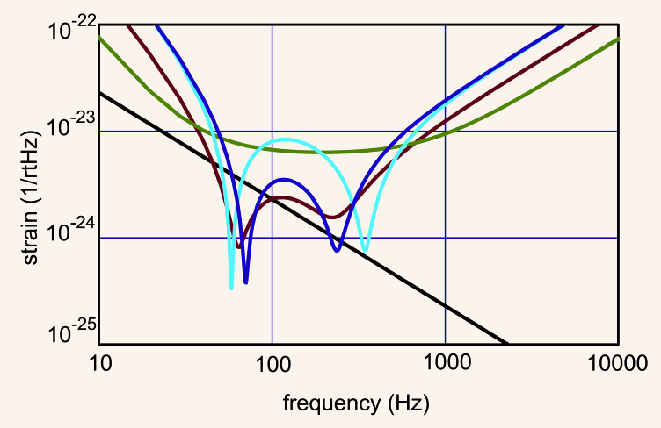
Optomechanical dynamics in Advanced LIGO
SN-RPN correlations due to optical spring effect
Thermal Noise
SQL

Slide 22
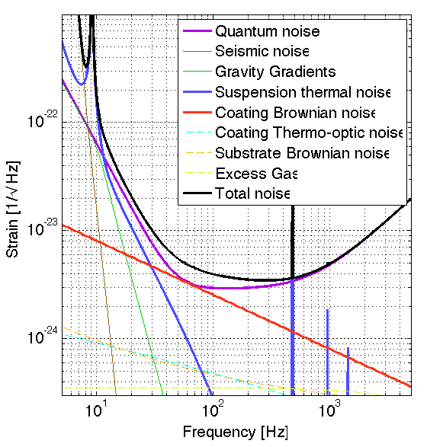
Clash with Thermal Noise
Must eliminate all classical forces to reach the quantum radiation pressure limit
Nemesis: Thermal noise
Antidote: Classical radiation pressure forces
  Intrinsically “cold”
  Can be used to drain thermal energy from the mechanics
Environment
T ~ 300 K
Mechanics
T_{eff}
Laser
T ~ 0 K
Notes:
<number>

Slide 23
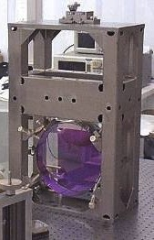
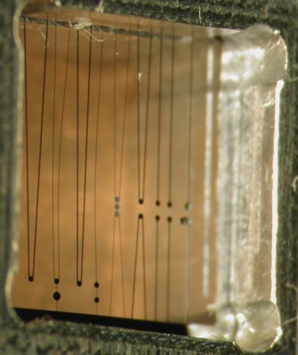
Three scales on which we study quantum light-mirror coupling
250 ng
1 g
10 kg
Notes:
<number>

Slide 24
Gram-scale mirrors

Slide 25
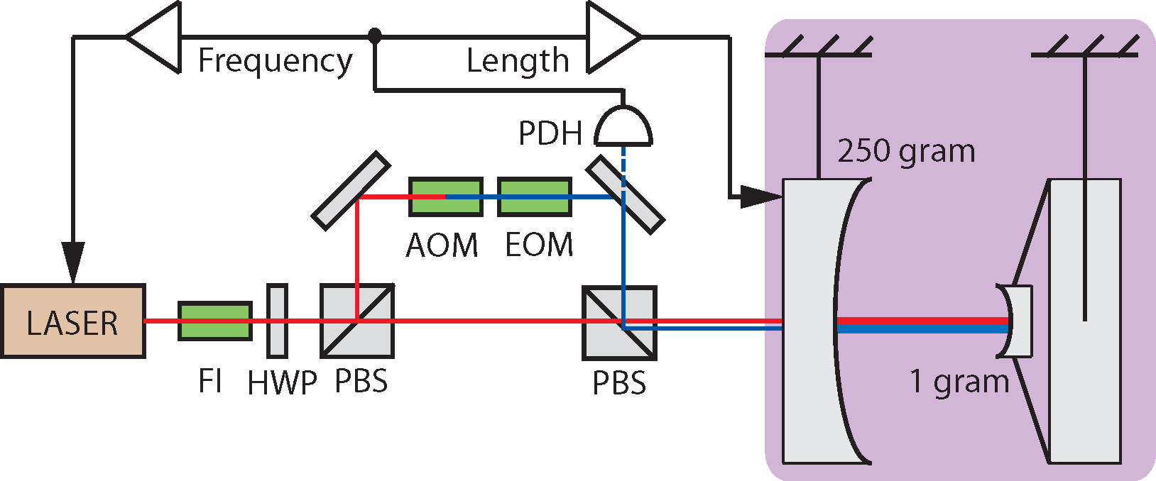
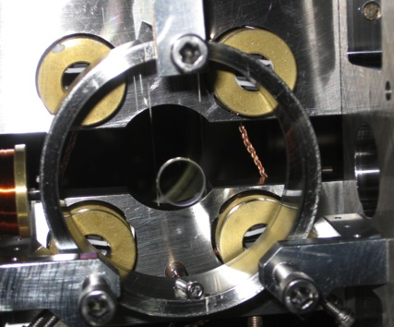
Experimental cavity setup
1 m
10%
90%
5 W
Optical fibers
1 gram
mirror
Coil/magnet pairs
for actuation (x5)‏

Slide 26
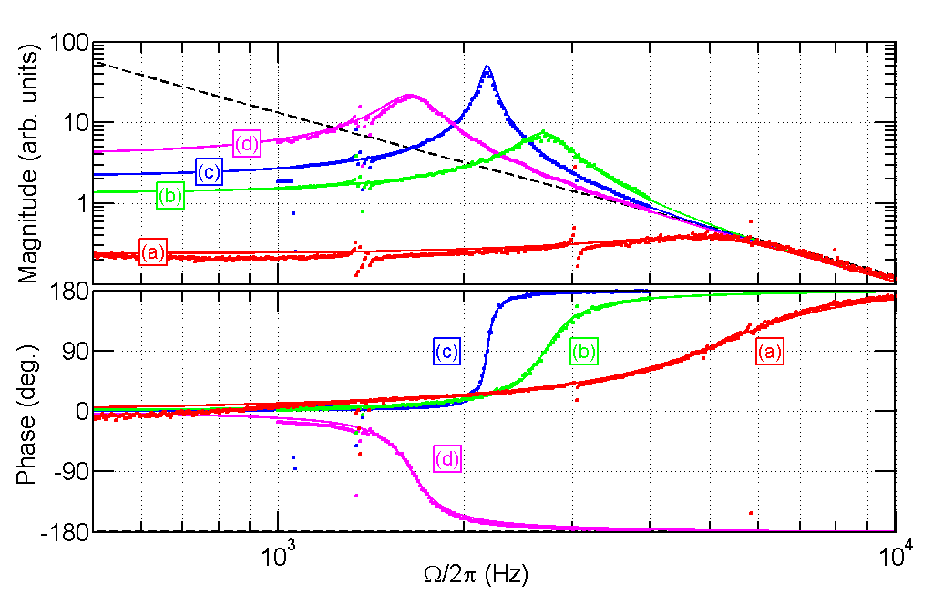
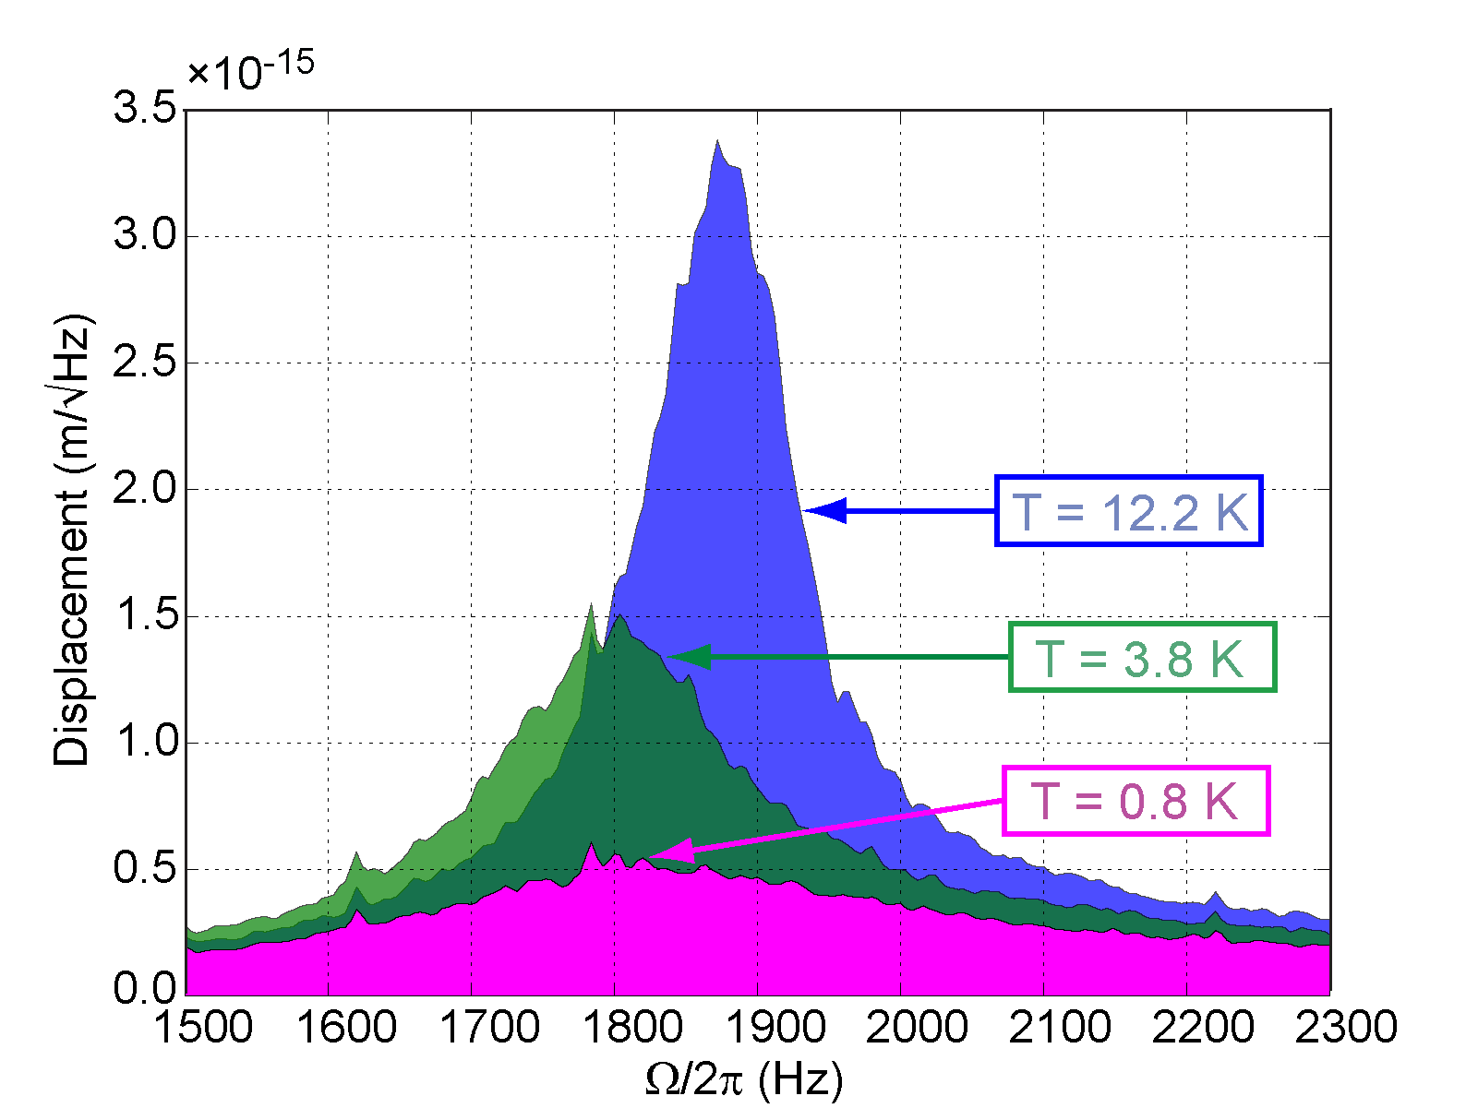
Trapping and cooling
Optical trap response
Optical cooling
Stiff!
Stable!
T. Corbitt et al., Phys. Rev. Lett 98, 150802 (2007)

Slide 27
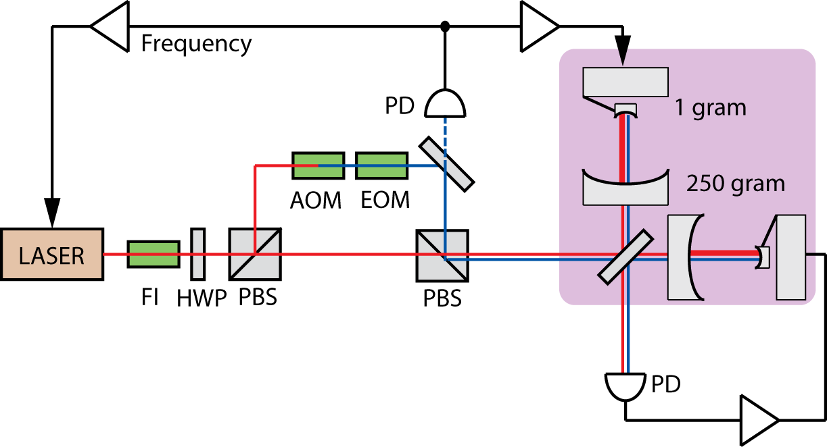
The experiment grows
T. Corbitt et al., Phys. Rev. A 73, 023801 (2006)
Two identical cavities with 1 gram mirrors at the ends
Common-mode rejection cancels out laser noise

Slide 28
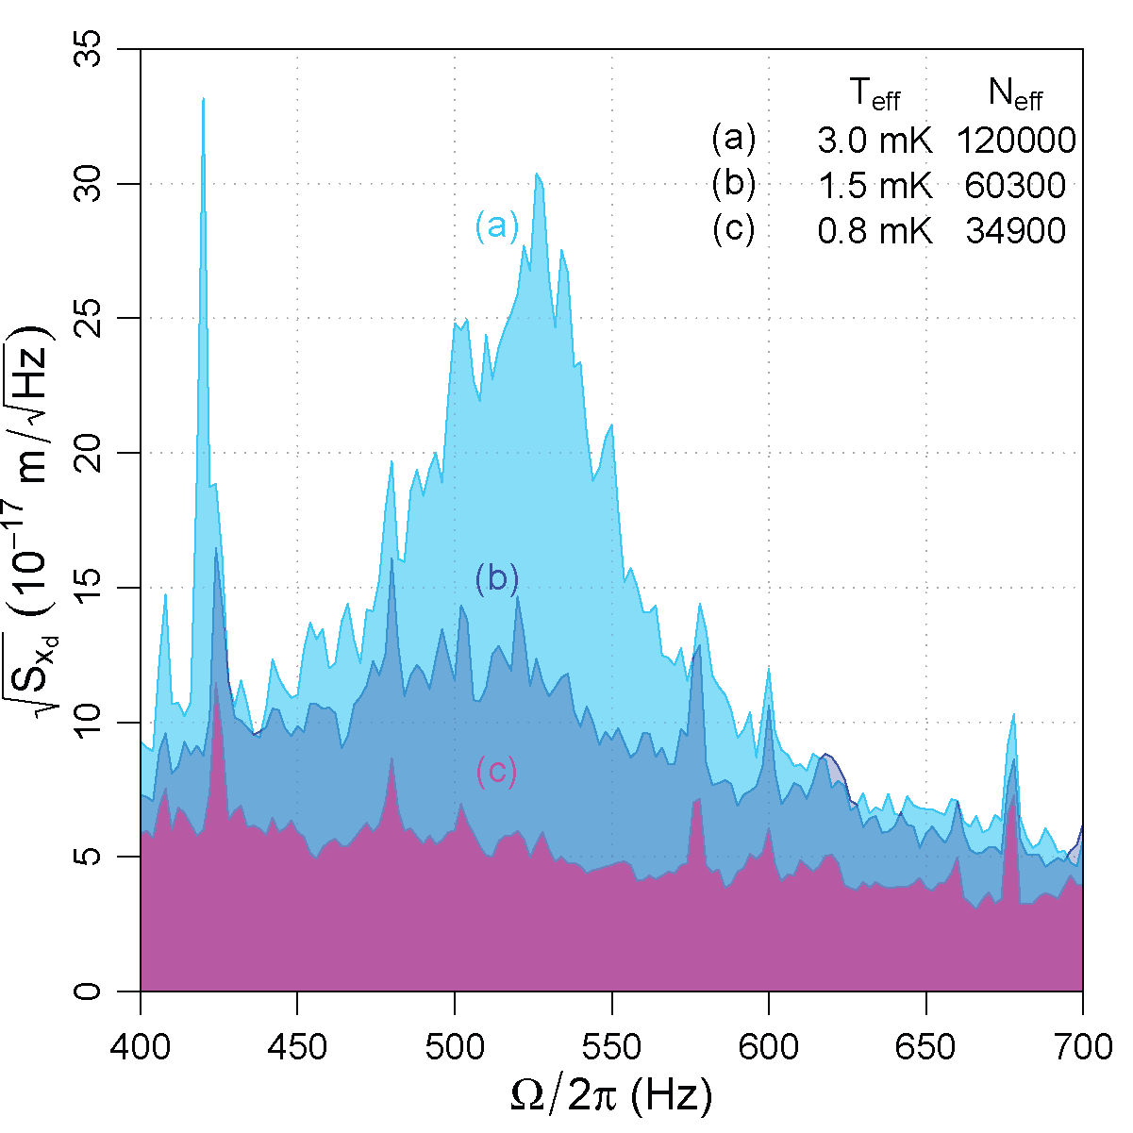
Optically trapped and cooled mirror
Optical fibers
T_{eff} = 0.8 mK
N = 35000
1 gram
mirror
C. Wipf, T. Bodiya, et al. (March 2010)
Notes:
Mechanical Q = 1.5e6
Cooling factor larger than mechanical Q because Gamma = Omega_eff/Q. The OS increases Omega but doesn’t affect Gamma (OS is non-mechanical), so Q must increase to keep Gamma constant.

Slide 29
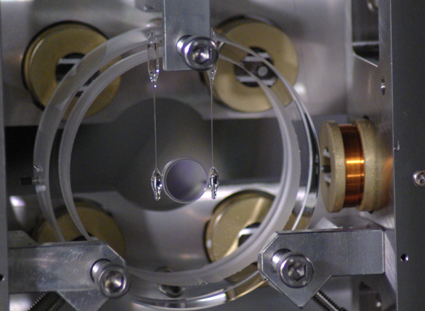
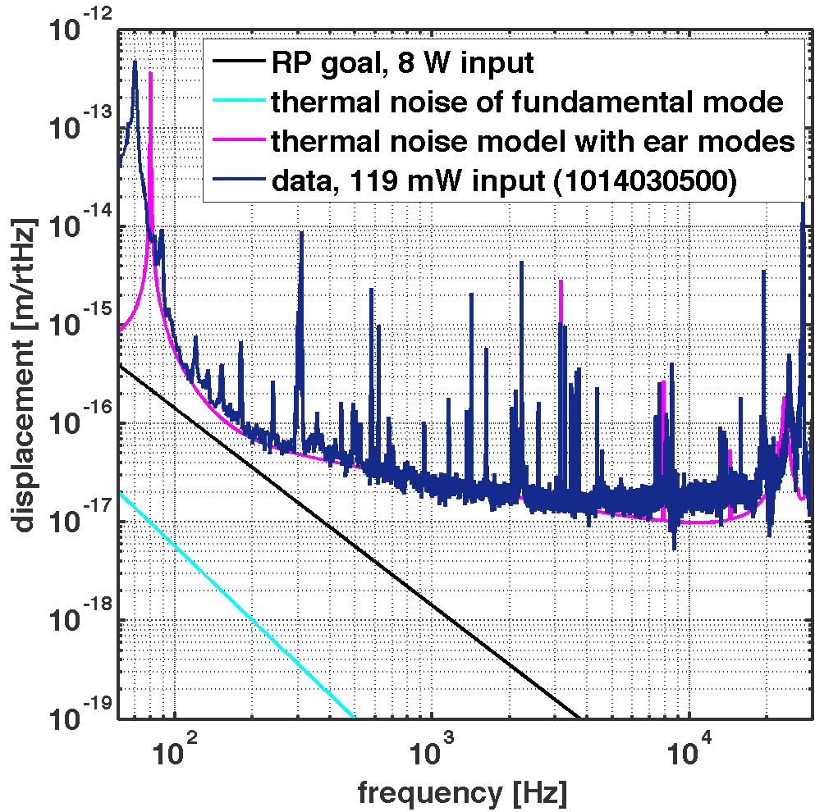
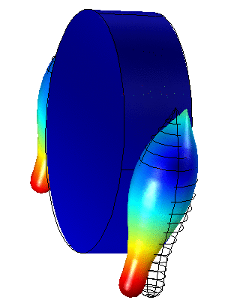
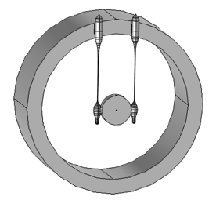
The elusive quantum regime
Q > 1.5e6
A. Neben, C. Wipf, T. Bodiya, E. Oelker, et al. (NJP 2012)

Slide 30
Kilogram scale mirrors

Slide 31
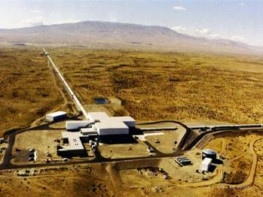
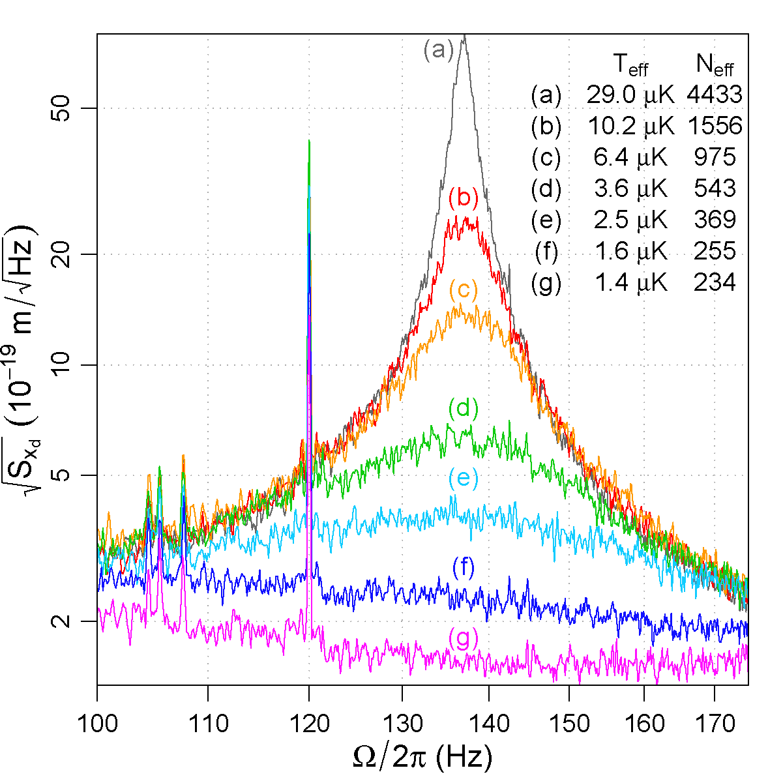
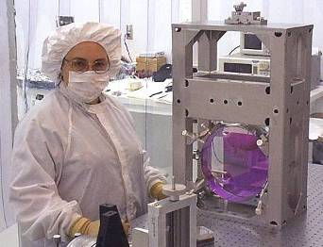
Cooling the kilogram-scale mirrors of Initial LIGO
LIGO Scientific Collaboration

Slide 32

Microgram scale mirrors

Slide 33
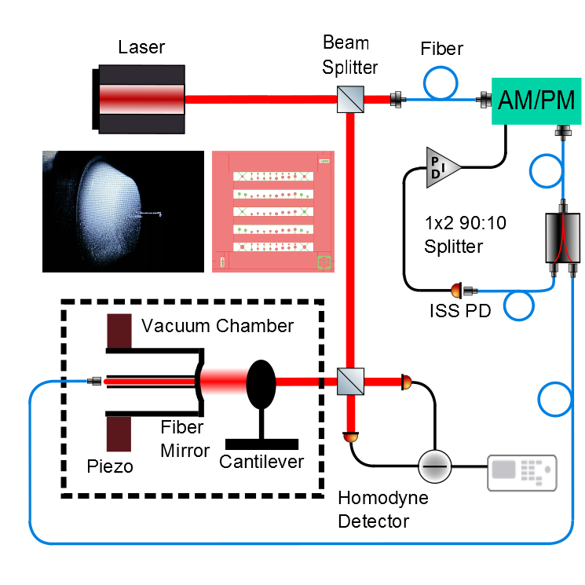
Cryogenic Micromirror

Slide 34
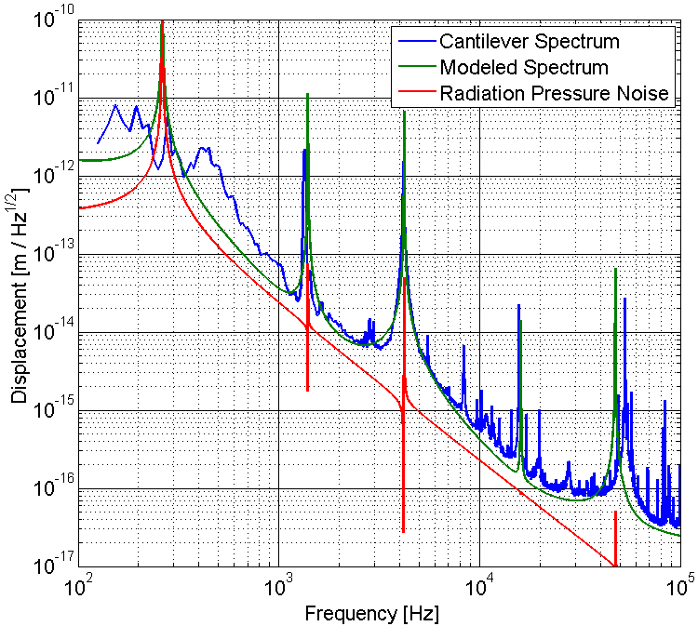
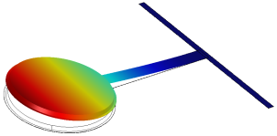
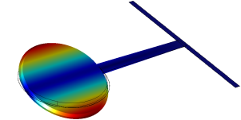
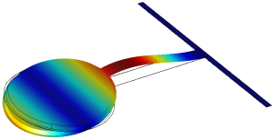
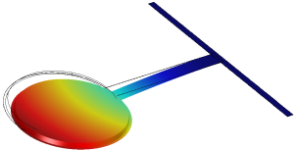
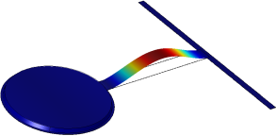
Still thermal noise
Collaboration
with T. Corbitt

Slide 35
Looking to the Future
Notes:
<number>

Slide 36

Beyond Advanced LIGO (3G?)

Slide 37
Future Terrestrial Detectors
Newtonian noise reduction
  Seismic sensing arrays
  Underground observatories
Thermal noise reduction
  Cryogenic cooling
Quantum noise reduction
  Full-spectrum squeezed vacuum injection
  Back-action evasion
Longer arms
Notes:
Back action evasion. E.g measure momentum of free particle. P commutes with Hamiltionian H = p^2/2m for free particle, so p is a qnd observable
<number>

Slide 38


Capturing the elusive wave …
Beautiful instrument capable of listening to the sounds of the Universe
Astrophysics
Tests of general relativity
Direct applications of quantum optics and observations of quantum effects on truly macroscopic scales
40 kg
Notes:
<number>

Slide 39
The cast and crew
Adam Libson
Nancy Aggarwal
Bobby Lanza
Antonios Kontos
Aaron Buikema
Haocun Yu
Eric Oelker
Tomoki Isogai
Maggie Tse
Sheila Dwyer
Chris Wipf
Tim Bodiya
Matt Evans
Lisa Barsotti
John Miller
Daniel Sigg
Peter Fritschel
Thomas Corbitt
Garrett Cole
Andreas Mueller
David McClelland
Colleagues at
  LIGO Laboratory
  LIGO Scientific Collaboration

Slide 40




The End
(but the journey is just the beginning)
The End
Notes:
<number>

Slide 42

Frequency dependent squeezed light
Mavalvala + Evans
Filter cavity
Extrapolation for Adv. LIGO:
16m filter cavity: factor of 2 reduction in shot noise (6dB),
25% reduction in radiation pressure noise (2 dB)
Oelker, Isogai et al. (2015)
Notes:
Demonstration of frequency-dependent squeezing. Measured noise relative to that due to the naturally occurring vacuum
state (shot noise) as a function of sideband frequency and readout quadrature . The dierence between the experimental
lter cavity detuning (oset from resonance) and the desired value of 1248 Hz is denoted by
. Dashed curves represent the
output of the model described in [10] using the parameters given in the legend and Table. I. The deviation of the recorded
data from prediction below 300Hz is due to unmodeled environmental disturbances rather than a fundamental limitation of
the technique. Data in this band were excluded from our analyses. The solid black curve provides an estimate of the overall
improvement achievable if this frequency-dependent squeezed vacuum source were applied to the appropriate interferometer.
Ellipses illustrate the modeled squeezing magnitude and angle (Wigner function) at the frequency at which they are located.
The measured noise is given by the projection of the ellipse onto the appropriately coloured readout vector
<number>

