Slide 1


Pulsars and Gravity
R. N. Manchester
CSIRO Astronomy and Space Science Sydney Australia
Summary
Brief review of pulsar properties
Tests of gravitational theories
Detection of GW with pulsar timing
Pulsar Timing Array (PTA) projects
Current status and future prospects

Slide 2
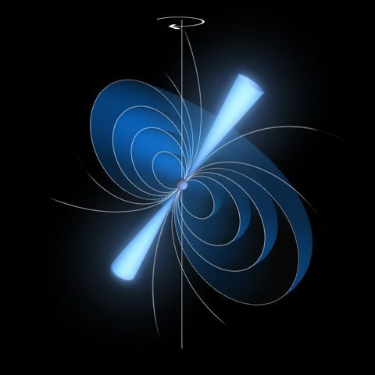
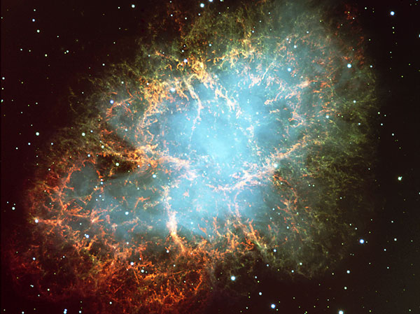
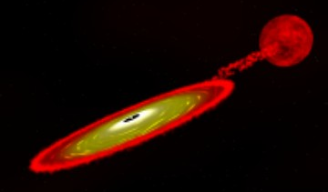
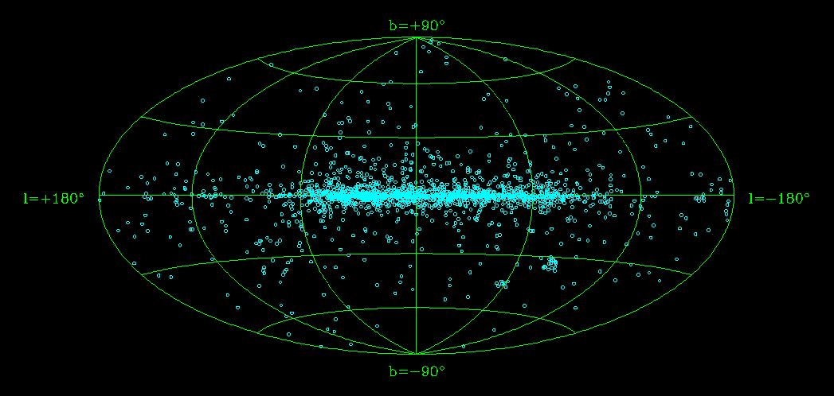
What are pulsars?
Pulsars are rotating neutron stars radiating beams of emission that we see as pulses as they sweep across the Earth
Neutron stars are formed in supernova explosions by the collapse of the core of a massive star
Millisecond pulsars are old pulsars that have been recycled by accretion of matter from a binary companion
Almost all known pulsars lie within our Galaxy
Neutron stars have a mass about 1.4 M_{Sun} but a radius of only ~15 km
Their surface gravity is enormous, ~10¹² g_{Earth}, hence their break-up rotation speed is very high, ~1 kHz

Slide 3
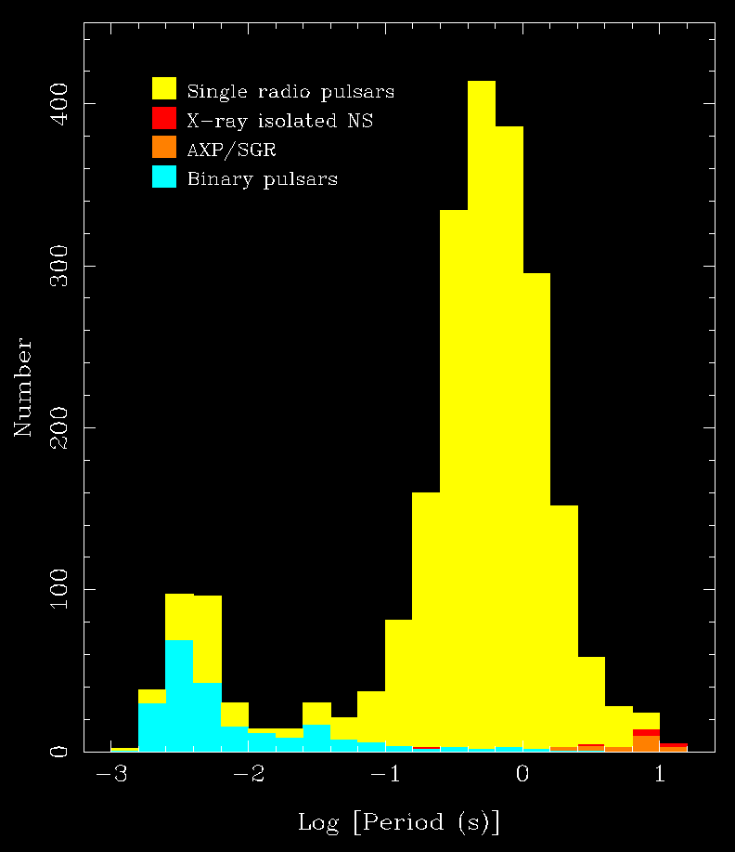
A Pulsar Census
Currently 2536 known (published) pulsars
2365 Galactic disk psrs
256 in binary systems
367 millisecond pulsars
143 in globular clusters
8 X-ray isolated neutron stars
24 magnetars (AXP/SGR)
28 extra-galactic pulsars
Data from ATNF Pulsar Catalogue, V1.54 (www.atnf.csiro.au/research/pulsar/psrcat) (Manchester et al. 2005)

Slide 4
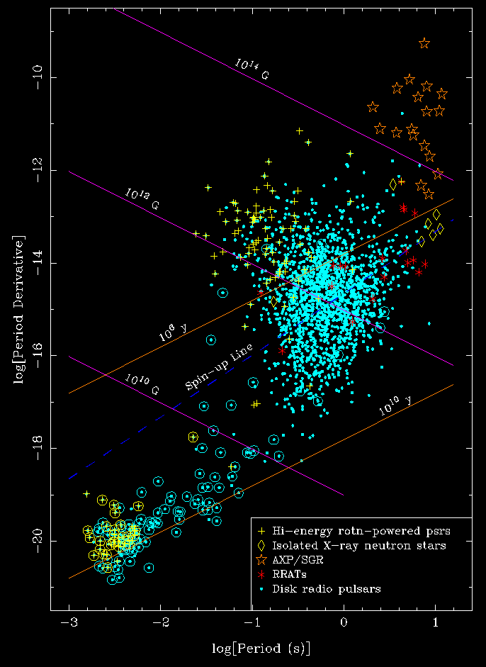
.
The P – P Diagram
Galactic Disk pulsars
P = Pulsar period
P = dP/dt = slow-down rate
.
.
For most pulsars P ~ 10⁻¹⁵
MSPs have P smaller by about 5 orders of magnitude
Most MSPs are binary, but few normal pulsars are
τ_{c} = P/(2P) is an indicator of pulsar age
Surface dipole magnetic field ~ (PP)^{1/2}
.
.
.
Great diversity in the pulsar population!
(Data from ATNF Pulsar Catalogue)

Slide 5
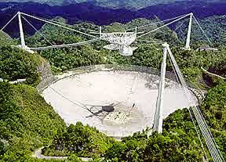
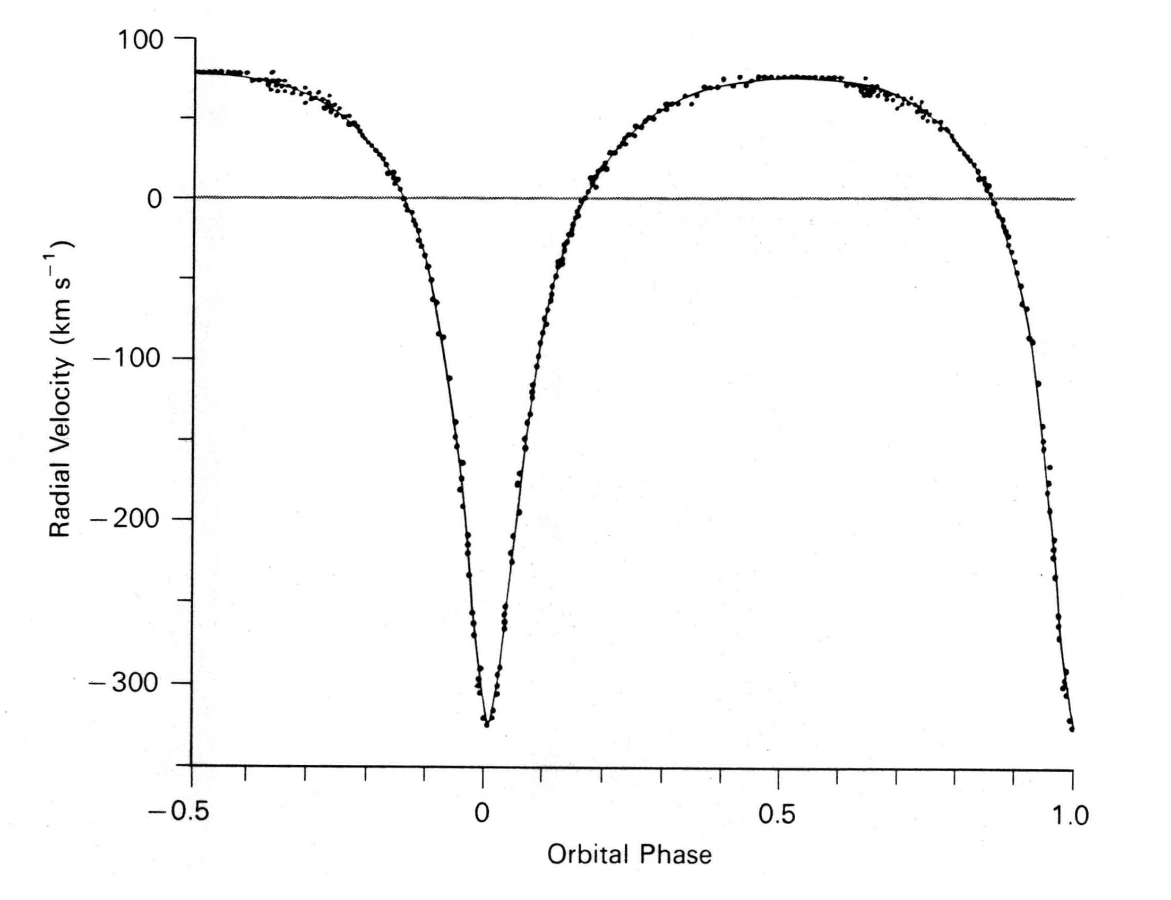
PSR B1913+16: The First Binary Pulsar
Discovered at Arecibo Observatory by Russell Hulse & Joe Taylor in 1975
Pulsar period 59 ms, a recycled pulsar
Doppler shift in observed period due to orbital motion
Orbital period only 7 hr 45 min
Maximum orbital velocity 0.1% of velocity of light
Relativistic effects detectable!

Slide 6
Post-Keplerian Parameters: PSR B1913+16
Given the Keplerian orbital parameters and assuming general relativity:
Periastron advance: 4.226598(5) deg/year
  M = m_{p} + m_{c}
Gravitational redshift + Transverse Doppler: 4.2992(8) ms
  m_{c}(m_{p} + 2m_{c})M^{-4/3}
Orbital period decay: -2.423(1) x 10⁻¹²
  m_{p} m_{c} M^{-1/3}
First two measurements determine m_{p} and m_{c}. Third measurement checks consistency with adopted theory.
M_{p} = 1.4398 +/- 0.0002 M_{sun}
M_{c} = 1.3886 +/- 0.0002 M_{sun}
Both neutron stars!
(Weisberg, Nice & Taylor 2010)

Slide 7
Orbital Decay in PSR B1913+16
Orbital motion of two stars generates gravitational waves
Energy loss causes slow decrease of orbital period
Predict rate of orbit decay from known orbital parameters and masses of the two stars using GR
Ratio of measured value to predicted value = 0.997 +/- 0.002
PSR B1913+16 Orbit Decay
Confirmation of general relativity!
First observational evidence for gravitational waves!
(Weisberg , Nice & Taylor 2010)

Slide 8
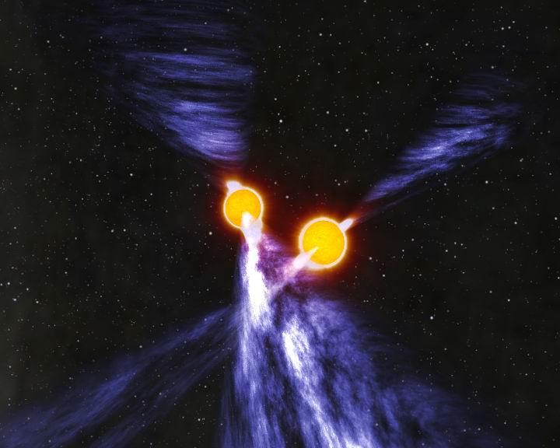
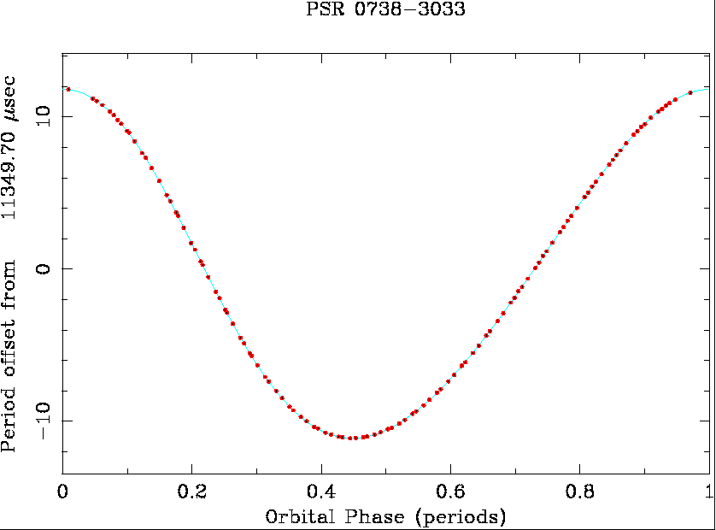
PSR J0730-3039A/B
The first double pulsar!
Discovered at Parkes in 2003
One of top ten science break-throughs of 2004 - Science
P_{A} = 22 ms, P_{B} = 2.7 s
Orbital period 2.4 hours!
Periastron advance 16.9 deg/yr!
(Burgay et al., 2003; Lyne et al. 2004)
Highly relativistic binary system!

Slide 9
Measured Post-Keplerian Parameters for PSR J0737-3039A/B
GR value Measured value Improves as
Periast. adv. (deg/yr) - 16.8995 +/- 0.0007 T^{1.5}
γ Grav. Redshift (ms) 0.3842 0.386 +/- 0.003 T^{1.5}
P_{b} Orbit decay -1.248 x 10⁻¹² (-1.252 +/- 0.017) x 10⁻¹² T^{2.5}
r Shapiro range (10⁻⁶ s) 6.15 6.2 +/- 0.3 T^{0.5}
s Shapiro sin i 0.99987 0.99974 T^{0.5}
.
.
+16 -39
GR is OK! Consistent at the 0.05% level!
Non-radiative test - distinct from PSR B1913+16
(Kramer et al. 2006)

Slide 10
Double Pulsar GR Test – Update
R: Mass ratio
ω: periastron advance
γ: gravitational redshift
r & s: Shapiro delay
P_{b}: orbit decay
Ω_{SO}: Spin-orbit coupling
.
.
Six measured relativistic parameters!
Five independent tests of GR (using R)
Best measurement of P_{b}
Now limits deviations from GR to 0.02%
.
(Kramer et al. 2016)
Notes:
Omega_SO from eclipse modelling

Slide 11
Other tests of gravitational theories
Tests of Strong Equivalence Principle (SEP)
  Forced eccentricity of wide orbits in pulsar – white-dwarf systems due to acceleration in Galactic gravitational field
  Upper limit on acceleration of individual pulsars from measured Ps
Limits on dipolar gravitational radiation
  Orbit decay of pulsar – white-dwarf systems
.
These tests place limits on various combinations of the Parameterised Post-Newtonian (PPN) parameters that describe different gravitational theories.
(Stairs 2003)

Slide 12
Constraints on Scalar-Tensor Theories
Deviations from GR expressed in terms of matter-scalar coupling constants α₀, β₀
For GR, α₀ = β₀ = 0
Wide asymmetric circular binaries give SEP limit
Solar-system tests: LLR and Cassini
Close asymmetric binaries (J1141-6545, J1738+0333) give strongest limits from absence of P_{b} due to dipolar GW emission
.
GR
(Freire et al. 2012)
Notes:
Modified Newtonian Dynamics

Slide 13
Pulsar Timing Arrays (PTAs)
A PTA consists of many pulsars widely distributed on the sky with frequent high-precision timing observations over a long data span
Can in principle detect gravitational waves (GW)
    GW passing over the pulsars are uncorrelated
    GW passing over Earth produce a correlated signal in the TOA residuals for all pulsars
Most likely source of GW detectable by PTAs is a stochastic background from super-massive binary black holes in distant galaxies
Predictions of GWB amplitude suggest that observations of ~20 MSPs over ~10 years needed for detection
A timing array can also detect instabilities in terrestrial time standards – establish a pulsar timescale
Idea first discussed by Hellings & Downs (1983), Romani (1989) and Foster & Backer (1990)

Slide 14
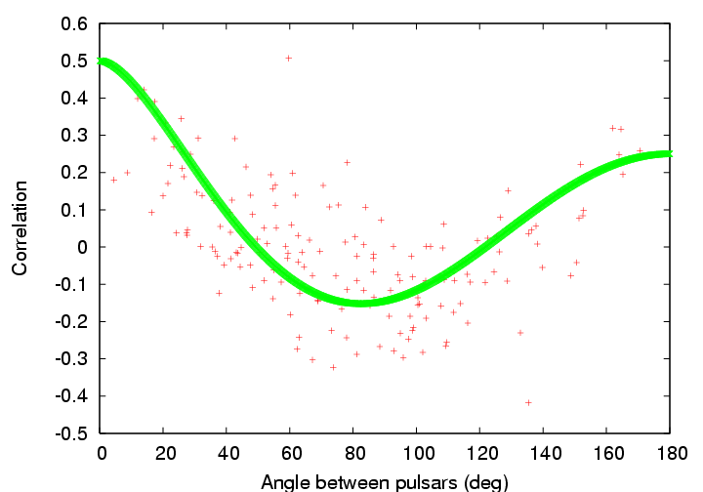
Correlated Timing Signals
Clock errors
  All pulsars have the same TOA variations: Monopole signature
Solar-System ephemeris errors
  Dipole signature
Gravitational waves
  Quadrupole signature
Hellings & Downs GW correlation function
Can separate these effects provided there is a sufficient number of widely distributed pulsars
(Hobbs et al. 2009)

Slide 15

Major Pulsar Timing Array Projects
European Pulsar Timing Array (EPTA)
  Radio telescopes at Westerbork, Effelsberg, Nancay, Jodrell Bank, (Cagliari)
  Normally used separately, but can be combined for more sensitivity
  Timing 22 MSPs, 10 with σ_{ToA} < 2 μs, data spans 5 - 18 years
North American pulsar timing array (NANOGrav)
  Data from Arecibo and Green Bank Telescope
  Timing 40 MSPs, 16 with σ_{ToA} < 2 μs, data spans 1 - 28 years
Parkes Pulsar Timing Array (PPTA)
  Data from Parkes 64m radio telescope in Australia
  Timing 21 MSPs, 20 with σ_{ToA} < 2 μs, data spans 3 – 19 years

Slide 16
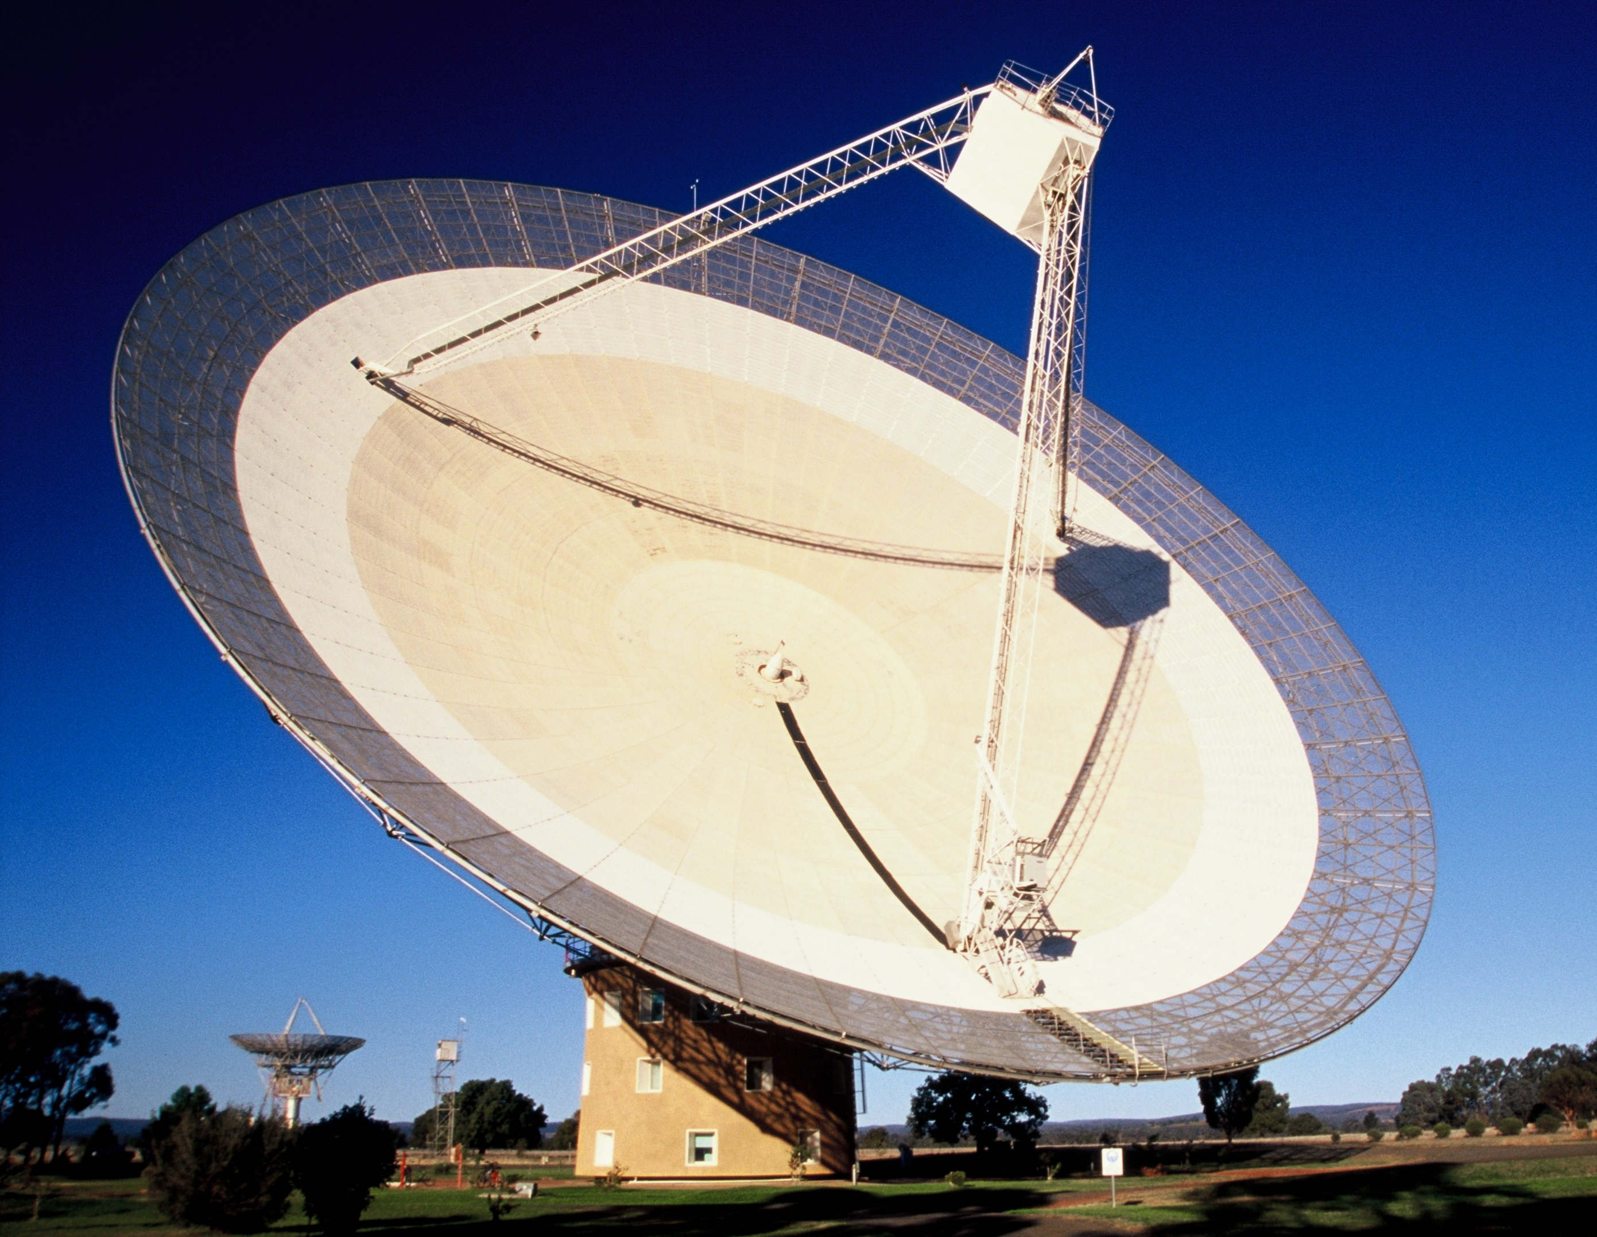
The Parkes 64-m Radio Telescope

Slide 17
Sky Distribution of PTA MSPs
.
About 110 MSPs with P < 15ms, P < 10⁻¹⁹ and not in globular clusters
~70 MSPs currently being timed by PTAs
11 MSPs timed by two PTAs
8 MSPs timed by all three PTAs
(Zhu et al. 2015)

Slide 18
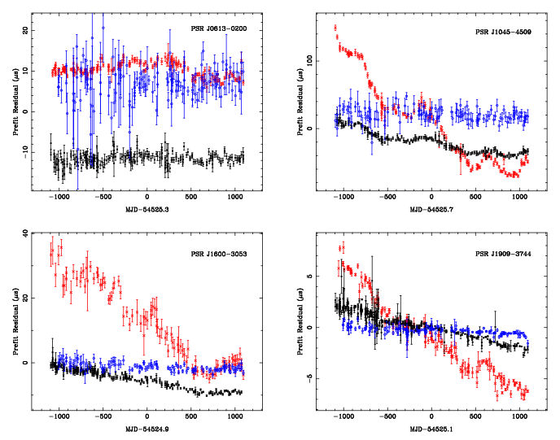
Multi-band Observations
50cm
10cm
20cm
PPTA: regular observations in three bands:
50cm ~700 MHz
20cm ~1400 MHz
10cm ~3100 MHz
(Manchester et al. 2013)
NANOGrav 9-yr data set:
Red: 327 MHz (Arecibo)
Orange: 430 MHz (Arecibo)
Green: 820 MHz (GBT)
Blue: 1400 MHz (Ar/GBT)
Purple: 2100 MHz (Ar/GBT)
(Arzoumanian et al. 2015)

Slide 19
The Isotropic GW Background
Strongest source of nHz GW waves is background from orbiting super-massive black holes in distant galaxies
Rate of energy loss to GW:
Chirp mass:
Frequency in source frame:
Number of mergers per comoving volume based on model for galaxy evolution (e.g. Millennium simulation) plus model for formation and evolution of SMBH in galaxies
(Sesana 2013)

Slide 20
Simple parameterisation of characteristic strain for cosmological distribution of circular BH binaries:
A is the characteristic strain at a GW frequency f = 1/1 yr
GW modulates observed pulsar frequency
Modulation spectrum of observed timing residuals:
GW power ~ f ^{-13/3}
Pulsar timing arrays are most sensitive to GW signals with frequency f ~ 1/T_{span} ~ few nanoHertz
Strength of GW background often expressed as a fraction of closure energy density of the Universe:
(Phinney 2001; Jenet et al. 2006)

Slide 21
Stochastic GW Background: Distribution of SMBBH
Most of background from SMBBH in galaxies at z = 1-2
Biggest contribution from largest BH masses: 10⁸ – 10⁹ M_{sun}
(Sesana et al. 2008)

Slide 22
EPTA Limit on GWB
Best six EPTA pulsars, 18-year data span
Bayesian analysis: pulsar parameters, noise processes, GWB
GWB 95% limit: A_{1yr} < 3 x 10⁻¹⁵
Consistent with Sesana (2013) prediction for GWB from SMBHB in galaxies
Limit on cosmic-string tension: Gμ/c² < 10⁻⁷
LIGO limit
Spectra sensitivity
Power-law SMBH 95% Limit
String limit
Sesana (2013) SMBH prediction
(Lentati et al. 2015)
Notes:
BBN – Big Bang Nucleosynthesis

Slide 23
NANOGrav Limit on GWB
Bayesian analysis
Pulsar white noise parameters separately derived
Combined analysis for GWB and red noise
95% confidence limit A_{1yr} = 1.5 x 10⁻¹⁵
McWilliams model ruled out at 99.2% level, Sesana (2013) OK at 20% level
Models with environmental orbit decay (e.g., Ravi et al.) or eccentric binaries (Heurta et al. 2015) are favoured
(Arzoumanian et al. 2015b)

Slide 24
A New PPTA Limit on the Nanohertz GW Background
Based on PPTA 10cm data sets for the four best-timed pulsars
11-year data span – 3.5 yrs longer than Shannon et al. (2013) PPTA data set
Inclusion of 20cm and 50cm data reduces the sensitivity – DM corrections are not sufficiently accurate
Bayesian analysis method
New limit: A_{1yr} < 1.0 x 10⁻¹⁵
Ω_{GW} < 2.3 x 10⁻¹⁰ at f = 0.2 yr⁻¹ (6 nHz)
J1909-3744
J0437-4715
J1713+0747
J1744-2304
(Shannon et al., Science, 2015)
Essentially rules out standard models for GWB!

Slide 25
Comparison with GWB Models
Observational limits (95% conf):
  N13: NANOGrav (Demorest et al.)
  E15: European PTA (Lentati et al.)
  P13: Parkes PTA (Shannon et al.)
  P15: PPTA 10cm (Shannon et al.)
GWB models:
  K15: Kulier et al. ✖ (99.5%)
  S13: Sesana ✖ (91%)
  M14: McWilliams et al. ✖ (99.8%)
  M14e: McWilliams et al. ✖ (96%)
  R14: Ravi et al. (✔) (20%)
  R15: Ravi et al. ✖ (95%)
Different assumptions about galaxy merger rates and SMBBH evolution
(Shannon et al., Science, 2015)
M14e and R14 include gas/stellar-interaction at late times
Notes:
Probabilities: K15

Slide 26
Scenarios for SMBBH Evolution
Fiducial: Std model
Slow merger: Dynamic friction x10⁻⁴
Recoil: 500km s⁻¹ kick – SMBHB escapes
Stalled: stellar/gas interaction x10⁻² (“last parsec” case)
Environment: stellar/gas
interaction at late times x10²
(Shannon et al. 2015)
GW: GW emission dominates over other loss processes
Slow merger, recoil, or stalled merger unlikely to be important
Most probable reason for lack of detection is orbit decay due to stellar/gas interactions at late times – less energy into GW
Also implies GWB detectability is greater at higher frequencies (f > ~1 yr⁻¹)

Slide 27
Single Sources
Likely that many SMBH binary systems are highly eccentric
GW spectrum may be dominated by a strong individual source
First GW detection by PTAs could be a single source with period <~ 1 year!
(Sesana 2012; Shannon et al. 2015)

Slide 28
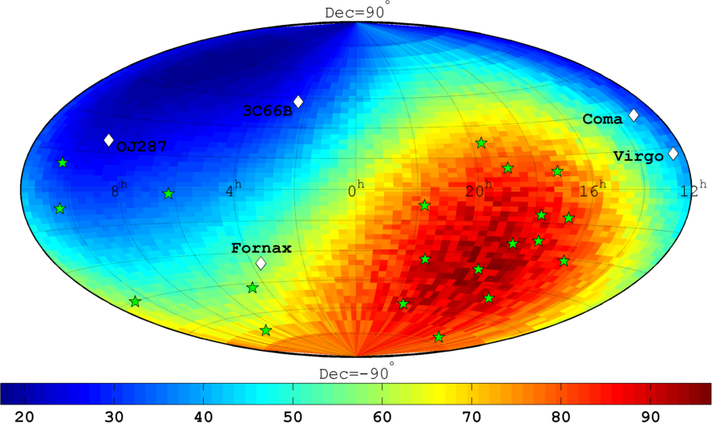
PPTA Limits on Single GW Sources
Searched PPTA data set for arbitrary time series of GW amplitudes A₊, A_{x} that satisfy the quadrupolar constraints for a given source direction
Searched these time series for sinusoidal components that could result from orbital motion of a SMBHB
Repeated for all possible source directions
1 yr⁻¹
2 yr⁻¹
Spectral strain sensitivity at different sky locations
Distance (Mpc) to which a SMBBH with chirp mass 10⁹ M_{Sun} emitting GW at 10⁻⁸ Hz can be detected
(Zhu et al. 2014)

Slide 29
Localisation of a GW Source
PPTA data set with simulated source in Fornax cluster, S/N ~ 5
Earth-term correlation statistic
Max detection statistic (o) close to source position ( )
Localisation poor ~ 400 sq deg
Use pulsar term! – pulsar-Earth interferometer
Fringe spacing θ_{f} = λ_{GW}/[2πd(1+γ)] – few arc min (γ is z dirn cosine, GW propn dirn +z )
Localisation ~ θ_{f} /(S/N) – sub-arc-min possible
However, pulsar distances must be known to better than λ_{GW}/(1+γ)
So far, only one pulsar (J0437-4715) has a sufficiently accurate dist. (d = 156.79±0.25 pc)
(Zhu et al. (2015)
(Reardon et al. 2015)
(Lee et al. 2011)

Slide 30
GW Detection Sensitivity
Simplified model, based on correlation analysis of M pulsars in PTA
White timing noise only, all pulsars with same rms noise σ
At low signal levels (S/N < 1): S/N ~ MT^{13/3}/σ²
At higher signal levels (S/N > 1): S/N ~ MT^{1/2}/σ^{3/13} – effect of uncorrelated pulsar term
(Siemens et al. 2013)
For GWB detection, increased observation time and higher precision ToAs don’t help so much
PTAs are (hopefully) already in S/N ~ 1 regime!
Most effective strategy is to increase M!

Slide 31

The International Pulsar Timing Array
The IPTA is a consortium of consortia, formed from existing PTAs
Currently three members: EPTA, NANOGrav and PPTA
Aims are to facilitate collaboration between participating PTA groups and to promote progress toward PTA scientific goals
The IPTA organises annual Student Workshops and Science Meetings – 2016 meetings will be in Sth Africa, 20 June – 1 July
Main current focus is making available the combined data sets. Difficult because of different instruments and signal processing methods in different PTAs
Expect significant improvement in GW detection sensitivity from full IPTA data set (at least 50 MSPs)

Slide 32
Further in the future:
Existing systems: Wide-band receivers, signal processor upgrades
New telescopes (pre-SKA):
  LOFAR (Europe): 36 stations, 1500 km max baseline, 30 – 250 MHz, operating now
  MWA (W. Aust.): 128 “tiles”, 1.5 km, 80 – 300 MHz, operating
  MeerKAT (Sth Africa): 64 x 13m array, 8 km max baseline, 1.0 – 1.7 GHz (3 GHz later), 2017
  CHIME (Canada): 5 x 100m x 20m, 400 – 800 MHz, 2017
  FAST (China): 500m reflector, 50 – 3000 MHz, 2017
  SHAO 65m, >2 GHz, operating; QTT 110m, 2020+
Square Kilometre Array (SKA) – Phase I:
  SKA-mid (Sth Africa): ~200 x 15m, 0.4 – 14 GHz, 2020+
  SKA-low (W. Aust.): ~1500 tiles, 50 – 300 MHz, 2020+
SKA – Phase II: Mid: 10 x Phase I; Low: 4 x Phase I, 2030+

Slide 33

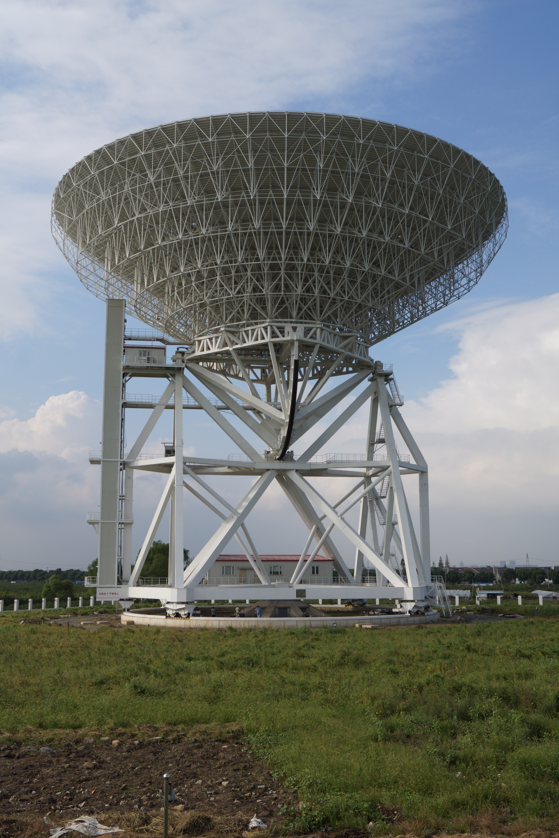
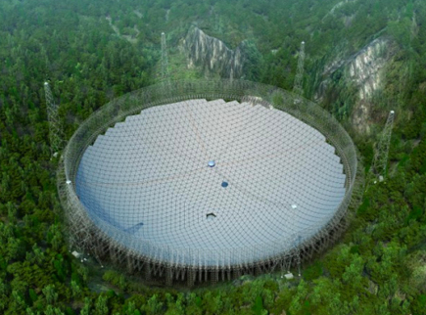
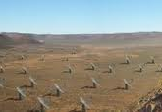
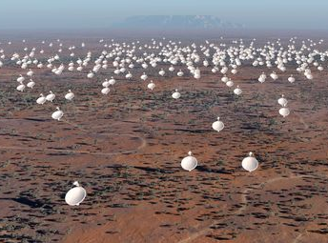
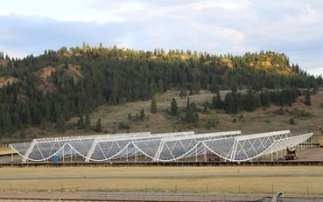
LOFAR
New Telescopes
MWA
Now
Now
SHAO 65m
FAST
QTT
Now
2017
2020+
MeerKAT
CHIME
SKA-Mid
2016
2017
2020+

Slide 34
GWB Anisotropy
Expect some anisotropy in GWB – nearby strong sources may dominate
Spherical harmonic analysis
From EPTA data set, power in l > 0 harmonics < 40% of power in l = 0 monopole
From preliminary analysis of NANOGrav 9-year data set, fluctuations < 5% of monopole power
No significant detection of anisotropy so far – needs FAST, SKA!
(Taylor et al. 2015; Mingarelli 2015)

Slide 35
GW Polarisation
In metric theories of gravity, GWs have up to six distinct polarisation states
GR has two (+ and x)
Correlation (“H-D”) curve is a function of polarisation state
(Will 2014)
Detection require obs of 40 – 60 “100-ns” pulsars for ~5 years – needs SKA!
(Lee et al. 2008)

Slide 36
Binary pulsar systems put strong limits on deviations from GR
PTAs working at design sensitivity – but no GW detection yet
The time till detection depends on many factors, with the most uncertain being the predicted GW signal levels
Thank you!

