Slide 1
Looking for Gravitational Waves with a radio pulsar observatory Pulsar Timing Arrays and Indian Pulsar Timing Array experiment “In the era of Gravitational Waves”
Bhal Chandra Joshi
National Centre for Radio Astrophysics (TIFR), Pune
Collaborators :
Manjari Bagchi, A. Gopakumar, P K Manoharan, M. Surnis, Arun Naidu,
Prakash Arumugasamy, M A Krishnakumar, Yogesh Maan,
Dhruv Pathak, Abhimanyu S, Suryarao Bethupadi, Swetlana Mohapatra
+ …..

Slide 2
OUTLINE
Introduction to Radio pulsars and pulsar timing
Gravitational Wave sources and spectrum
Pulsar Timing Array - understanding the instrument
Design considerations for PTA and challenges in the experiment
Pulsar Timing Array experiments in operation
Gravitational wave sources for PTAS
Current state-of-art and recent results
Indian Pulsar Timing Array (InPTA) initiative and preliminary results
Dedicated Indian instrument - TATA Pulsar Timing Array (TAPTA)
PTAs - Road ahead

Slide 3
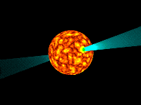
Radio Pulsars
Radio pulsars are highly magnetized rotating stars.
Pulsed radio emission is due to a narrow beam anchored on the magnetic poles of rotating NS, with its magnetic axis offset from its rotational axis
As these stars are a collapsed remnant, they are almost entirely made up of neutrons and are massive and compact
Mass ~ 1.4 M₀
Radius ~ 10 km
I ~ 10⁴⁵ g-cm²

Slide 4
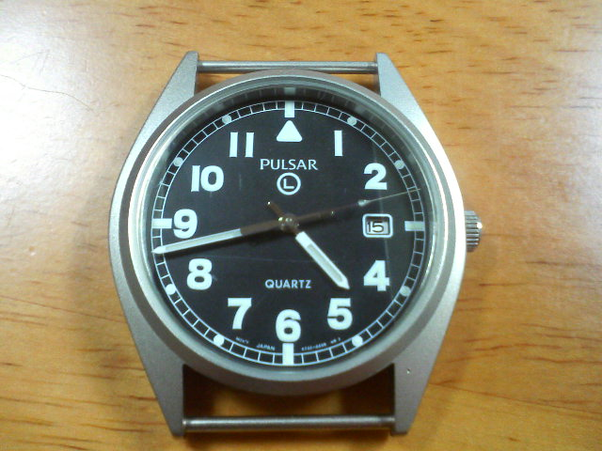
Pulsar as a clock
Their massive compact nature implies a very precise rotation
Pulses show a remarkable clock like stability
Stability of period ~ 1 part in 100 quintillion
Some pulsars rival the best atomic clocks
This plays important role in their usefulness for detection of Gravitational Waves (GWs)

Slide 5
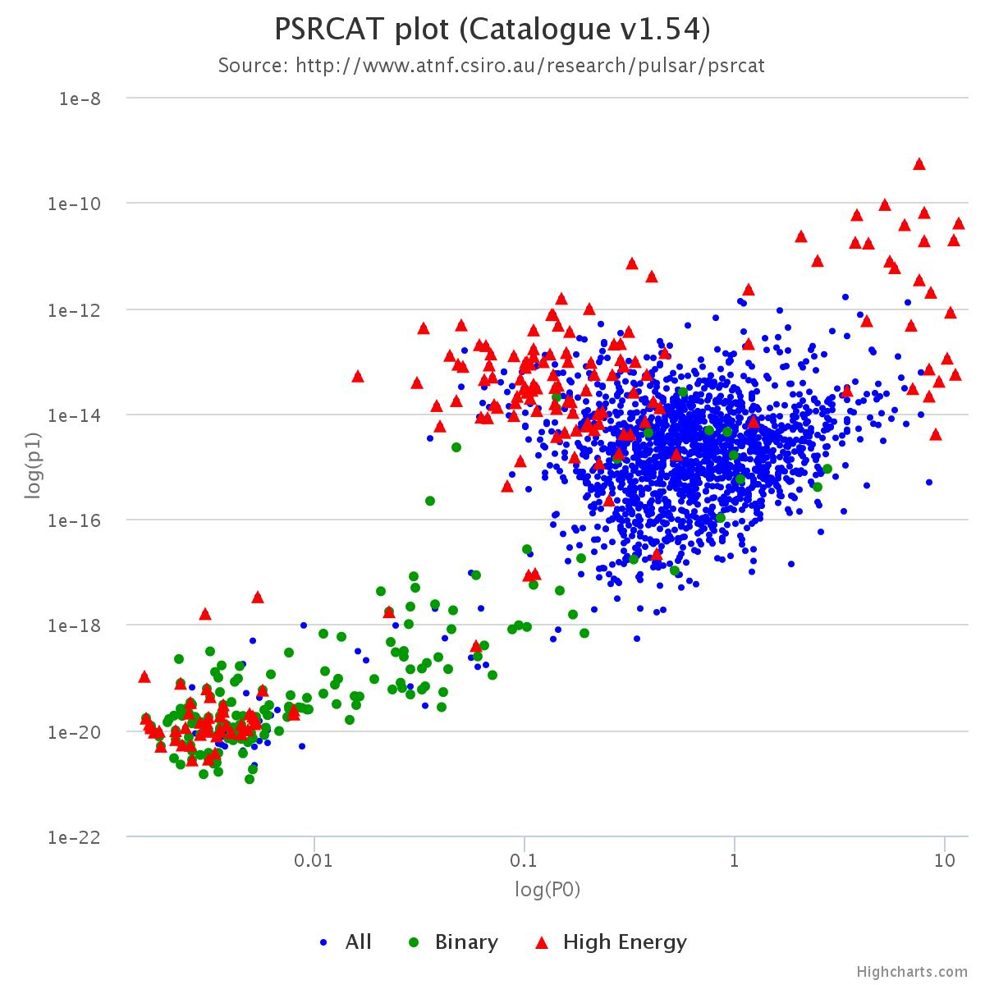
Pulsar population & GW detection
Known radio pulsars ~ 2500
Three main classes of radio pulsars
Normal pulsars
P ~ 1 s
B ~ 10¹² G
Magnetars
P ~ 2 to 11 s
B ~ 10¹⁴ G
Millisecond pulsars (MSPs)
P ~ 10 ms
B ~ 10⁹ G
Lower magnetic field implies a more stable rotation - excellent clocks
Exception – MSP in relativistic binaries
Exception – distant MSPs as pulsed signal is affected by propagation effects in the inter-stellar medium
Nearby MSPs (non-relativistic if in a binary system) are preferred for GW detection
Magnetars
Normal Pulsars
Millisecond Pulsars (MSP)

Slide 6
Introduction to pulsar timing
GW detection involves precision measurements of rotational parameters
Keeping track of the rotation cycles of the pulsar enables improving the precision of measurement as a function of time – pulsar timing
δν = δφ / T
T ~ 1 year = 3 x 10⁷ s ➔ 1 part 1000 measurement of phase error gives 1 part in 10¹² precision in measurement of rotational frequency (picoseconds)
Thus, pulsar timing compares prediction of pulse time-of-arrival (TOA) from a rotational model of star with that of observed TOA to refine the model

Slide 7
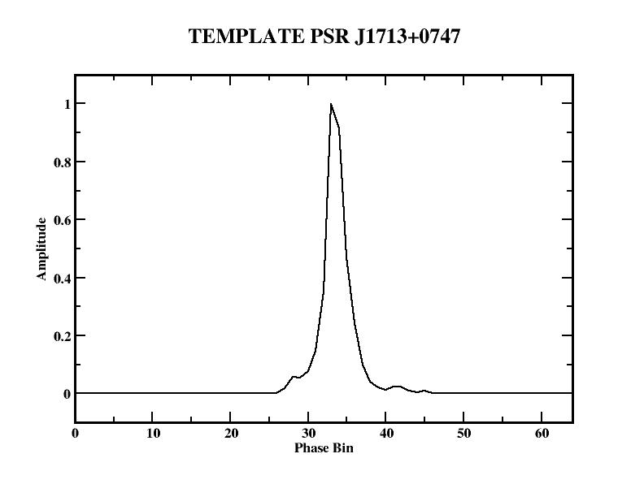
Pulsar timing - II
Pulsar Profiles - Average Pulse
Pulsars are weak radio sources - typical flux density 10 mJy (10⁻²⁸ W/m²/Hz)
With 5 to 6 order of magnitude larger background noise, single pulses are detectable for a handful of pulsars only
Pulsed emission is averaged, modulo pulse period, over several thousand pulses to obtain a stable integrated pulse profile
Pulse Time of Arrival ( TOA )
TOAs are obtained by cross-correlating a Noise Free template, s(t), to average profile, p(t), where
p(t) = a * s( t – t_{f} ) + n
Cross correlation is done in Fourier Domain to determine t_{f} independent of bin size in time (Taylor, 1992. Phil. Trans. Roy. Soc., 341,117)
Time (upto a few ns precision ) at the middle of observations, as determined from the local observatory atomic clock, usually a Hydrogen Maser, is adjusted by t_{f} to get TOA

Slide 8
Pulsar Timing Recipe
Assign Time of Arrival (TOA) to a fiducial point on integrated profile
Observable at a radio telescope like Ooty Radio Telescope or GMRT
Correct TOAs to SSB - perturbations on rotation frequency from solar system, inter-stellar medium, gravitational potential (galaxy or cluster) and a companion in case of a binary
t_{SSB} = t_{topo} + t_{clock} – D/f² + Δ_{R} + Δ_{S +} Δ_{E}
Assume a model of pulsar rotation ( t = t_{SSB})
ν(t) = ν₀ + ν_{dot}(t-t₀) + ½ ν_{ddot}( t – t₀)²
Calculate pulse number from the above two relations
N = ν * ( t – t₁)
The integral part is a prediction of period number of the pulse from t₁
The fractional part should be zero for a prediction matching the data
The timing residual = fractional part = difference between the observed and predicted TOAs
Minimize the timing residual in a least square sense counting each pulse

Slide 9
Model Parameters
Pulsar Timing technique allows high precision determination of
Pulsar spin period and its higher order derivatives
Position and proper motion
Parallax
Dispersion delay
Binary Keplerian parameters
Orbital period
Orbital separation
Component masses
Binary post Keplerian parameters
Advance of periastron
Orbital period decay
Gravitational redshift
Range and shape of Shapiro delay
Miscellaneous
Solar wind, ephemeris for solar system bodies, tie with absolute ICRF system
Discovery of new effects
A good model implies “white noise” like timing residuals
Systematics in timing noise indicate un-modeled parameters – timing noise, GW
GW appears as a systemic effect in timing residuals

Slide 10
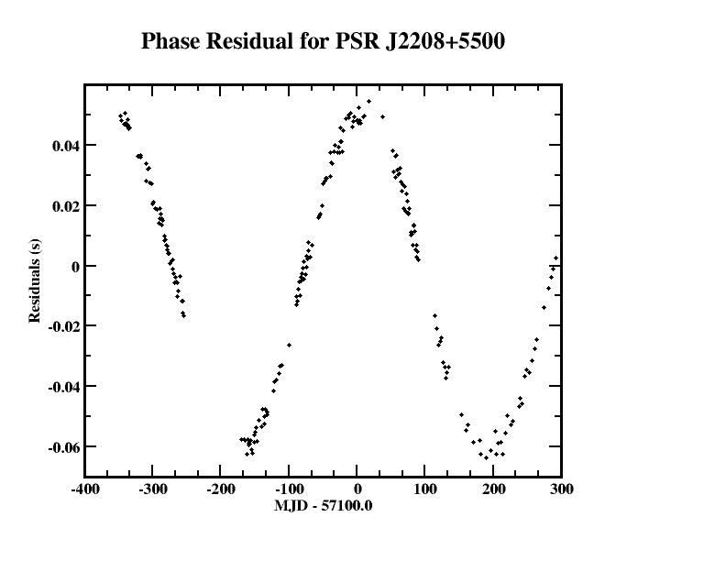
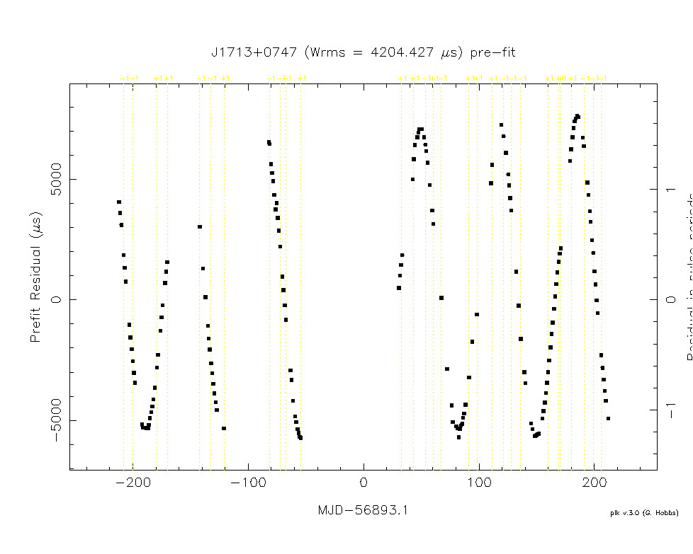
Pulsar Timing in action
Determining position of GMRT discovery pulsar – PSR J2208+5500
(Joshi et al. 2009, MNRAS, 398, 943; Surnis, Joshi et al. 2017 submitted)
68 day Orbital period
PSR J1713+0747
observed at ORT

Slide 11
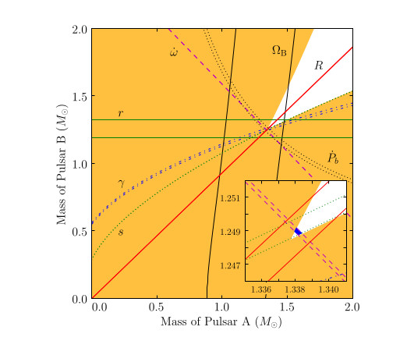
Pulsar Timing – a precision measurement tool
Double pulsar (PSR J0737-3039A & B)
(Burgay …Joshi.. et al. 2003,Nature,426,531;
Lyne..Joshi… et al. 2004, Science, 303,1153)
Only system with both NS observed as radio pulsars
Tight (2.5 hr) edge on orbit
Both NS were seen as pulsars
Two clocks going round each other
Two pulsars come closer to each other every day by 7.152 (0.008) mm !!
> 0.05 % tests of GTR possible
(Kramer et al. 2006; Kramer et al. in prep)
Pulsar timing could be very handy for detection of GWs
Kramer et al. 2006

Slide 12
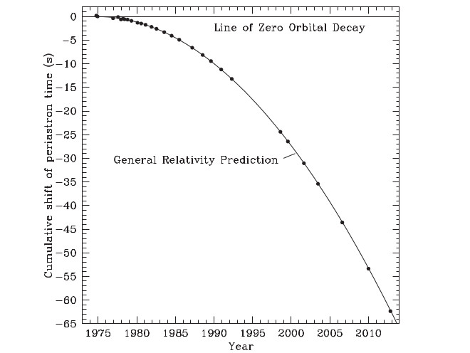
Gravitational Waves
Gravitational Waves were unique distinguishing feature of General theory of Relativity, when it was proposed by Einstein (Einstein, “About Gravitational Waves”, RPAS, 1918, 154)
Indirect detection of Gravitational Waves (GW) was first reported by Hulse & Taylor in double neutron star binary (DNS) - PSR B1913+16
Rate of loss of energy from the binary system is exactly matched with the expected loss due to GW radiation from this system over more than 40 years
Since then this effect is reported in 9 DNS systems
Weisberg & Huang 2016

Slide 13
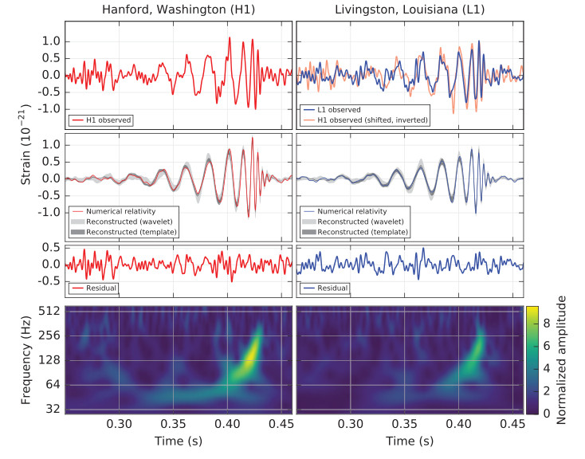
Direct detection of GWs
30 and 35 M_{o}
Abbott et al. 2016, PRL, 116, 0611002

Slide 14
Sources of GWs - I
Typical candidate sources
White Dwarf – White Dwarf binaries
Neutron Star – White Dwarf binaries - several systems discovered so far
Neutron Star – Neutron Star - Double Pulsar
Neutron Star – Black hole - Not Yet Discovered !!!!
Black hole – Black hole - ALIGO Discoveries
Supermassive Black Hole binary systems - of interest to PTAs
Other sources – EMRI, inflation, SNR etc
Searches are on - Parkes / GBT / Effelsberg/ ALMA / GMRT / upgraded GMRT
Many of these with a radio pulsar are also good laboratories for tests of alternative gravity theories
Strong field tests, radiative tests, tests for violation of SEP, GW dipole radiation (Burgay …Joshi.. et al. 2003; Lyne..Joshi… et al. 2004, Kramer et al. 2006; Kramer et al. in prep, Ransom et al. 2014, Will et al. 2014, Kennea et al. 2013, Perera et al. 2017)

Slide 15
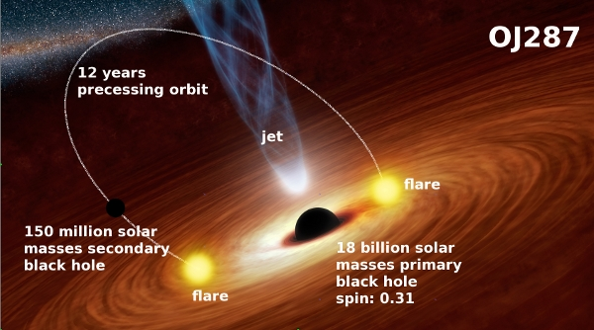
Sources of GWs - II
Ultra-low frequency persistent GW in the frequency range of nano-Hertz are produced by a binary with two supermassive black hole (SMBHB – 100 million to 1 billion M_{o})
Such binaries can exist in the center of a galaxy formed by merger of two galaxies, e.g., OJ 287 (See recent papers by Mauri, Gopakumar 2010,2011, 2016)
Typical orbital periods of many years implying frequency of nano-Hertz (wavelength of few parsecs ~10¹⁷ m) & integration time ~ years
Superposition of GW from many such sources forms an isotropic stochastic Gravitational Wave background (SGWB)

Slide 16
Sources of GWs - III
Types of GW sources
Continuous persistent GW sources
Spinning compact stars
Compact binaries
Cosmological origin
Transient sources
merger of binary systems with compact objects
Backgrounds
This zoo will produce GW in frequency ranges spanning 14 orders
Different GW experiments ( terrestrial, space, pulsars - ALIGO, LISA, PTA) sensitive to different bands and are complimentary to each other

Slide 17
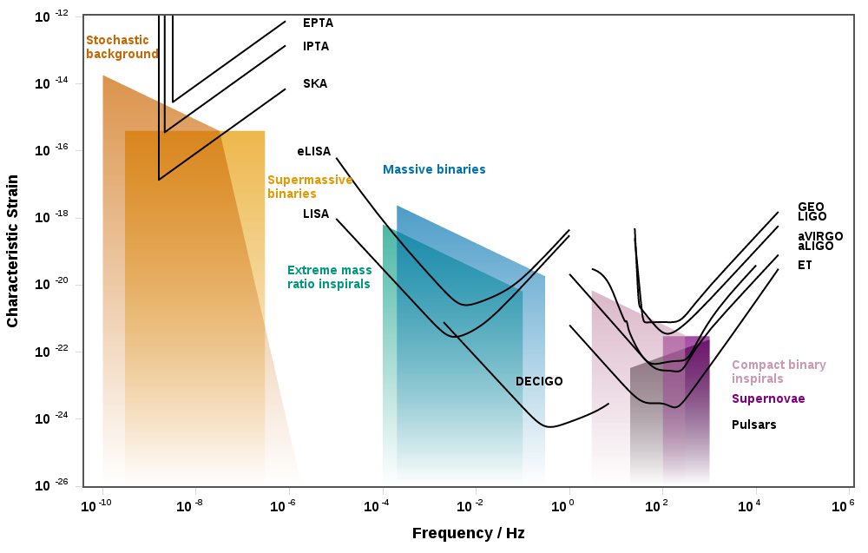
GW spectrum and instruments

Slide 18
Even bigger GW Detector - PTA
Frequency of GW radiated by super-massive black hole binary systems (SMBH) fall in the frequency range of nano-hertz
Detector sensitive to such frequency need to integrate signal over duration of years and need to have arm – lengths of the order of parsecs (Joshi 2013, IJMPD, 22, 1341008)
Pulsar Timing Array (PTA) provide such a detector with passive observations of an ensemble of pulsars
Experiments, using radio pulsars as gravitational wave detectors, are called Pulsar Timing Arrays
PTAs complement other experiments (ALIGO, LISA, Cosmological)
Frequency range
Spectrum

Slide 19
Pulsar Timing Arrays
Apparent frequency of pulsar clock varies due to perturbation in metric by a passing GW – imprinted on timing residuals and correlated across an ensemble of pulsars
Historical perspective
Detection of stochastic gravitational wave background (SGWB) first proposed considering 5-year timing residuals of long period PSRs B1919+21, B1933+16 & B2016+28 (Sazhin 1978; Detweiler 1979)
Limits from slow pulsars ~ 0.01 % of closure/critical density
4 pulsars - DSN antennas (Hellings & Downs 1983)
PSR B1237+25 (Romani & Taylor 1983)
Discovery of millisecond pulsars(MSP) - short P, low B (Backer et al. 1982)
Better clocks, higher precision time of arrivals (TOAs)
Interesting limits from MSP (Foster & Backer 1990; Kaspi et al. 1994)
Challenges - errors due to ephmeris, DM variations, red noise
Use of a pair or ensemble for better sensitivity to SGWB, also individual sources (Detweiler 1978; Hellings & Downs 1983, Foster & Backer 1990)
Parkes PTA (PPTA), North American Nano-hertz Observatory for Gravitational Waves (nanograv), European PTA (EPTA) - IPTA

Slide 20
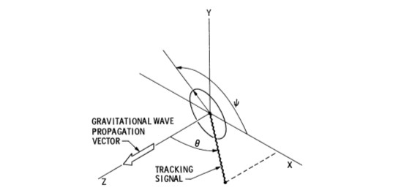
Pulsars as GW telescope
GW signature in residuals
GWs are solutions of weak-field linearized Einstein’s field equations
Perturbations in flat space time
Retard/advance travel time of EM radiation from pulsars
Changes in travel time with time contributes to residuals
Fractional frequency change
δν/ν = 0.5 cos 2ψ ( 1 − cos θ ) [h(t) – h(t – d/c – d cos θ/c)]
Information about amplitude at two time and space coordinates - reception (earth) & emission (pulsar)

Slide 21
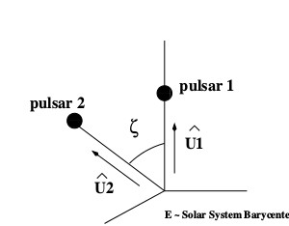
Response of PTA
Principle of detection of SGWB
PTA is formed by measuring δν/ν over an ensemble of pulsars
Emission (pulsar) term will be uncorrelated over the ensemble
Reception (earth) term will be correlated
ρ(ζ) = (1−cos(ζ))/2 ∗ ln[(1−cos(ζ)/2] - 1/6 ∗ (1−cos(ζ))/2 + 1/3

Slide 22
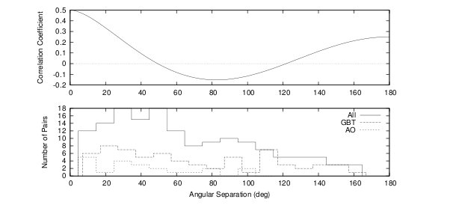
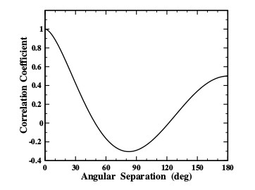
“Antenna pattern” of PTA
PTA attempts to measure correlations in the fractional frequency change across pairs of pulsars in the ensemble of pulsars
Response or “antenna pattern” of PTA
SGWB excites the full “antenna pattern”, while individual SMBHB sources excite a part of the pattern
( Hellings & Downs 1983; Backer & Demorest 2008; Joshi 2013)

Slide 23
Design of PTA - I
The aim of PTAs is to detect Hellings-Down correlation
Accordingly, a good PTA requires
Pulsars with exceptionally high rotational stability
A reasonable distribution of pulsars mimicking the pair-wise angular separation
Pulsars with high signal to noise ratio pulsed emission
Pulsars with stable light curves
Pulsars on line of sites without unusual ISM structures
Absence complicates timing precision and efficacy of PTA
Sample for PTA is small even though 2500 pulsars are known todate

Slide 24
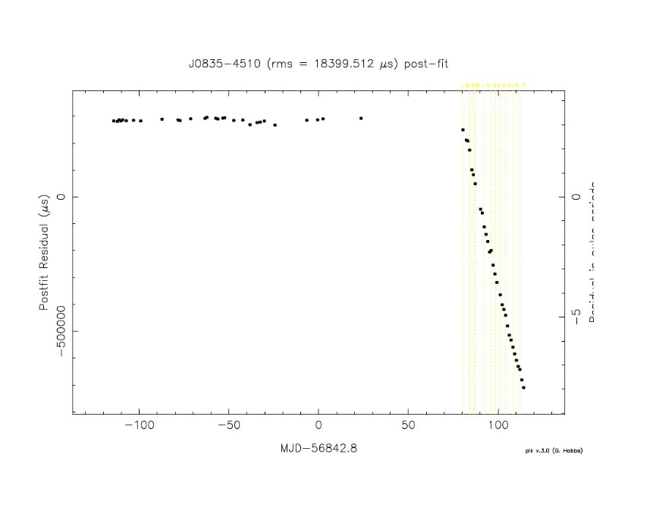
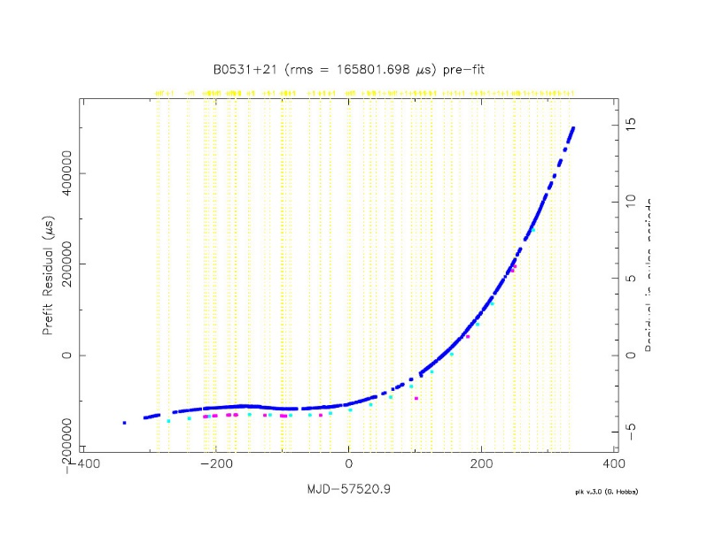
Design of PTA - Challenges - II
Factors affecting the sensitivity of a PTA
Rotational irregularities - pulsar glitches and timing noise (“red noise”)
Propagation effects - variation in Dispersion smear, scintillation and scatter-broadening
Emission jitter
Vela glitch(ORT) Dec 12, 2016 3 Years of Crab monitoring at ORT

Slide 25
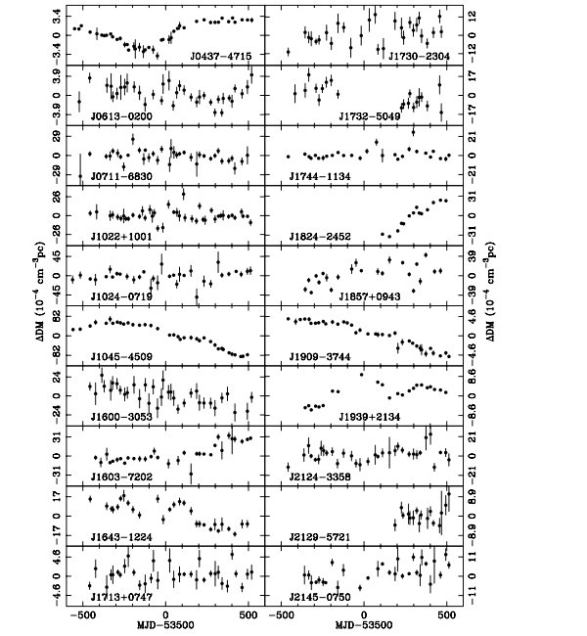
Design of PTA - Challenges - III
Measuring variation in dispersive smear is very important for PTAs and these were measured for the first time in last decade as a side-product of PTA experiments . (You et al. 2007)
This requires frequent two frequency near simultaneous observations
GMRT at 1400 MHz
ORT at 326.5 MHz
TIFR’s facilities can play a major role

Slide 26
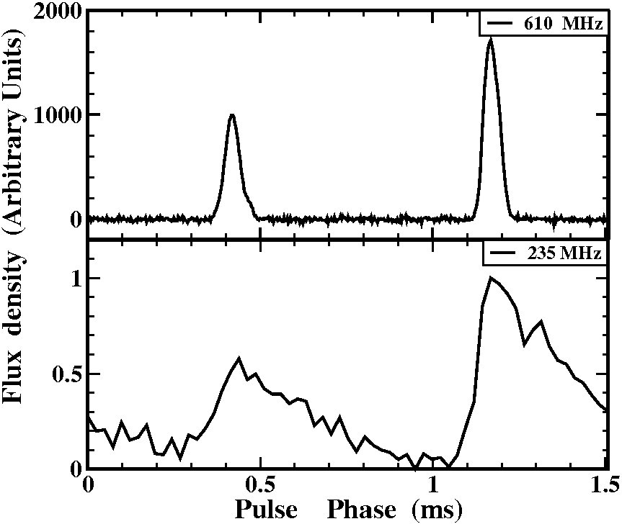
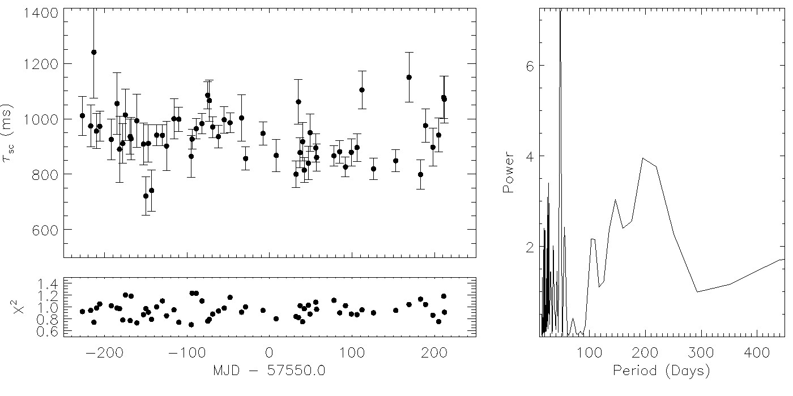
Design of PTA - Challenges - IV
Interstellar scatter-broadening
Broadens the pulse
Systematic delay in TOA
Shannon et al. 2016 Joshi & Ramakrishna 2006
PSR J1642-1224
Variations in
pulse broadening
seen at ORT

Slide 27
Design of PTA - Noise Budgets
Courtsey Cordes & McLaughlin
IPTA Science Meeting 25 June 2012
Notes:
What’s correctable and what’s not? Orbital not. Scintillation yes. Scattering maybe. Delphine Perrodin will describe an cross-correlation method for characterizing timing noise.

Slide 28
Design of PTA - V
Only 3 out of 50 MSPs usable MSPs are good clock and contrinute effectively to existing PTAs
Searches with Fermi directed MSPs and large radio telescope are on and are planned with SKA with a hope to increase this sample to about 300 MSPs with 50 good “White” clocks (Large scale pulsar surveys with instrument such as upgraded GMRT are very important)
Even then it will take 4 to 5 years post survey to characterize the newly discovered clocks (Large scale pulsar timing programs with upgraded GMRT, LOFAR, MeerKAT and SKA-Phase-I are very important)

Slide 29
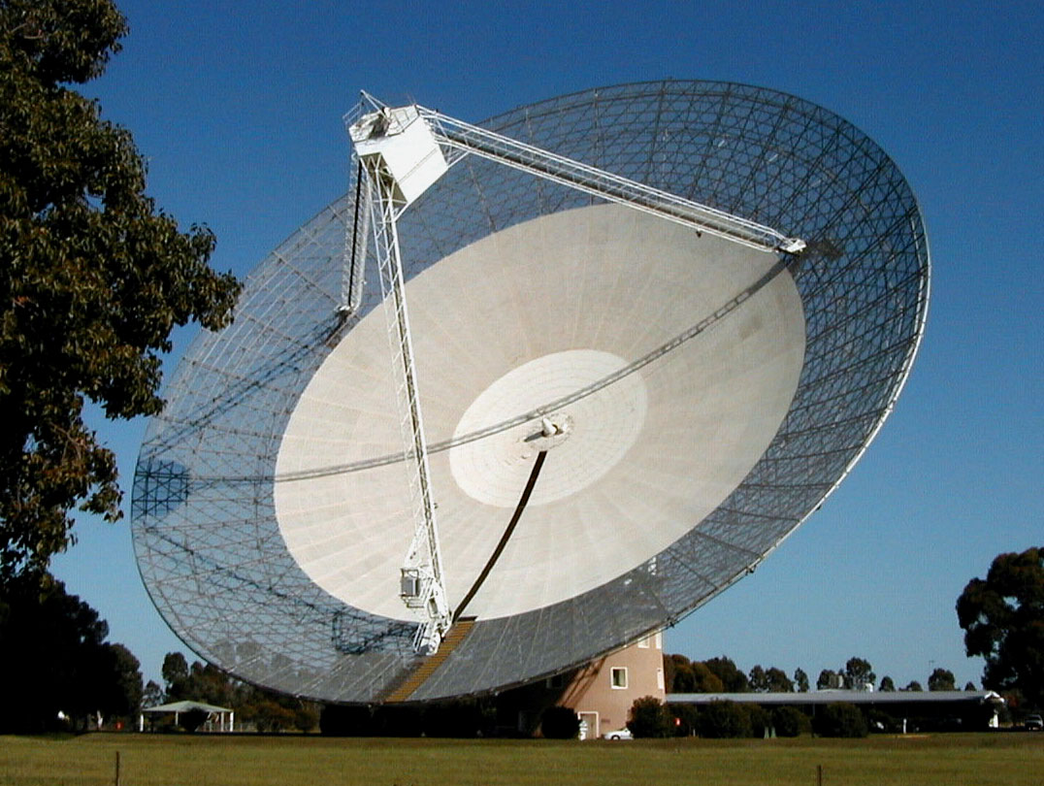
Parkes Pulsar Timing Array (PPTA)
PPTA uses the Parkes 64-m
20 MSPs are timed every 2-3 weeks at 10, 20 and 70 cm wavelength Australia Telescope National Facility, CSIRO, Sydney

Slide 30
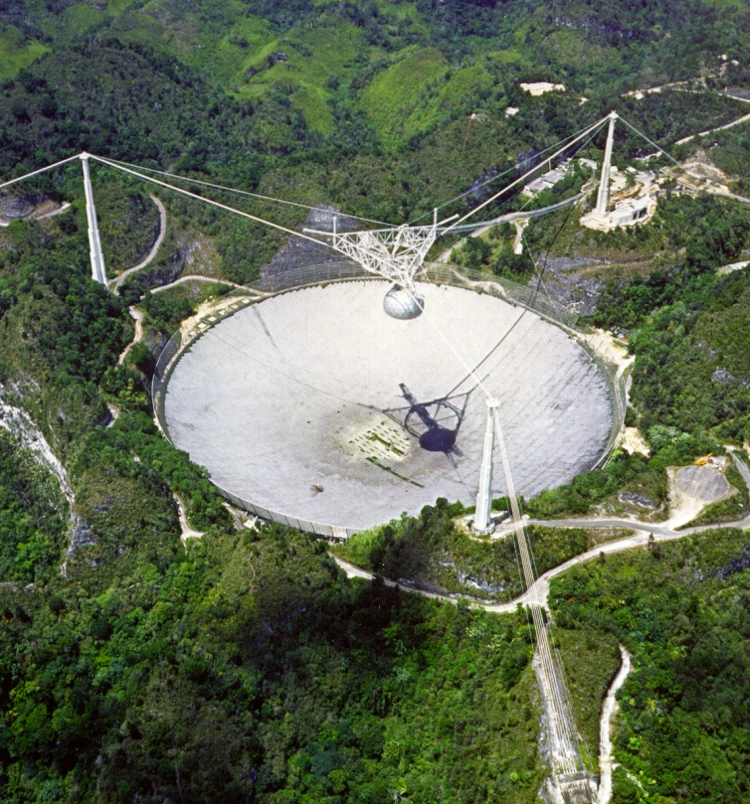
North American Nanohertz Observatory for Gravitational Waves (NANOGrav)
NANOGrav uses Arecibo and Green Bank Telescope
35 pulsar are timed every 20 days at 2 GHz and 325 MHz
West Virginia University

Slide 31
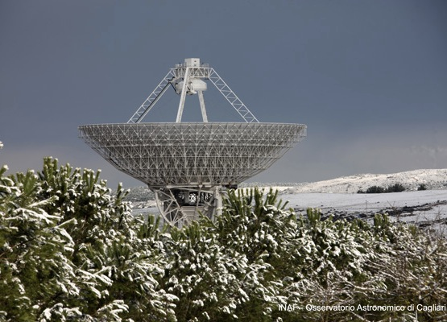
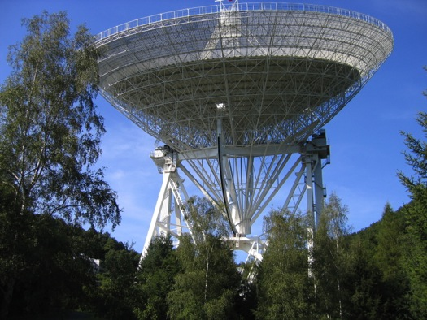
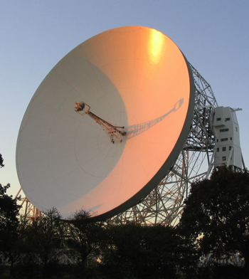
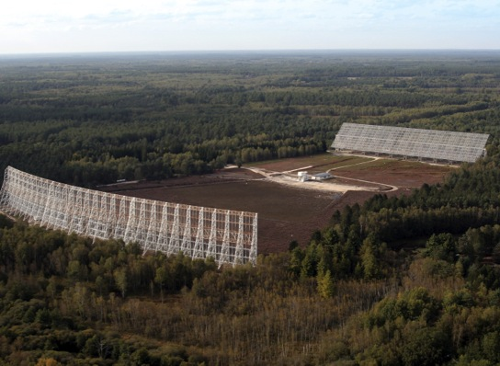
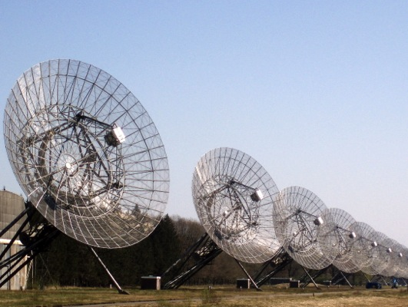
The European Pulsar Timing Array (EPTA)
SRT, Sardinia, Italy
Lovell, Jodrell Bank,
UK
Effelsberg 100-m, Germany
Plus theory:
NRT, Nancay, France
WSRT, Westerbork, NL

Slide 32
GWs for PTA - I
There are three most likely classes of GW sources, detectable by a PTA
Isotropic Stochastic Gravitational Wave Background (SGWB)
Gravitational Waves from individual super-massive black hole binaries (SMBHB)
Gravitational burst sources with “memory”
SGWB
SGWB is generated by an incoherent superposition of GW emitted by whole cosmic population of SMBHB system during its lifetime of 10⁶ years, with a random placement of such systems.
The strain spectrum for SGWB is given by
h(f) = A * (f / 1 yr)-^{2/3}
(Phinney 2001; Jaffe & Backer 2003)

Slide 33
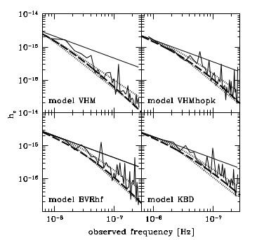
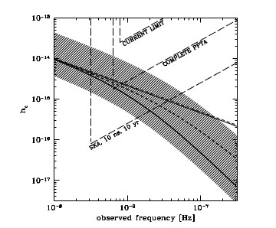
GW for PTA - II
The spectrum depends on model of hierarchical assembly, such as
Assuming large abundance of light seed BH (100 M₀) (Volonteri et al. 2003)
Same as (a) but with modified rate of accretion (Volonteri et al. 2006)
Assuming large abundance of massive BH (10000 M₀) (Koushiappas et al. 2004)
Assuming few massive BH (10000 M₀) (Begelman et al. 2006)
Sesana et al. 2008
Key assumption here is all SMBHB reach last parsec for GW driven evolution, but this may not be true
“Stalled” last mile problem gives a much lower SGWB

Slide 34
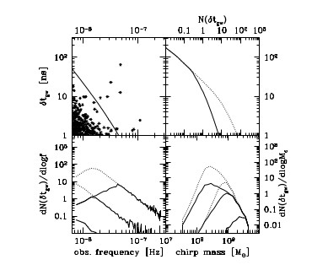
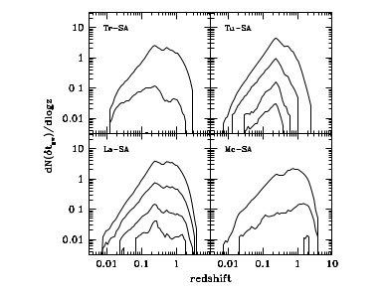
GWs for PTA - III
Are their individual SMBHB which can outshine SGWB in PTA range ?
Masses of SMBH in merging galaxies estimated from scaling relations obtained from catalogue of merging galaxies (Bertone et al. 2007)
MC simulations with 12 models involving scaling relations with bulge mass, bulge magnitude, red-shift and dispersion velocity and three different mass accretion mechanism show (Sesana et al. 2009)
Resolvable sources have typical chirp mass > 10⁸ M₀ in 0.2 < z < 1.5
All models predict at least 1 resolved SMBHB at TOA residuals of 1—50 ns
Sesana et al. 2009

Slide 35
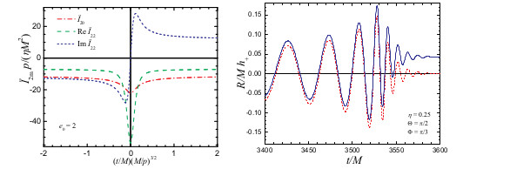
GWs for PTA - IV
GW memory is permanent change in spacetime metric left by a passing GW burst (Zel’Dovich & Polranev 1974;Braginsky & Thorne 1987)
GW memory in coalescing BHB (Blanchet & Damour 1991, Thorne 1991)
Less likely to be detected in ALIGO, but potential detection possible in LISA and PTA
Favta 2010
A PTA will detect a burst with memory as a jump in TOA residuals
While jump in one pulsar could be a pulsar glitch, correlated jump in an ensemble is a signature of GW burst with memory

Slide 36
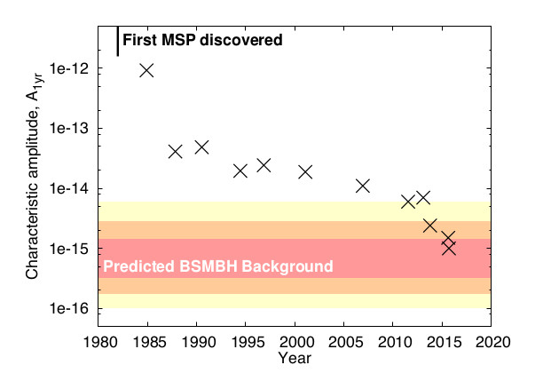
Current status of IPTA - I
Burke-Spoloar 2015, arXiv:1511.07869

Slide 37
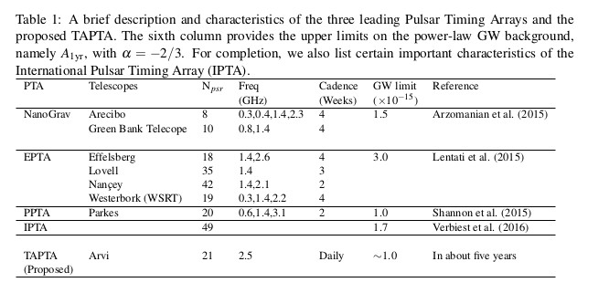
Current status of IPTA - II
Verbiest et al. 2016, MNRAS, 458, 126

Slide 38
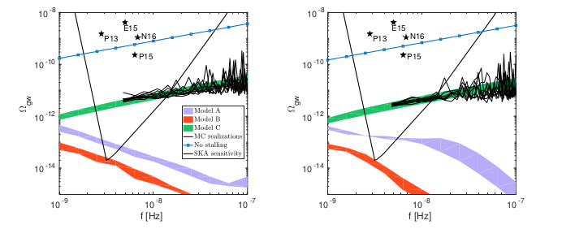
Current status of IPTA - III
Why have we not detected SGWB ?
Evolution of SMBHBs are probably not well understood and more work is needed here
Bias in scaling relation
Increased estimate of SGWB by factor of 2 (William et al. 2014)
reduced SGWB by factor of 3 (Sesana et al. 2016)
“Stalled” evoluttion of SMBHB (Dvorkin & Barausse 2017)

Slide 39
Current status of IPTA - IV
No individual source has been detected so far in search of PTA data
Sensitivity of a 10 year PTA experiment with 20 MSPs towards a GW burst with memory ~ 6 x 10⁻¹⁵ (Haasteren & Levin 2014)
No detection so far but crucially depends on merger rates of SMBHB
Data Setrst | No of pulsars | Limit (10⁻¹⁴) | Reference
5 year Nanograv | 17 | 3 | Arzoumanian et al. 2014
24 hr J1713+0747 | 1 | 1000 | Dolch et al. 2014
Jodrell B1937+21 | 1 | 1530 | Yi et al. 2014
EPTA | 41 | 0.6-1.5 | Babak et al. 2016

Slide 40
LIGO & PTA constrain hybrid inflation?
ALIGO events possibly from merger of primordial black holes ??
Different models of inflation can lead to formation of these PBH (constrained below 30 M₀ by ALIGO events) and lead to tensor perturbation with a spectrum reaching upto the lower end of PTAs
ALIGO discoveries have a potential to provide one constraint on these, while PTAs provide an independent constraint
Orlofsky et al. 2017, PRD, 95, 2017

Slide 41
Indian PTA
Recently, we initiated an experiment with two major Indian facilities
The Ooty Radio Telescope and the Giant Meterwave Radio Telescopes are being used simultaneously since last two years for this experiment
A sample of 9 MSPs is being monitored once every 20 days using the Giant Meterwave Radio Telescopes (GMRT) at 1300 MHz
Apart from simultaneous observations, the same 9 pulsars are also being monitored every 3 days at the Ooty Radio Telescope (ORT) at 334 MHz
ORT high cadence data allows good phase connection
Simultaneous low cadence ORT-GMRT data allows determination of DM variations to fourth decimal place

Slide 42
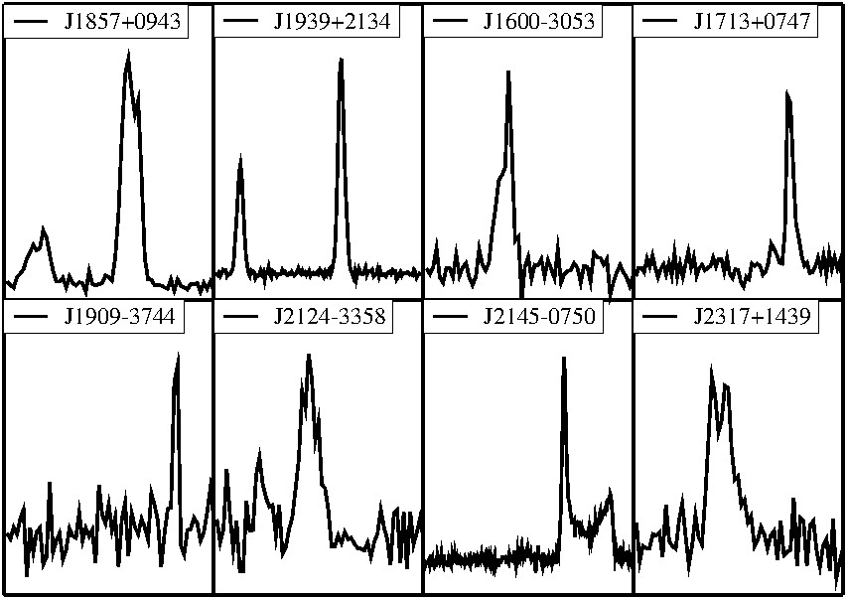
Pulsar sample
Sample of Pulsars
a

Slide 43
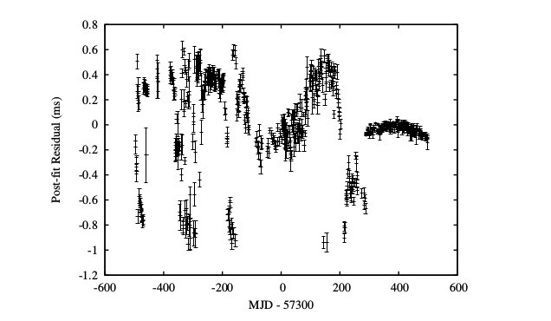
Towards sub-μs residuals
In the initial first year, we are tuning our instrument
From 2014, we first characterized the stability of observatory clock
New H Masers are procured and will soon be under commissioned

Slide 44
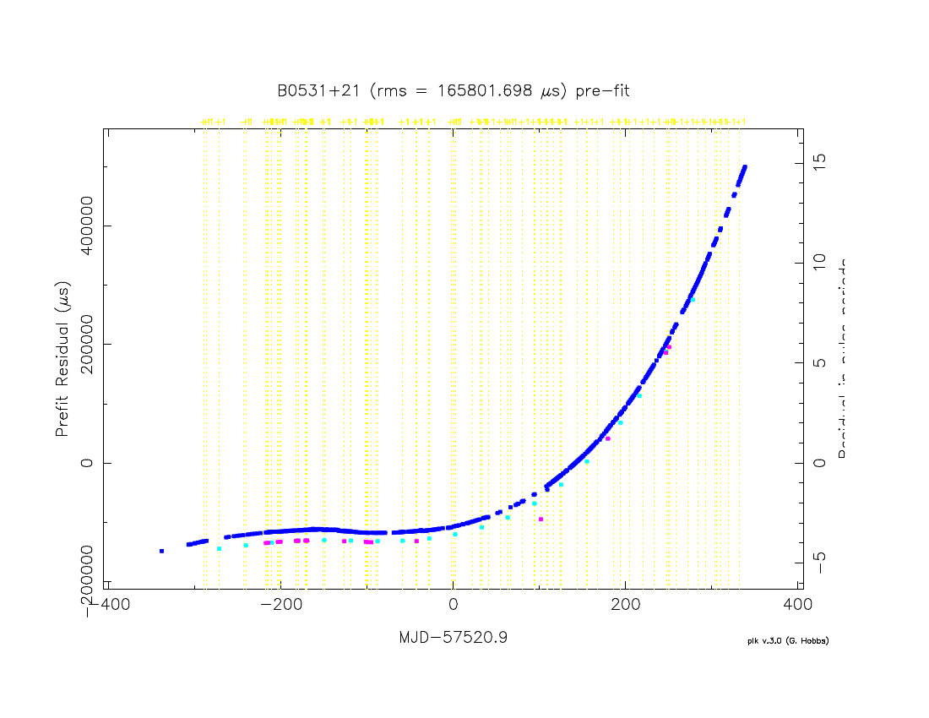
Towards sub-μs residuals
Observatory offsets between ORT, GMRT, Jodrell Bank, ASTROSAT were also measured by continuous and simultaneous monitoring of Crab and 3 other pulsars

Slide 45
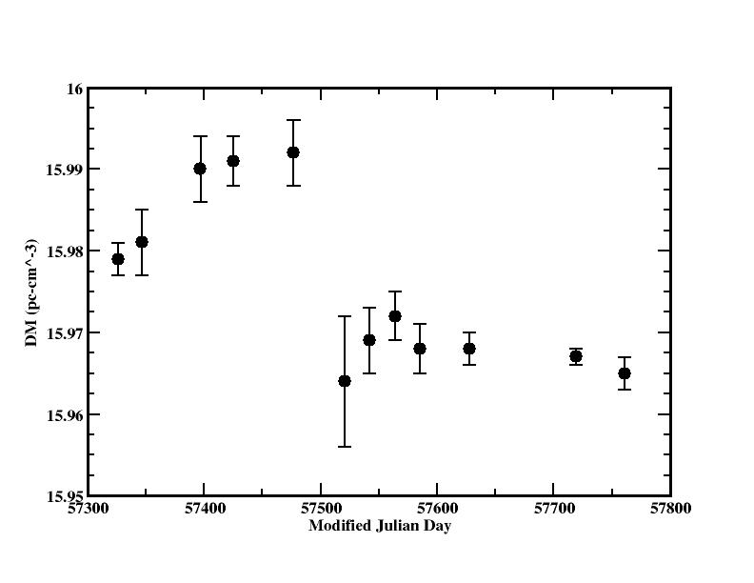
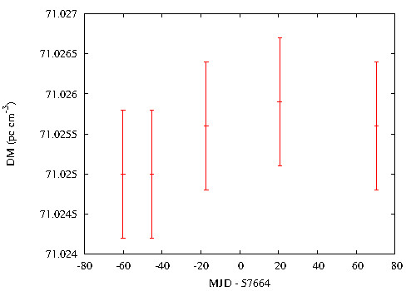
Estimation of variations in dispersion smear
PSR B2937+21 PSR J1713+0747

Slide 46
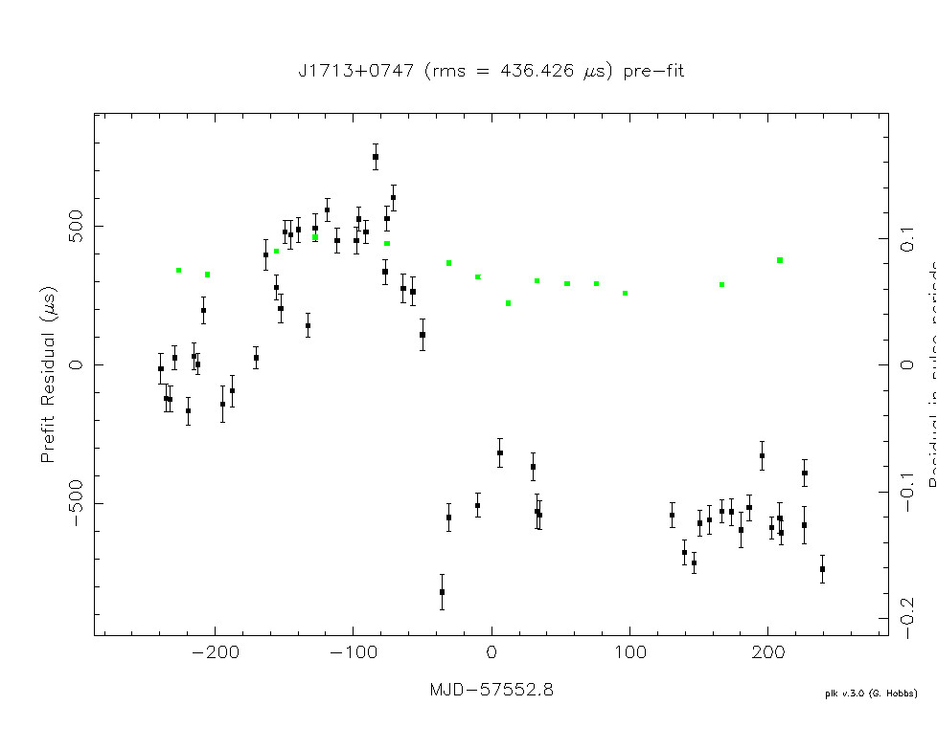
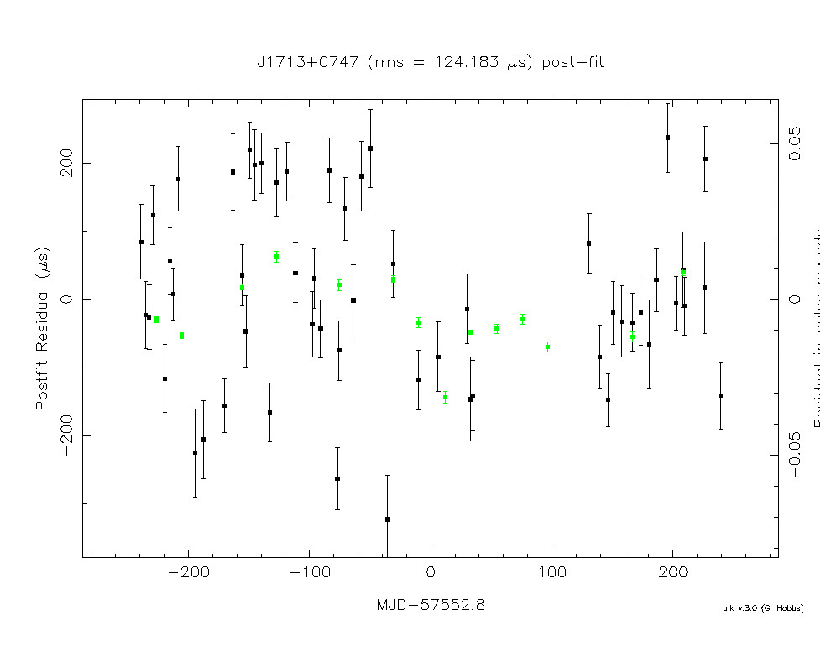
TOA improvements after DM corrections
Before DM corrections After DM corrections

Slide 47
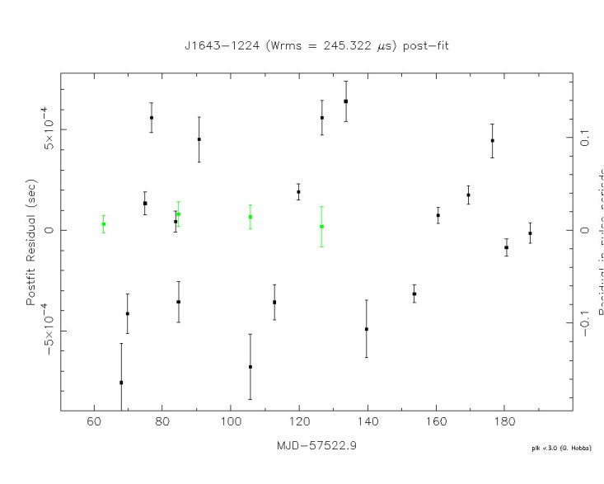
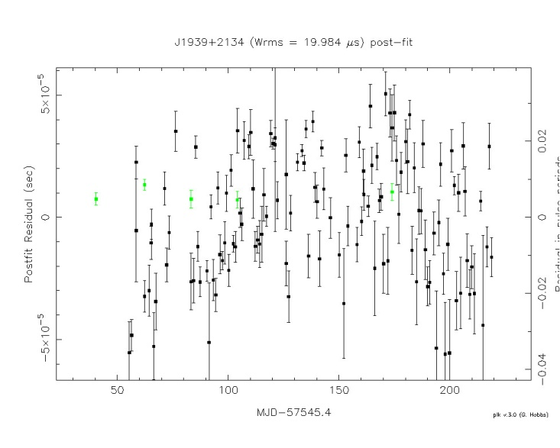
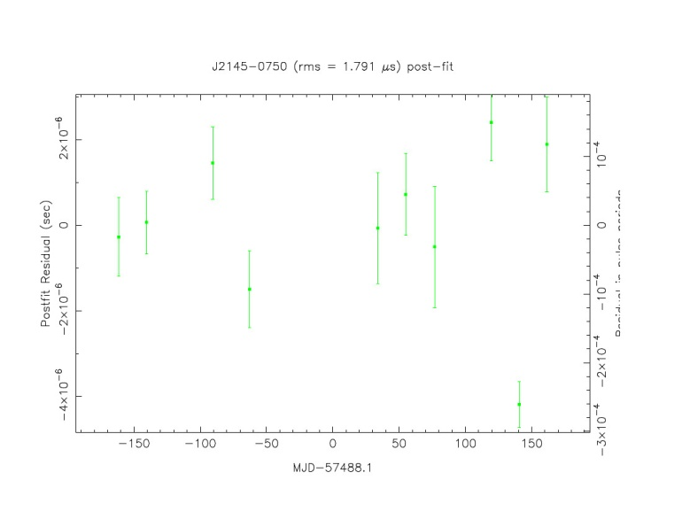
Timing solutions
PSR J1643-1224
PSR J1939+2134
Timing solutions for
three pulsars in our
monitoring program
PSR J2145-0750

Slide 48
InPTA pulsars preliminary measurements
Name of Pulsar | Epochs detected | typical TOA error(μs) | Typical post fit (μs)
J1600-3053 | 17 | 11 | 70
J1643-1224 | 18 | 33 | 245
J1713+0747 | 16 | 4 | 3
J1857+0943 | 16 | 5 | 23
J1909-3744 | 13 | 34 | 55
J1939+2134 | 18 | 2 | 20
J2124-3358 | 12 | 87 | 453
J2145-0750 | 18 | 5 | 2
J2317+1439 | 8 | 91 | 507

Slide 49
Tata Pulsar Timing Array:
A dedicated nano-Hz GW observatory
B C Joshi, A Gopakumar, M Bagchi, S Roy

Slide 50
TAPTA ?
The idea is to use the available three Arvi dishes to create an equivalent 50-meter dish, which will be used to monitor IPTA millisecond pulsars on a daily basis.
This will be the only facility in the world that would make such daily observations of IPTA pulsars for directly detecting nano-Hz gravitational waves
This would allow the TATA Pulsar Timing Array (TAPTA) to reach the sensitivities of existing Pulsar Timing Arrays like PPTA, EPTA and NANOGrav rapidly and complement the international effort of International pulsar timing arrays (IPTA) towards the goal of detecting and studying nano-Hertz GWs

Slide 51
Road ahead
Increase the ensemble
New large scale pulsar surveys begun with upgraded GMRT and planned with MeerKat / SKA Phase1
MSP sample needs to be quadrupled to get good clocks
Find good clocks
Intense pulsar timing programs to find “good white” clocks
Need telescope time on all major existing and planned facilities
More dedicated TAPTA like instruments needed
Better modeling of SGWB
Formation and evolutionary models of galaxy merger, SMBH merger rates
PTAs are already constraining hierarchical structure formation models and joint constraints with LISA will be very useful
Important for GW community at large as well
Analysis of IPTA data sets
Improve interoperability and share data
Analysis for search of individual sources
Analysis for search of burst with memory

Slide 52
Summary
Clocklike stability of radio pulsars make them useful astronomy tools in experiments to test gravity theories and detecting GW
Pulsar timing Array (PTA) is an experiment to detect nano-Hertz GW originating in SMBHB
PTA seek to detect SGWB as well as individual continuous wave SMBH sources and burst sources with memory
Three experiments – PPTA, nanoGRAV and EPTA are operational sharing their data in an international collaboration called International Pulsar Timing Array (IPTA) and have reached upper limits on h of 10⁻¹⁵ (energy density of 10⁻¹⁰ ) although no detections of either SGWB or individual sources have been made
TIFR’s facilities – ORT and GMRT can make and are making contributions to this effort in the form of Indian Pulsar Timing Array experiment (InPTA). In the initial phase, we have eliminated instrumental systematics and obtained post-fit solution ~ 1 μs, just factor of 5—10 larger than international experiments
A new dedicated high cadence PTA facility called TAPTA is proposed

Slide 53
Thank you

Slide 54
IPTA
O

