Slide 1
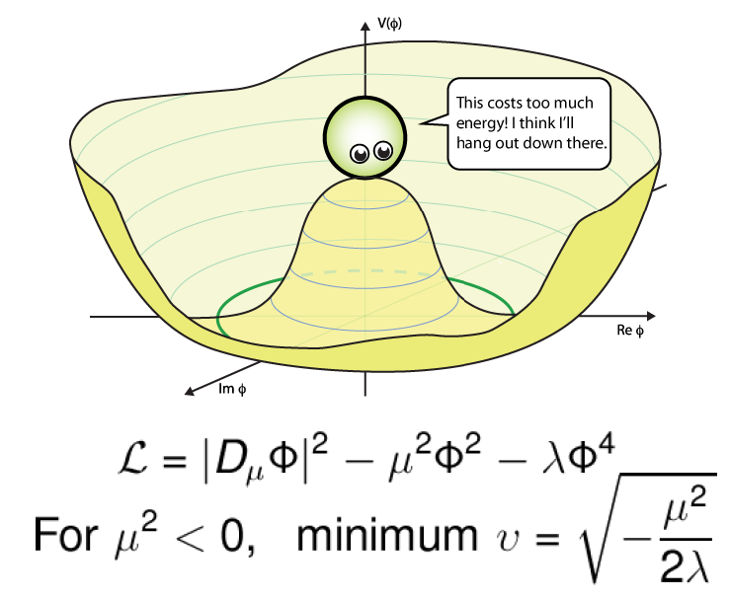
SERC School: SM & Higgs Theory

Slide 2
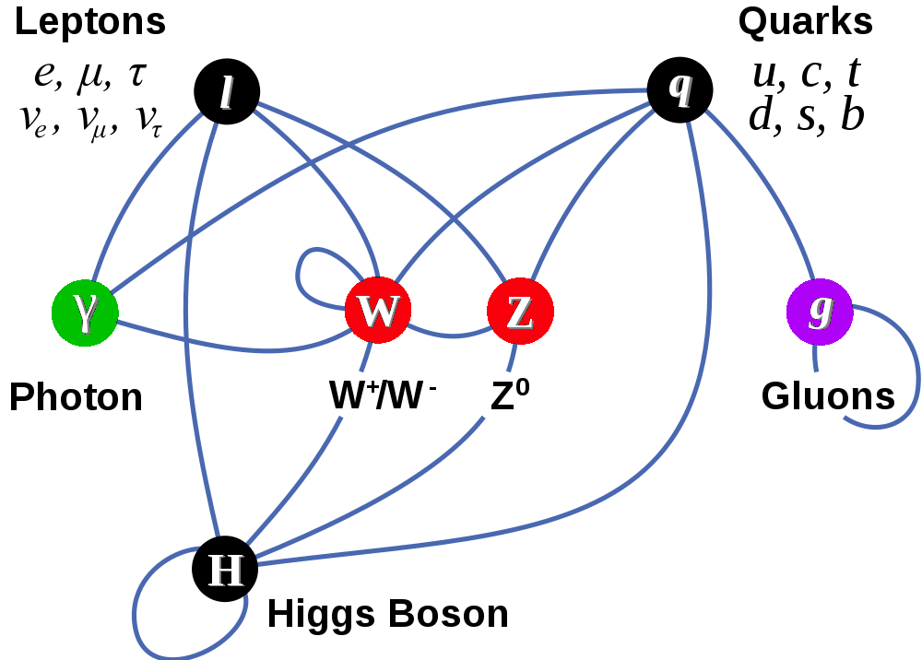
SERC School: SM & Higgs Theory
Matter Particles (fermions)
Interactions by exchange of vector bosons
Scalar boson – remnant of mass giver

Slide 3
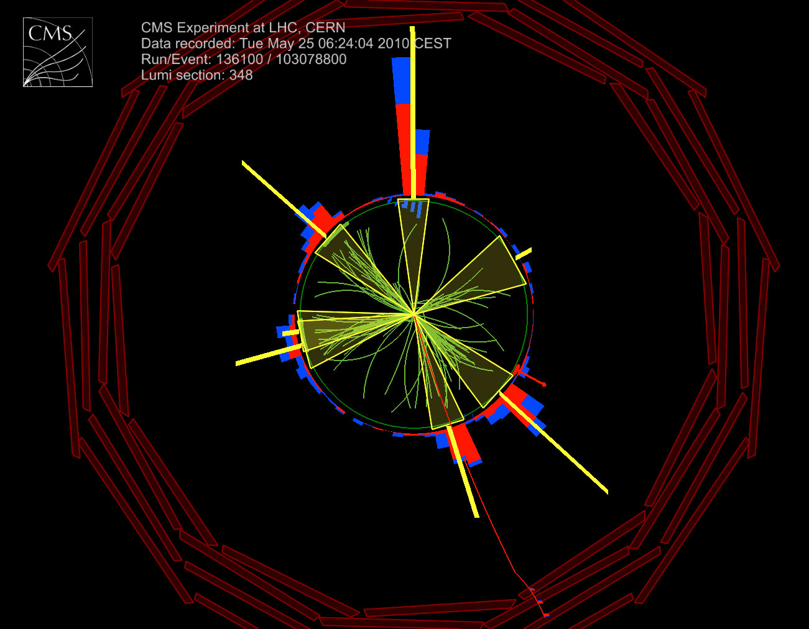
Relativistic Collisions
Particle collisions at very high energies produce many particles, some much more massive than initial particles
Many elementary and composite particles discovered & studied in great detail over the past 50 years
But, the Higgs is Special!
Let’s understand why?

Slide 4
Relativistic Kinematics
Einstein’s famous equation: E = M
The collision energy can manifest as mass!
For particles in motion: E² – P_{x}² – P_{y}² – P_{z}² = M²
Energy-Momentum is conserved in collisions
Speed of light, c = 1
We use a common unit for mass, energy and momentum GeV

Slide 5
Relativistic Quantum World
Quantum Fields permeate all space-time
EM field vibrations → photons (light quanta)
Given sufficient energy matter fields create quanta (particles), that can be long lived or ephemeral
Matter-anti-matter pairs manifest out of vacuum
Particles interact with each other exchanging quanta
Photons, Gluons, W and Z, (graviton)
Works beautifully for massless quanta – QED, QCD
W & Z quanta are massive – decay promptly
Mass terms in lagrangian break gauge invariance

Slide 6
Quantum Field Theory
Describes Elementary Particle Dynamics
All the fifty years of conscious brooding have brought me no closer to the answer to the question, “What are light quanta?” Of course today every rascal thinks he knows the answer, but he is deluding himself.
– Albert Einstein (1951)
Like silicon chips of more recent years, the Feynman diagram was bringing computation [of quantum field theory amplitudes]
to the masses.
– Julian Schwinger

Slide 7
Scalar, Charged Scalar, Spinor & Vector Fields
Quantization of the field coordinates
Promote fields and conjugates to operators
Impose commutation (anti-commutation for Dirac) fields
Normal mode expansion of the fields – non-interacting
Ladder operators
Plane wave solutions with definite momenta

Slide 8
Interactions
Construct out of covariant quantities
Interactions must respect experimental observations

Slide 9
Gauge Transformation

Slide 10
Gauge Principle → Interactions
Global gauge invariance led to conserved current
Demanding local invariance results in interaction!

Slide 11
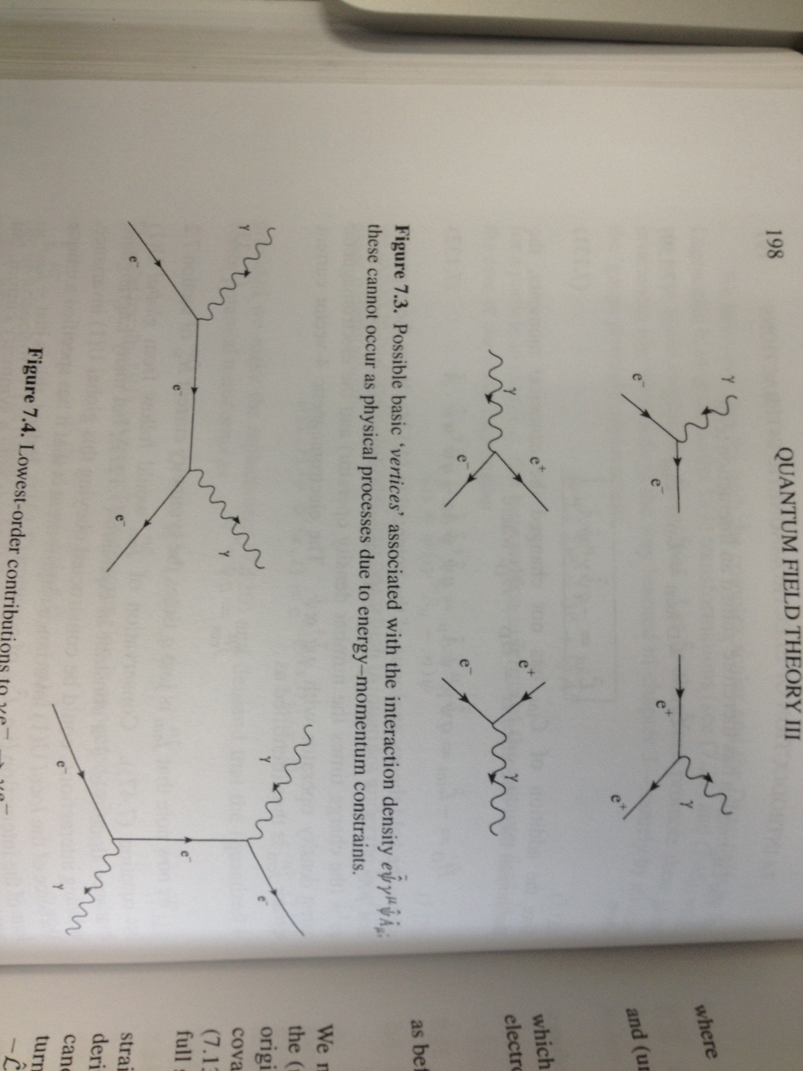
Feynman Rules for QED

Slide 12
Electro-Weak Theory

Slide 13
Four Fermion Interaction
n
p
What interaction can describe this decay?
How about – charged currents?
Discovery of beta+ decays – hermitian conjugate
Works Surprisingly well!
But, not perfectly, both ΔJ=0 and 1 seen
This implied potential other forms of interaction
e–

Slide 14
Pseudoscalars and Axial Vectors
What is the correct interaction?
Weak interactions found to be violating parity

Slide 15
Discovery of Maximal P Violation
Resulted in identification of interaction as V-A!
Universal coupling – same for all leptons
μ
e–

Slide 16
Neutrino – Electron Scattering
μ
e–

Slide 17
Neutral Currents

Slide 18
Intermediate Vector Bosons
Introducing:
→

Slide 19
Quark Weak Isospin Doublets

Slide 20
GIM Mechanism

Slide 21
Weak Neutral Currents

Slide 22
What’s the origin of mass?

Slide 23
Goldstone Model

Slide 24
Spontaneous Symmetry Breaking

Slide 25
Different Degrees of Freedom!

Slide 26
EWK Particle Content

Slide 27
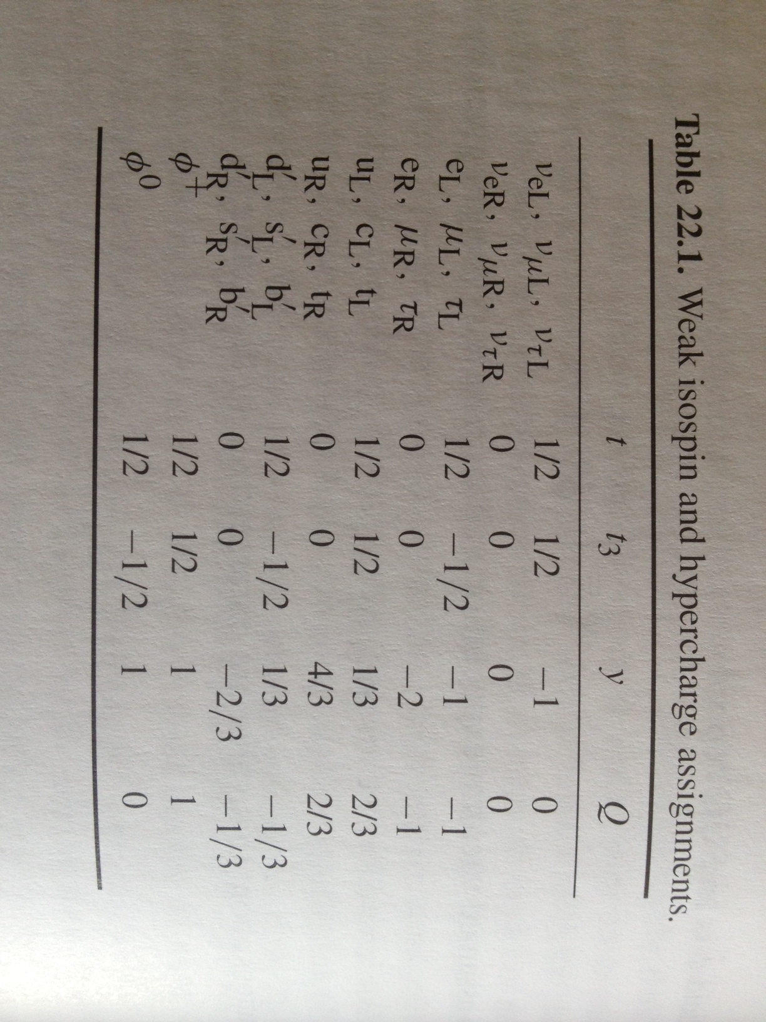
Weak Isospin & Hypercharge

Slide 28
EWK Lagrangian

Slide 29
Spontaneous Symmetry Breaking

Slide 30
Z and Photon

Slide 31
Leptonic Part of L

Slide 32
Quark Part of L

Slide 33
Axial and Vector Couplings

Slide 34
Yukawa Couplings

Slide 35
Electro-Weak Symmetry Breaking
50 years ago, gauge theory unified electro-weak interactions, but could not accommodate non-zero masses for W± & Z
Introduction of a doublet of complex scalar fields with peculiar potential provided masses for W± & Z and left γ massless!
Predicted a remnant scalar particle!
Coupling to Higgs field provides masses to matter particles!!

Slide 36
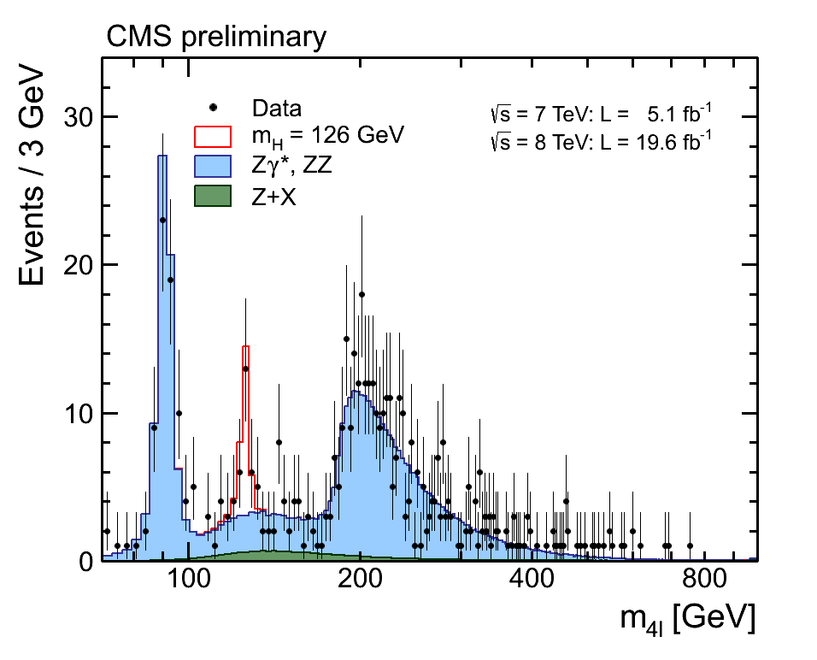
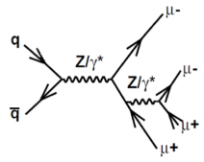
Decays to ZZ to 4-light leptons
CMS HIG-13-002
Cluster of events rising above the background consistent at 4.7σ level with SM Higgs signal
Clearly observe production of Z decay to 4 leptons
125.8 ± 0.5 ± 0.2 GeV
ZZ production for M_{4l} > 2M_{Z}
M_{Z} = 91 GeV

Slide 37
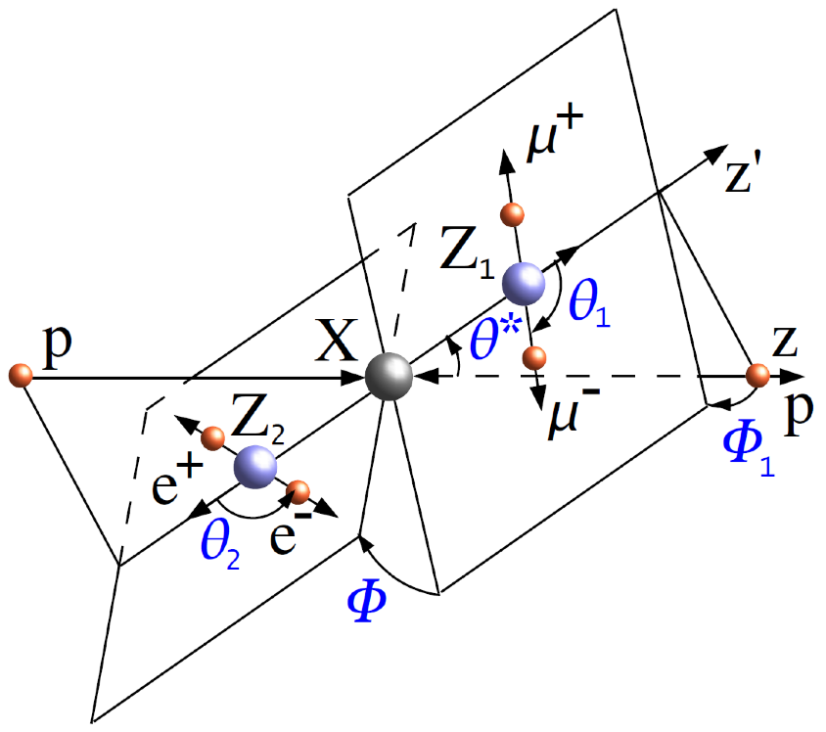
Use Angular Information
Reduce BG further & study additional properties of these events
Angles shown carry information of scalar (SM H), pseudo-scalar vs spin-2 decay versus ZZ production

Slide 38
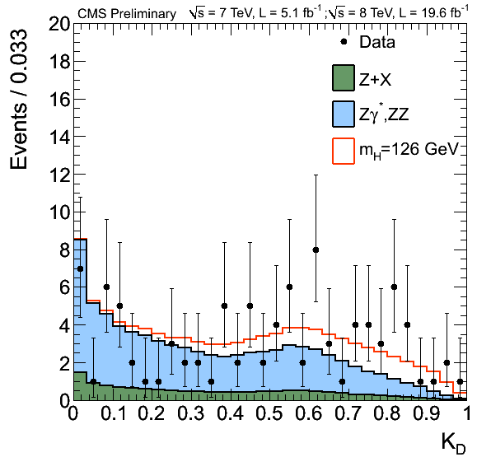
Kinematic Discriminator
CMS HIG-13-002

Slide 39
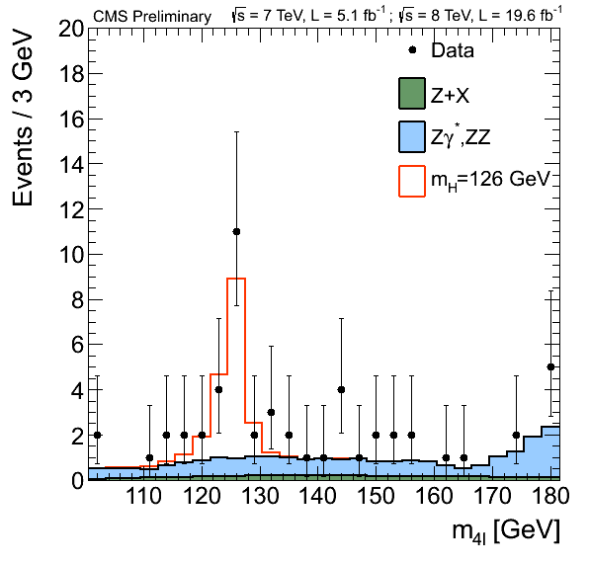
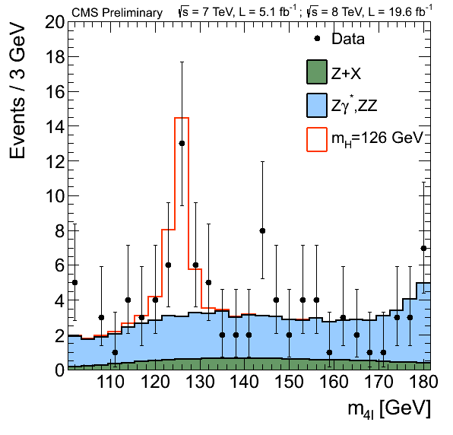
Strong Evidence in decays to ZZ
CMS HIG-13-002
Boost using angular information from 4.7 to 6.7 sigma
Reduce background, while keeping signal-like events
125.8 ± 0.5 ± 0.2 GeV

Slide 40
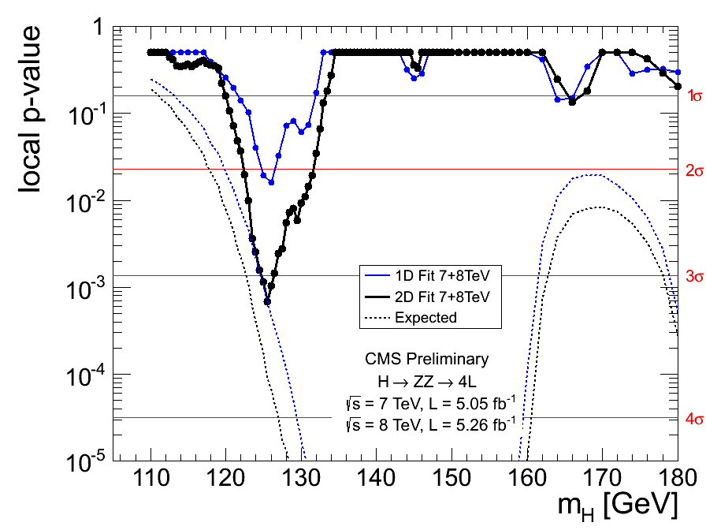
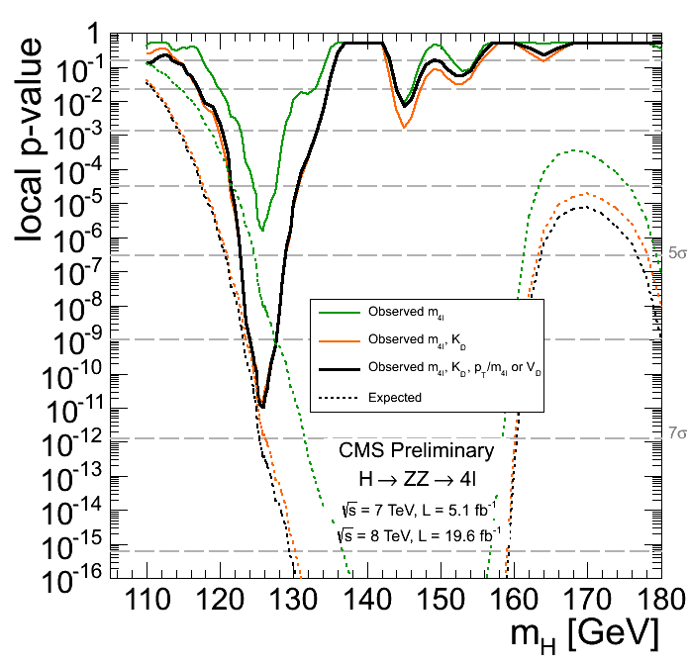
ZZ Signal Strength
CMS HIG-13-002
Adding statistics → Cleaned up nicely
→
ZZ M4L
ZZ M4L & MELA
ZZ M4L
ZZ M4L, KD and P_{T}

Slide 41
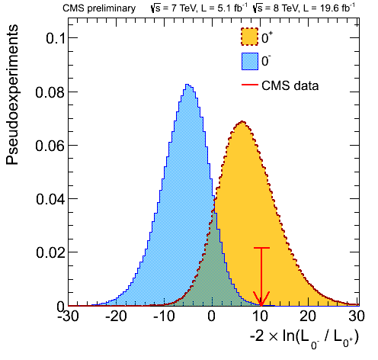
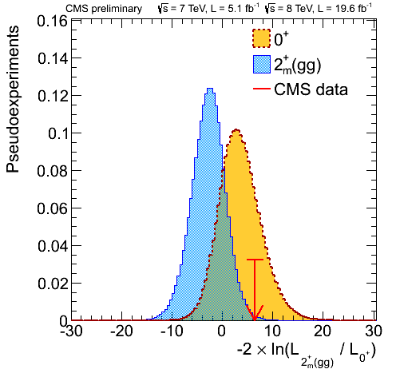
The new boson is scalar like!
CMS HIG-13-002
Angular analysis of ZZ using KDs for 0⁺, 0–, 1 and 2⁺
Disfavors 0– over 0⁺ by CL_{S} value of 0.16% and 2⁺ by 1.5%
Spin 1 disfavored by a lot

Slide 42
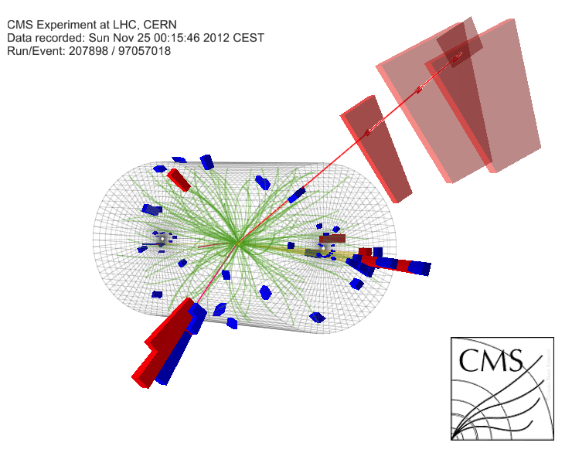
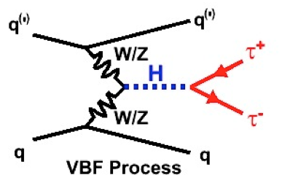
Higgs Decay to Tau Pairs
CMS HIG-13-004
Taus with high branching fraction can probe in all production modes:
W and Z boson fusion; Gluon fusion and W, Z, top associated production
Final states VBF + GF:
eμ, μμ, eτ_{h}, μτ_{h}, τ_{h}τ_{h}
Also, VH (WH & ZH)
llτ_{h}, lτ_{h}τ_{h}, llτ_{h}τ_{h}

Slide 43
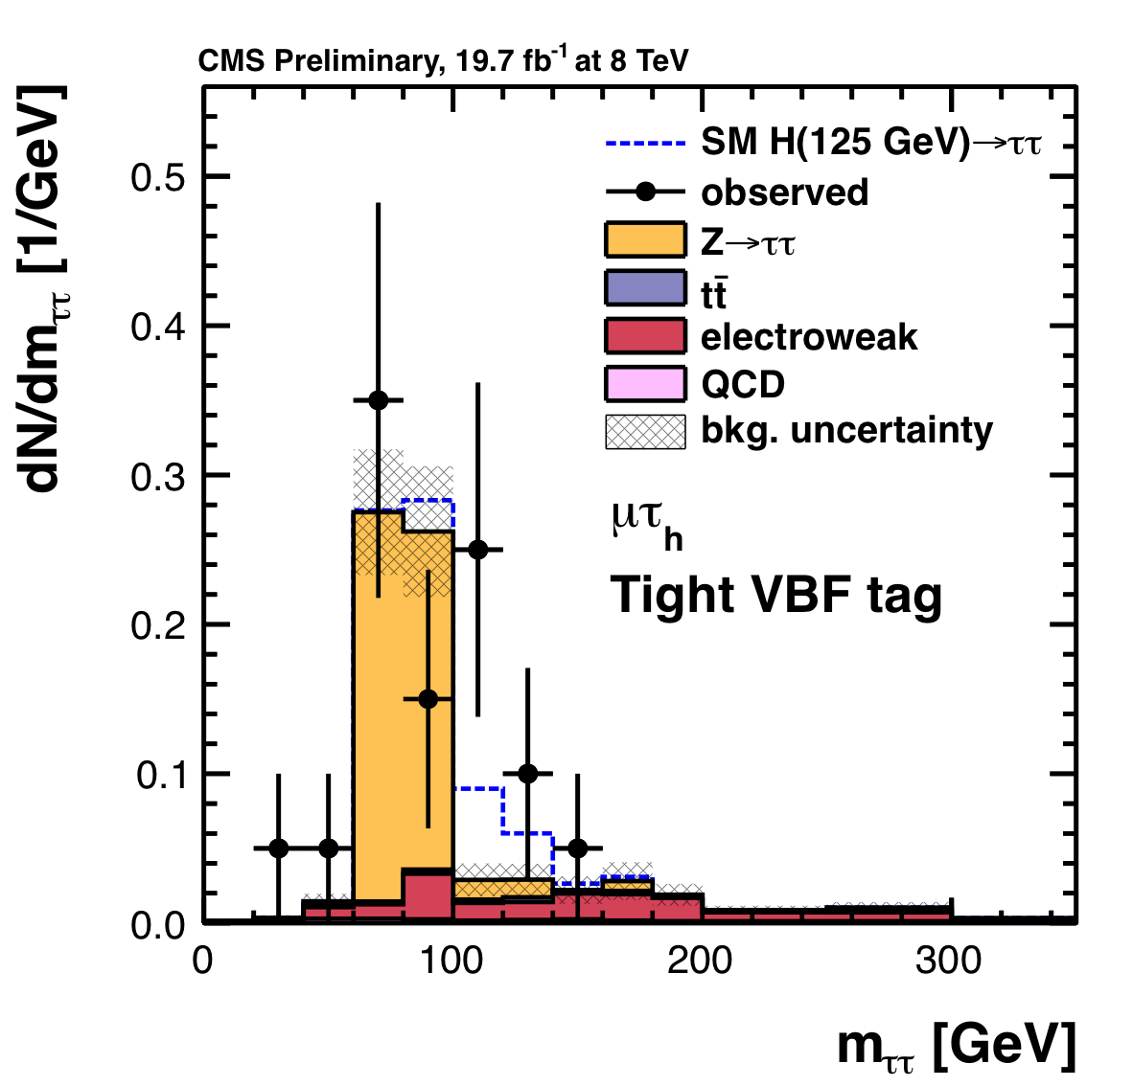
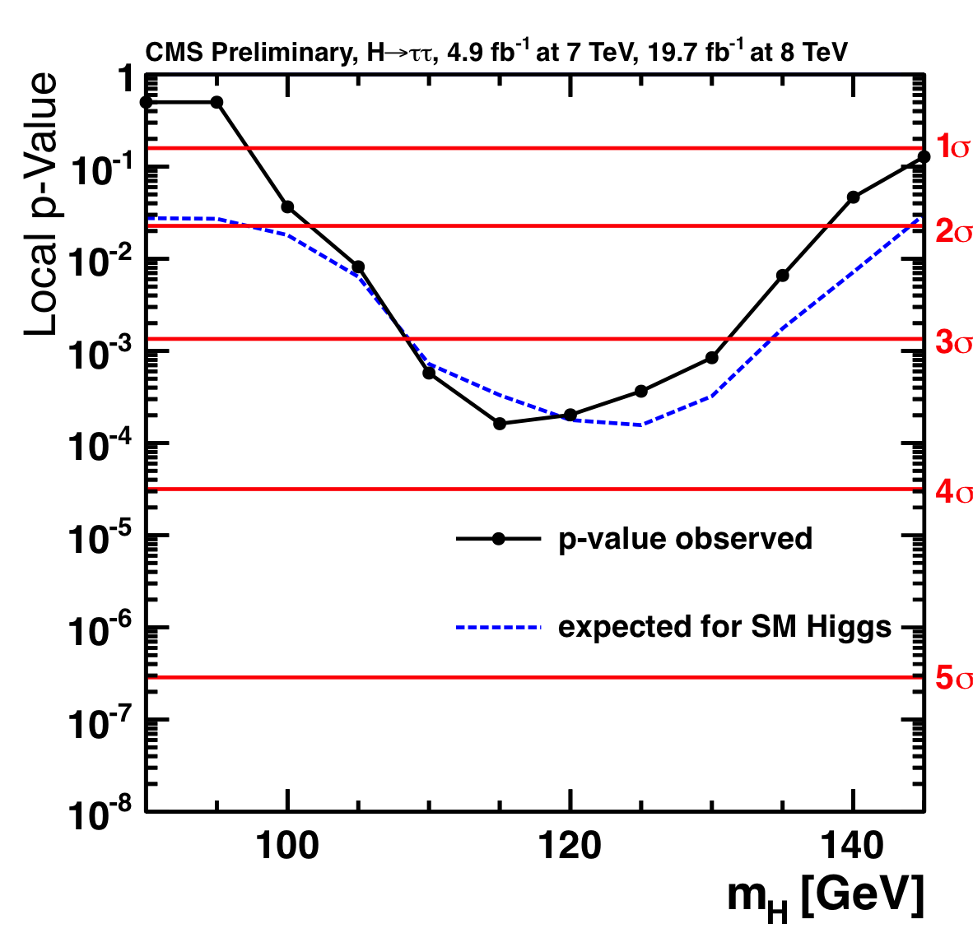
Combination of ττ All Categories + Channels
CMS HIG-13-004
A 3.4σ signal @ 125 GeV emerging (expected 3.9σ)
>4 σ evidence for fermion coupling combined with bb.

Slide 44
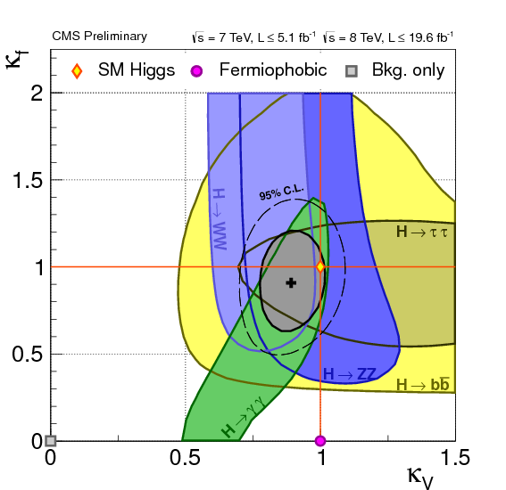
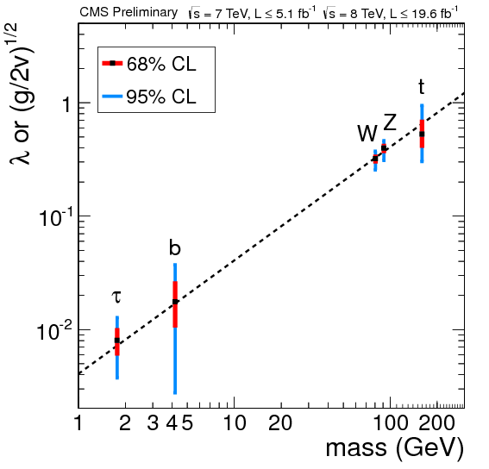
Couplings Scan
CMS HIG-13-005
Details on CMS Higgs combination: Roberto Covarelli’s talk in parallel session.

